Slide 1
Assessment 102
Michigan School Testing Conference 2020
Tuesday, February 11, 2020
Workshop WS 6
bit.ly/mstc-102

Slide 2
Goals & Agenda
Increase participants knowledge with a deeper understanding in these big ideas of assessment
Types of test scores
Interpretations of test scores
Reliability
Validity
Growth
Standard setting

Slide 3
Your presenters for this afternoon
Ellen Vorenkamp: Wayne RESA
Jonathan Flukes: Oakland Schools
Joseph Martineau: Educational Testing Service
Jim Gullen: Michigan Assessment Consortium

Slide 4
Who is with us this afternoon?
Please tell us a little about yourself
Your name
Where you work
What you do
Stand up & find one person in the room who you don’t know and introduce yourself
Discuss what learning you would like to take away from this afternoon’s session

Slide 5
Types of Scores
1. Think individually and write down as many examples of these different types of scores on sticky notes. 3-4 minutes.
Raw Score
Scaled Score
Performance Level
Growth
#### Score
Examples Uses
2. Place the sticky notes on the chart paper on the Examples side
Notes:
Why Do Standardized Testing Programs Report Scaled Scores? https://www.ets.org/Media/Research/pdf/RD_Connections16.pdf

Slide 6
Types of Scores
Many of the steps, actions, criteria, and rules identified here are implicit
In my experience, it helps to make them explicit because it can clarify intent and improve quality

Slide 7
Score Interpretation
Types of Scores

Slide 8
Three Types of Score Interpretation
Type | Identifying Characteristic | Basic Quality Requirements | Question Addressed
Norm -referenced | Scores are interpreted relative to scores from a norming group. | A well-defined, well-identified, and up-to-date norming group. | How is this student or this group of students doing in comparison with a larger group of peers?
Criterion -referenced | Scores are interpreted relative to a definition describing how much is enough to qualify as at a given level. | A well-defined, well-identified and up-to-date set of thresholds (or cut scores) for how much is enough at one or more levels. | To what degree does this student or group of students possess enough knowledge, skills, and abilities to qualify as at a given level?
Standards -referenced ** | Scores are interpreted relative to specific content-area knowledge, skills, and abilities. | Highly-targeted test content addressing specific, well-defined, well-measured, and narrow slices of content. | Has the student learned the content defined by a specific narrow slice of a content?
** also referred to as content-referenced

Slide 9
Item and Task Scores
Types of Scores

Slide 10
Item/Task Raw Scores
Item
Response
Item Score

Slide 11
Item/Task Raw Scores
?
?
Item Score
Item
Response

Slide 12
Item/Task Raw Scores
?
?
Item Score
Item
Response
Filters supporting item score validity

Slide 13
Item/Task Raw Scores
?
Item Score
Item
Response
test administration rules

Slide 14
Item/Task Raw Scores
Item
Response
Item Score
item scoring rule(s)
test administration rules

Slide 15
Item/Task Raw Scores
Item
Response
Item Score
item scoring rule(s)
e.g., rubrics
e.g., scoring keys
test administration rules

Slide 16
Item/Task Raw Scores
Item
Response
Item Score
item scoring rule(s)
test administration
test administration rules

Slide 17
Item/Task Raw Scores
Item
Response
Item Score
item scoring
item scoring rule(s)
test administration
test administration rules

Slide 18
Item/Task Raw Scores
Item
Response
Item Score

Slide 19
Item/Task Raw Scores
Item
Response
Item Score
Task
Response

Slide 20
Item/Task Raw Scores
Item
Response
Item Score
Task
Response

Slide 21
Item/Task Raw Scores
Item
Response
Item Score
Partial Score
Task
Response
Partial Score
Partial score

Slide 22
Item/Task Raw Scores
Item
Response
Item Score
Partial Score
Task
Response
Partial Score
Partial score

Slide 23
Item/Task Raw Scores
Item
Response
Item Score
Partial Score
Task
Response
Partial Score
Task
Score
Partial score

Slide 24
Item/Task Raw Scores
Item
Response
Item Score
Partial Score
Task
Response
Partial Score
Task
Score
Partial score
Partial-score weighting rule(s)
equal weights
40% part A + 30% part B, …

Slide 25
Item/Task Raw Scores
Item
Response
Item Score
Partial Score
Task
Response
Partial Score
Task
Score
Partial score
Task scoring
Partial-score weighting rule(s)

Slide 26
Item/Task Raw Scores
Item
Response
Item Score
Item
Response
Item Score
Partial Score
Task
Response
Partial Score
Task
Score
Partial score

Slide 27
Item/Task Raw Scores
Item
Response
Item Score
Item
Response
Item Score
Partial Score
Task
Response
Partial Score
Task
Score
Partial score
Item
Response
Item Score
Item
Response
Item Score
Item
Response
Item Score

Slide 28
Sum Scores Total Scores Raw Scores
Types of Scores

Slide 29
Sum Scores, Total Scores Raw Scores
Item
Response
Item Score
Item
Response
Item Score
Partial Score
Task
Response
Partial Score
Task
Score
Section
Score
Partial score
Item
Response
Item Score
Item
Response
Item Score
Item
Response
Item Score

Slide 30
Sum Scores, Total Scores Raw Scores
Item
Response
Item Score
Item
Response
Item Score
Part A Score
Task
Response
Part B Score
Task
Score
Section
Score
Part C score
Item
Response
Item Score
Item
Response
Item Score
Item-score
weighting rule(s)
Item
Response
Item Score
Sum of MC points + 10 * sum of CR points

Slide 31
Sum Scores, Total Scores Raw Scores
Item
Response
Item Score
Item
Response
Item Score
Part A Score
Task
Response
Part B Score
Task
Score
Section
Score
Part C score
Item
Response
Item Score
Item
Response
Item Score
Item
Response
Item Score

Slide 32
Sum Scores, Total Scores Raw Scores
Item
Response
Item Score
Item
Response
Item Score
Part A Score
Task
Response
Part B Score
Task
Score
Section
Score
Part C score
Item
Response
Item Score
Item
Response
Item Score
Item
Response
Item Score

Slide 33
Sum Scores, Total Scores Raw Scores
Item
Response
Item Score
Item
Response
Item Score
Part A Score
Task
Response
Part B Score
Task
Score
Section
Score
Part C score
Item
Response
Item Score
Item
Response
Item Score
Item
Response
Item Score

Slide 34
Sum Scores, Total Scores Raw Scores
Item
Response
Item Score
Item
Response
Item Score
Part A Score
Task
Response
Part B Score
Task
Score
Section
Score
Part C score
Item
Response
Item Score
Item
Response
Item Score
Section
Score
Item
Response
Item Score

Slide 35
Sum Scores, Total Scores Raw Scores
Item
Response
Item Score
Item
Response
Item Score
Part A Score
Task
Response
Part B Score
Task
Score
Section
Score
Part C score
Overall
Score
Item
Response
Item Score
Item
Response
Item Score
Section
Score
Item
Response
Item Score

Slide 36
Sum Scores, Total Scores Raw Scores
Item
Response
Item Score
Item
Response
Item Score
Part A Score
Task
Response
Part B Score
Task
Score
Section
Score
Part C score
Overall
Score
Item
Response
Item Score
Item
Response
Item Score
Section
Score
Item
Response
Item Score
Section-score weighting rule(s)

Slide 37
Sum Scores, Total Scores Raw Scores
Item
Response
Item Score
Item
Response
Item Score
Part A Score
Task
Response
Part B Score
Task
Score
Section
Score
Part C score
Overall
Score
Item
Response
Item Score
Item
Response
Item Score
Section
Score
Item
Response
Item Score
Section-score weighting rule(s)
Overall scoring

Slide 38
Sum Scores, Total Scores Raw Scores
Item
Response
Item Score
Item
Response
Item Score
Part A Score
Task
Response
Part B Score
Task
Score
Section
Score
Part C score
Overall
Score
Item
Response
Item Score
Item
Response
Item Score
Section
Score
Item
Response
Item Score
The darker the container, the higher the level of inference necessary, the greater the number of assumptions that must to be addressed, and the stronger the assumptions that must to be addressed to make a successful argument for the validity of score use

Slide 39
Sum Scores, Total Scores Raw Scores
Item
Response
Item Score
Item
Response
Item Score
Part A Score
Task
Response
Part B Score
Task
Score
Overall
Score
Part C score
Item
Response
Item Score
Item
Response
Item Score
Item
Response
Item Score

Slide 40
Sum Scores, Total Scores Raw Scores
Item
Response
Item Score
Item
Response
Item Score
Item
Response
Item Score
Item
Response
Item Score
Overall
Score
Item
Response
Item Score
Item
Response
Item Score
Item
Response
Item Score
Item
Response
Item Score

Slide 41
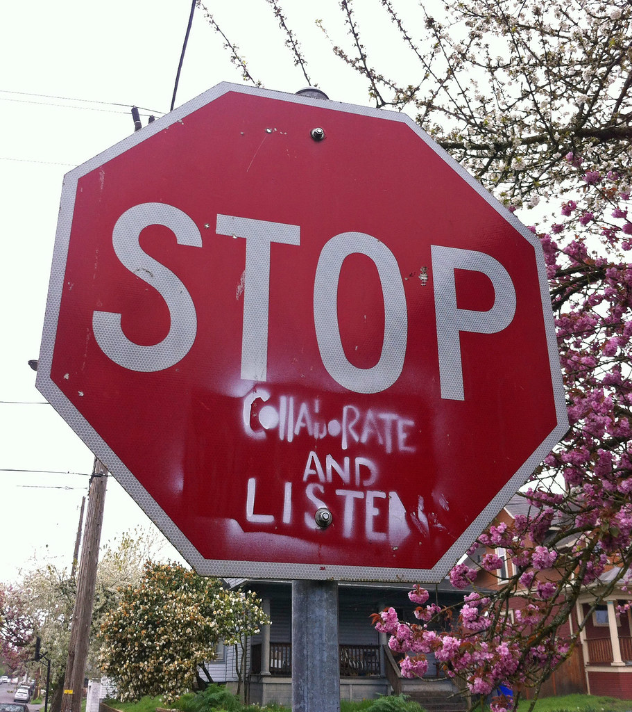
Stop & Check
We just reviewed
Raw scores
Re-visit the chart paper
Add any new examples or uses
Discuss what you heard
Pose any new wonderings/questions
Examples Uses

Slide 42
Scaled Scores
Types of Scores

Slide 43
Scaled Scores
Item Score
Item Score
Item Score
Item Score
Overall
Score
Scaled
Score
Item Score
Item Score
Psychometric model
e.g., Percent correct
e.g., Percentile rank
e.g., Z-score
e.g., Classical test theory (CTT)
e.g., Item response theory (IRT)
e.g., Multidimensional IRT (MIRT)
Item Score
Item Score

Slide 44
Scaled Scores
Item Score
Item Score
Item Score
Item Score
Overall
Score
Scaled
Score
Item Score
Score estimation
Item Score
Psychometric model
Item Score
Item Score

Slide 45
Scaled Scores
Item Score
Item Score
Item Score
Item Score
Overall
Score
Scaled
Score
Item Score
Norm-referenced
Raúl’s score is higher than 80% of the class.
Shameem’s score is 2 standard deviations above the state mean.
Item Score
Item Score
Item Score

Slide 46
Scaled Scores
Item Score
Item Score
Item Score
Item Score
Overall
Score
Scaled
Score
Item Score
Criterion-referenced
Lorena’s score indicates achievement at the “nearly proficient” level.
François’ score demonstrates proficiency level 3.5 in English used in the classroom, enough to reasonably access academic content in English-only classrooms.
Item Score
Item Score
Item Score

Slide 47
Scaled Scores
Item Score
Item Score
Item Score
Item Score
Overall
Score
Scaled
Score
Item Score
Content-referened
Jamal has mastered 3-digit addition without regrouping, but has not yet mastered 2-digit addition with regrouping.
Deandra can comprehend narrative text written at mid-grade-2 level, but is not yet able to comprehend informational text written at the same level.
Item Score
Item Score
Item Score

Slide 48
Scaled Scores
Item Score
Item Score
Item Score
Item Score
Scaled
Score
Item Score
Item Score
Item Score
Item Score
Some IRT models estimate scores directly from patterns of item scores

Slide 49
Stop & Check
We just reviewed
Scaled Scores
Re-visit the chart papers
Add any new examples or uses
Discuss what you heard
Pose any new wonderings
Examples Uses

Slide 50
Performance Levels/Achievement Levels
Types of Scores

Slide 51
Performance Levels/Achievement Levels
Item Score
Item Score
Item Score
Item Score
Scaled
Score
Performance
Level
Item Score
Item Score
Item Score
Item Score

Slide 52
Performance Levels/Achievement Levels
Item Score
Item Score
Item Score
Item Score
Scaled
Score
Performance
Level
Item Score
Cut scores
Item Score
e.g., Grading thresholds
e.g., Percentiles/quantiles/top-middle-bottom x%
e.g., Performance relative to the average
e.g., Standard setting results
Item Score
Item Score

Slide 53
Performance Levels/Achievement Levels
Performance level classifications
Item Score
e.g., State reported performance levels
e.g., Grades
e.g., Ability groups
e.g., Performance ranking
e.g., Above/near/below average
e.g., StDevs above/below the mean (i.e., z-scores)
Item Score
Item Score
Item Score
Scaled
Score
Performance
Level
Item Score
Cut scores
Item Score
e.g., Grading thresholds
e.g., Percentiles/quantiles/top-middle-bottom x%
e.g., Performance relative to the average
e.g., Standard setting results
Item Score
Item Score

Slide 54
Performance Levels/Achievement Levels
Item Score
Item Score
Item Score
Item Score
Scaled
Score
Performance
Level
Item Score
Norm-referenced
Robert’s score is in the first quartile of his class.
Andrea’s score is in the top half of scores statewide.
Carlos’ score is in the middle third of scores nationwide.
Item Score
Item Score
Item Score

Slide 55
Performance Levels/Achievement Levels
Item Score
Item Score
Item Score
Item Score
Scaled
Score
Performance
Level
Item Score
Criterion-referenced
Lorena’s score indicates achievement at the “nearly proficient” level.
François’ score demonstrates proficiency level 3.5 in English used in the classroom, enough to reasonably access academic content in English-only classrooms.
Item Score
Item Score
Item Score

Slide 56
Stop & Check
We just reviewed
Performance Levels
Re-visit the chart papers
Add any new examples or uses
Discuss what you heard
Pose any new wonderings
Examples Uses

Slide 57
Growth Scores Growth Levels Growth Targets
Types of Scores

Slide 58
Growth Scores, the Simple Case
Current scaled score or
performance level
Growth score
Prior scaled score(s)
and/or performance level(s)
in the same content area

Slide 59
Growth Scores, the Simple Case
Current scaled score or
performance level
Growth score
Prior scaled score(s)
and/or performance level(s)
in the same content area
Growth Model (in order of model complexity)
e.g., Gain score (subtraction)
e.g., Residual gain
e.g., Residual gain percentile
e.g., Value added
e.g., Student growth percentile

Slide 60
Growth Scores, the Simple Case
Current scaled score or
performance level
Growth score
Prior scaled score(s)
and/or performance level(s)
in the same content area
Growth Estimate
e.g., Gain score
e.g., Residual gain score
e.g., Residual gain percentile
e.g., “Value added”
e.g., Student growth percentile
Growth Model

Slide 61
Growth Scores, the Simple Case
Current scaled score or
performance level
Growth score
Prior scaled score(s)
and/or performance level(s)
in the same content area
Norm-referenced
Gerhard’s growth was greater than 30 percent of his peers with a similar prior score history (i.e., SGP = 30).
Wanda’s gain score was more than 3 standard deviations higher than the statewide mean.

Slide 62
Growth Scores, the Simple Case
Current scaled score or
performance level
Growth score
Prior scaled score(s)
and/or performance level(s)
in the same content area
Norm-referenced
Gerhard’s growth was greater than 30 percent of his peers with a similar prior score history (i.e., SGP = 30).
Wanda’s gain score was more than 3 standard deviations higher than the statewide mean.

Slide 63
Growth Scores, more complex cases
Current scaled score or
performance level
Growth score
Prior scaled score(s)
and/or performance level(s)
in the same content area
Prior scaled score(s)
and/or performance level(s)
in different content areas
Standards-referenced
Over the past three months, Marc has mastered 2-digit addition without regrouping and has partially mastered 2-digit addition with regrouping.
Over the past two weeks, Ben has learned to spell words with the digraphs “sh” and “ch.”
Since the beginning of Kindergarten, Marisol has learned to segment phonemes in three-phoneme words in the form consonant-vowel-consonant.
Student and/or school demographics

Slide 64
Growth Levels
Current scaled score or
performance level
Growth score
Growth
level
Prior scaled score(s)
and/or performance level(s)
in the same content area

Slide 65
Growth Levels
Current scaled score or
performance level
Growth score
Growth
level
Prior scaled score(s)
and/or performance level(s)
in the same content area
Growth cut scores

Slide 66
Growth Levels
Current scaled score or
performance level
Growth score
Growth
level
Prior scaled score(s)
and/or performance level(s)
in the same content area
Growth level classification
Growth cut scores

Slide 67
Growth Levels
Current scaled score or
performance level
Growth score
Growth
level
Prior scaled score(s)
and/or performance level(s)
in the same content area
Norm-referenced
Rafa’s grade-3 to grade-4 growth score is the bottom half of his class.
Monique’s growth score is in the highest decile statewide.
Ingrid’ growth score is in the middle third of here peers nationwide.

Slide 68
Growth Levels
Current scaled score or
performance level
Growth score
Growth
level
Prior scaled score(s)
and/or performance level(s)
in the same content area
Criterion-referenced
Manu’s grade-3 to grade-4 growth score is in the “acceptable” range as defined by the district Board of Education.
Priya’s growth score qualifies as “catching up” with her peers with similar score histories.
Piotr’s growth score is in the “falling behind” range as defined by the State Board of Education.

Slide 69
Growth Targets
Current scaled score or
performance level
Growth score
Growth target
Growth
level
Prior scaled score(s)
and/or performance level(s)
in the same content area

Slide 70
Growth Targets
Current scaled score or
performance level
Growth score
Growth target
Growth
level
Prior scaled score(s)
and/or performance level(s)
in the same content area
Growth-to-target approach
How to calculate how much growth a student would have to make over the next N measurement occasions to reach a target criterion-referenced achievement level.
Could be used in a norm-referenced manner, but I am unaware of any such examples.

Slide 71
Growth Targets
Current scaled score or
performance level
Growth score
Growth target
Growth
level
Prior scaled score(s)
and/or performance level(s)
in the same content area
Growth-to-target approach
Growth target
e.g., gain score target
e.g., adequate growth percentile (AGP)

Slide 72
Growth Targets
Current scaled score or
performance level
Growth score
Growth target
Growth
level
Prior scaled score(s)
and/or performance level(s)
in the same content area
Growth-to-target approach
Growth target
Growth-to-target cut scores

Slide 73
Growth Targets
Current scaled score or
performance level
Growth score
Growth target
Growth
level
Prior scaled score(s)
and/or performance level(s)
in the same content area
Growth-to-target approach
Growth target
Growth-to-target cut scores
Growth-to-target level
e.g., missed growth target
e.g., nearly made growth target
e.g., made growth target
e.g., exceeded growth target

Slide 74
Growth Targets
Current scaled score or
performance level
Growth score
Growth target
Growth
level
Prior scaled score(s)
and/or performance level(s)
in the same content area

Slide 75
Stop & Check
We just reviewed
Growth
Re-visit the chart papers
Add any new examples or uses
Discuss what you heard
Pose any new wonderings
Examples Uses

Slide 76
Switching Gears

Slide 77
Reliability
Reliability and Validity

Slide 78
Thinking about reliability and validity
Reliable and Valid
Reliable and Not Valid
XXX
XXX
XXX
XXX
Not Reliable and Valid
Not Reliable and Not Valid
X X X
X XX
X
X
X X
X
X X X
X XX
X
X X X

Slide 79
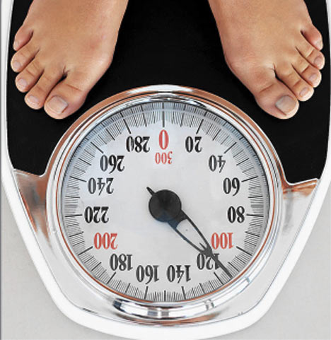
Reliability
How consistent are the scores we get from our tests?
Consistency is the first step toward having good measurement.

Slide 80
Reliability
We assess the strength of a (linear) relationship between two variables using the Pearson product-moment correlation coefficient.
Everyone calls it Pearson’s r
Ranges from -1 to 1
-1 or 1 show perfect correlation
0 shows no correlation
Only captures a linear relationship

Slide 81
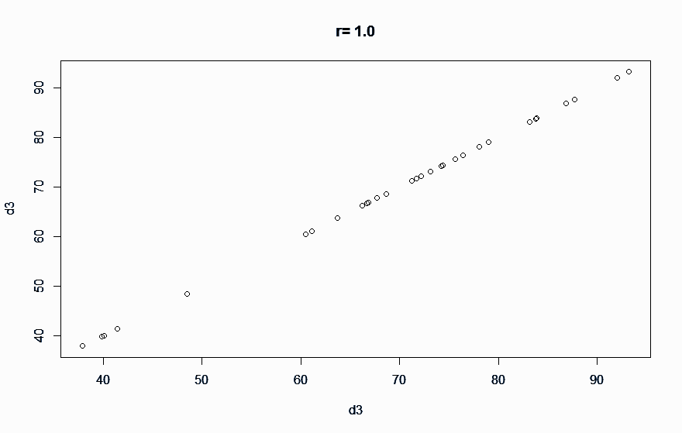
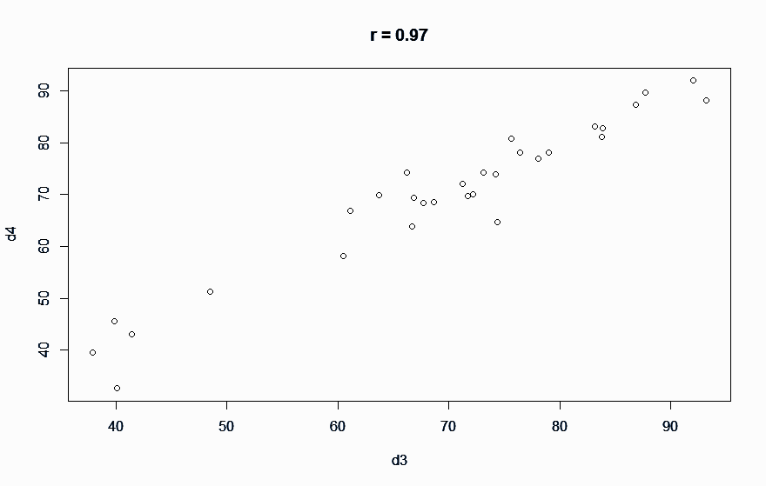
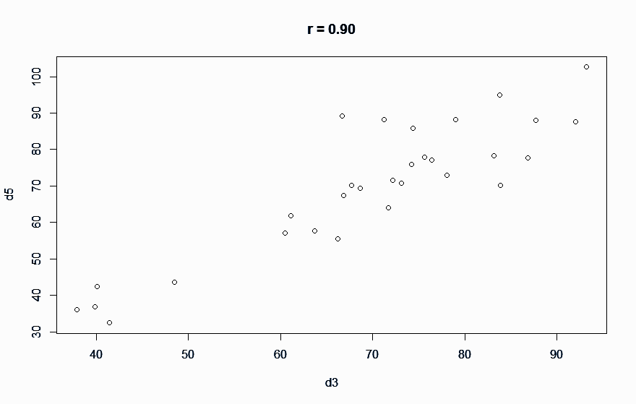
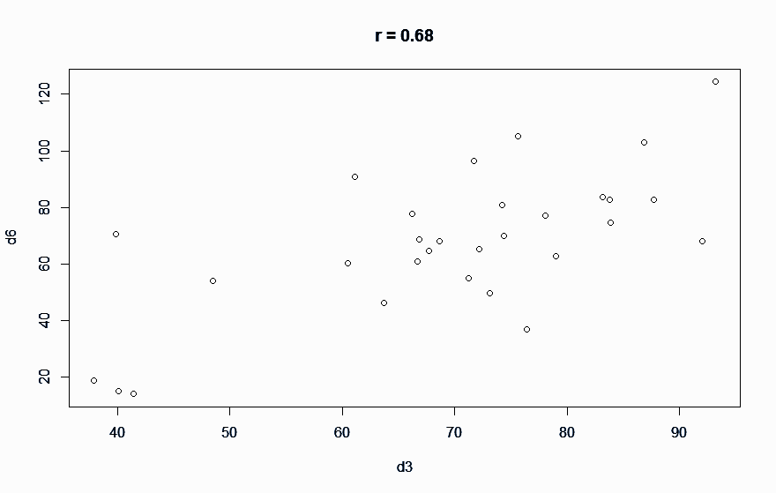
Reliability

Slide 82
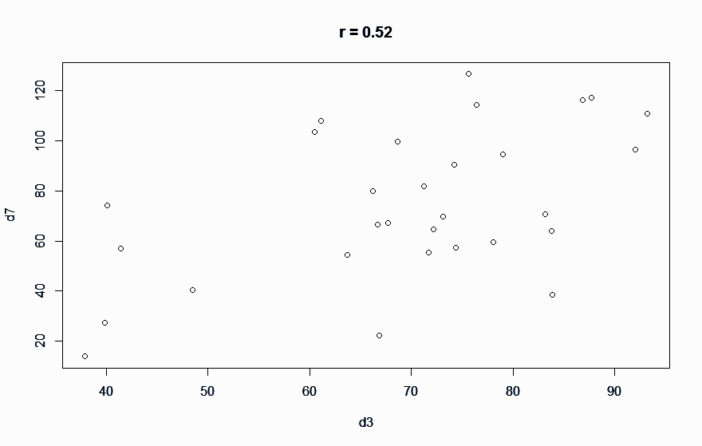
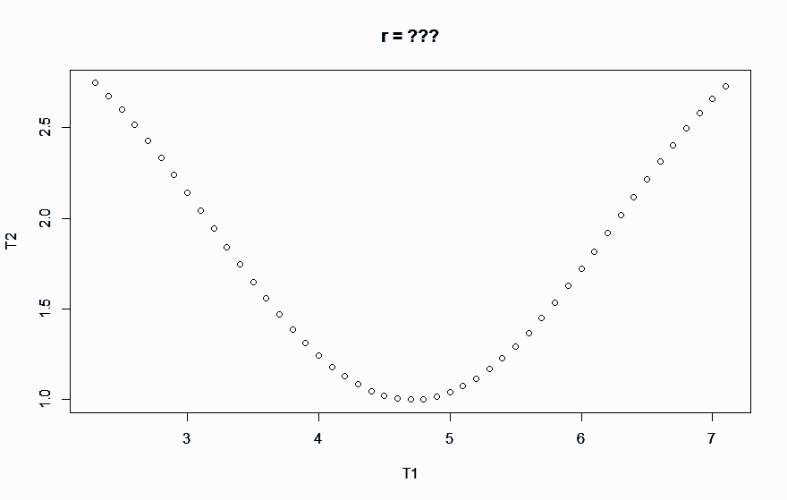
Reliability

Slide 83
Reliability
We use Pearson’s r to assess the relationship between two sets of scores and to determine the reliability of a test’s scores.
Where do we get two sets of scores from?
Give the test twice (Test-retest)
How much time between tests?
What if students learn more stuff between tests?
What if students forget some stuff between tests?

Slide 84
Reliability
Rather than give the same test twice, what if we split the test in half to get two tests?
This is “split-half” reliability
What if students are more tired for the second half of the test?
We could split even-odd items…but that has problems as well.

Slide 85
Reliability
Fortunately, we have a good statistic for this: Cronbach’s Alpha
Alpha gives us the average value of all possible split-halves of a test.
We interpret Alpha the same way as Pearson’ r

Slide 86
Reliability
If we have true parallel forms of a test, we can correlate those two scores to get “alternate forms” reliability
Having two strictly parallel forms requires A LOT of psychometric development
Probably not possible/efficient for classroom assessments

Slide 87
Reliability
What about performance tasks or observations?
For these types of items, we look at inter-rater reliability
How correlated are the scores of two raters on the same set of tasks?
This is important so that a person’s score depends on what they do, not who observes it!

Slide 88
Reliability
In general, all other things being equal, longer tests are more reliable than shorter tests
Tests that have higher stakes associated with them need to have higher reliability.
High-Stakes summative accountability test reliabilities are typically greater than 0.90
For our classroom assessments, 0.80 or greater is a good target.

Slide 89
WHAT’S SO IMPORTANT ABOUT RELIABILITY?
Take a few minutes to reflect…

Slide 90
Reliability is primarily a statistical computation…
Validity is much more….

Slide 91
Validity
Reliability and Validity

Slide 93
Validity
We have to gather and present evidence to establish the validity of a test for a stated purpose.
Note: Tests aren’t valid or invalid. The inferences or uses of a test are what need to be evaluated for validity
If you remember nothing else from today, remember that!

Slide 94
Validity
So, what types of evidence do we gather?
There are different “flavors” of validity
Face Validity
Sure, it kinda looks like a biology test.
Content Validity
People who know biology well think it looks like a biology test.

Slide 95
Validity
Concurrent Validity
Results on this test “agree” with results on other, well established tests of biology.
Criterion Validity
Results of this test “agree” with other ways to assess one’s knowledge of biology.
Predictive Validity
Results on this test do a good job of predicting results on other tests (or things)

Slide 96
Validity
Construct Validity
A construct is something we hypothesize exists but can’t see directly. This is also referred to as a latent variable or latent trait
Most of the things we use tests for in education are really assessing constructs.
Construct validity subsumes all the other types of validity we’ve talked about.
You choose which flavor(s) of validity evidence you will gather based on the purpose of your test.

Slide 97
LET’S PRACTICE LOOKING AT VALIDITY
With some help from James Popham,

Slide 98
WHAT’S SO IMPORTANT ABOUT VALIDITY?
Let’s take a few minutes to reflect…

Slide 99
STANDARD SETTING

Slide 100
Standard Setting
Definition (Gregory Cizek):
The task of deriving levels of performance on educational or professional assessments, by which decisions or classifications of persons (and corresponding inferences) will be made.

Slide 101
Standard Setting
There are LOTS of different standard setting techniques
We’ll talk about two that you could use at your school
Standard setting is basically a policy (or political) decision
There is no right answer or “true” standard

Slide 102
Angoff’s Procedure
William Angoff worked as a distinguished research scientist at ETS.
He described the procedure in a footnote to something else he was writing
He was actually uncomfortable with the method and attributed it to someone else
It has a number of variations that have been used

Slide 103
A (modified) Angoff Procedure
Picture in your mind the minimally competent student
For each question, determine how many…out of 100…minimally competent students would get that question correct
After you’ve done this for each item, add up your numbers and divide by 100. This is your cut score
Compile the cut scores of all the standard setters and take the median value

Slide 104
The Bookmark Method
Reorder the items on the test from easiest to hardest and distribute them to the panel
Think about a minimally competent student
Start at item 1 and decide if the minimally competent student would get that right. If so go on to the the next item and repeat
When you get to an item you think the MCS wouldn’t get right, put your bookmark there.
Take all panelists bookmark locations and take the median

Slide 105
Take a look back at the topics we covered today...
Types of test scores, Interpretations of test scores, Reliability, Validity, Growth, Standard setting
Write down three important take home thoughts, ideas, or concepts on sticky notes.
Discuss with your table group.
Keep the sticky notes and share them with a colleague back home.

