Slide 1
Assessment 101
Michigan School Testing Conference 2020
Tuesday, February 11, 2020
Workshop WS 3
bit.ly/mstc-101

Slide 2
This morning’s agenda…
Introductions
What is assessment Literacy?
How do define assessment?
Types of assessment and their characteristics
Balanced assessment systems
Summative assessments
Interim-benchmark assessments
Formative assessment practices
How do these relate to assessment “of” learning and assessment “for” learning?
Wrap-Up

Slide 3
This morning’s presenters:
Ellen Vorenkamp: Wayne RESA
Jonathan Flukes: Oakland Schools
Joseph Martineau: Educational Testing Service
Jim Gullen: Michigan Assessment Consortium

Slide 4
Who is with us this morning?
Please tell us a little about yourself:
Your name
Where you work
What you do
What you hope to get from this morning

Slide 5
Let’s warm up…
Think about how a teacher/principal/superintendent interacts with assessments:
In that role
How often are they interacting with assessments?
What kinds of information do they need from assessments?
What issues/pitfalls with assessment might they run into?
Take a few minutes and write down your thoughts on these things.
We’ll come back to this at the end of the morning.

Slide 6
First a word from our sponsor…
There is a good resource out there for you to find assessment information

Slide 7
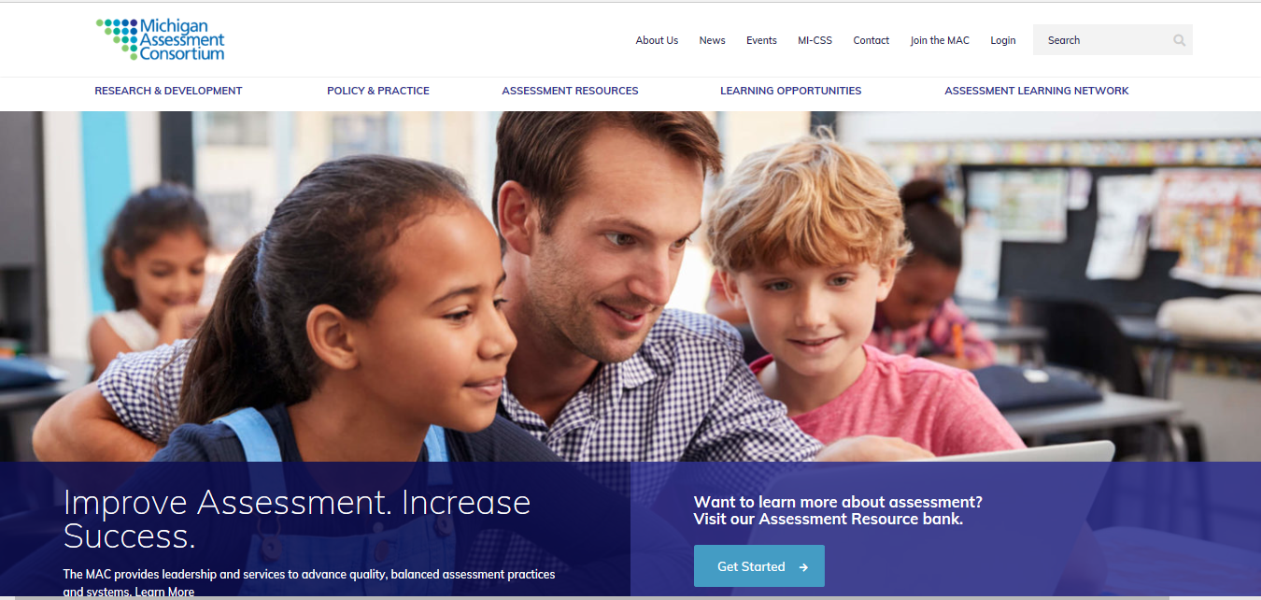
www.michiganassessmentconsortium.org

Slide 8
All of the Learning Points that we’ll be using this morning…and a lot more… can be found there.
You are welcome to the materials on the site. Many are free of charge.

Slide 9
What is assessment literacy?
Take 5-7 minutes to read What fundamental understandings are necessary for assessment literacy
As you read:
Place ✓ by things you affirm your understanding
Place a ? by things you would like to clarify
Place an ! next to ideas that are new to you or important

Slide 10
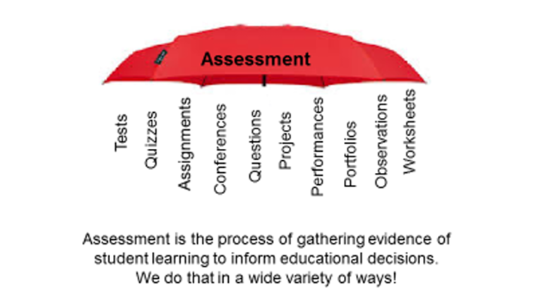
How do we define assessment?

Slide 11
Different assessment data needs require different assessment methods

Slide 12
Different frames of reference for assessment
Norm-referenced
Student performance is compared to other test takers
Criterion-referenced
Student performance is compared to pre-specified content
Standards-referenced
Student performance is compared to a set of content standards and associated performance level descriptors

Slide 13
Norm-referenced data
Audience participation!
Come up to the front and sort yourselves
Shortest to tallest
The person in the middle is the 50th %-ile, or the median
We typically start with the 1st %-ile and end with the 99th %-ile

Slide 14
Criterion-referenced data

Slide 15
Standards-referenced data
Standards-referencing is very similar to criterion-referencing
Rather than any old content, the reference is to the content standards
Student work may also be categorized into performance levels based on performance standards
Yes…two types of standards
No…that never causes any confusion!

Slide 16
Balanced Assessment Systems
Take 5-7 minutes and read What constitutes a high-quality, comprehensive, balanced assessment system
How would you explain this to a colleague in 2 minutes or less?
Find someone in the room to share your response with

Slide 17
Summative Assessment
Take 5-7 minutes to read What are summative assessments?
What makes an assessment summative?
How should summative assessment results be used?
How should summative assessment results NOT be used?

Slide 18
Interim-benchmark assessment
Take 6-8 minutes to read either What do we mean by interim/benchmark assessments? or Interim assessments: What are some key characteristics?
Form two groups, one for each article that was read
What are the three key points for the article?
Find someone from the other group and share each of your three main points.

Slide 19
Formative assessment practices
Take 8-10 minutes to read Formative Assessment: An enabler of learning by Heritage.
We’ll process this using the “First turn, last turn” activity

Slide 20
First Turn; Last Turn
Read Text; Highlight 2-3 statements
In your groups, starting with the person whose name is last alphabetically, share one of your ideas. The First Turn. Do not comment on your statement, just read it to the group.
Group members comment on the statement in round-robin order. (No Cross Talk!)
The person who read the statement shares his or her thinking on the item and gets—The Last Turn. Repeat.

Slide 21
Assessment “of” and assessment “for” learning
What is meant by these two terms?
What are some examples of these types of assessment?
How do they fit into the summative/interim-benchmark/formative assessment practices model that we’ve been thinking about?

Slide 22
Let’s cool down…
Look back at your thoughts about assessment that we started with
Think about how a teacher/principal/superintendent interacts with assessments:
In that role
How often are they interacting with assessments?
What kinds of information do they need from assessments?
What issues/pitfalls with assessment might they run into?
How has your thinking on these things changed given our work this morning?
Take a few minutes and write down your thoughts on these things.

Slide 23
Links and Resources
Presentation:
bit.ly/mstc-101
Today’s readings:
michiganassessmentconsortium.org
Assessment Learning Network > ALN Learning Points
What fundamental understandings are necessary for assessment literacy?
What constitutes a high-quality, comprehensive, balanced assessment system?
What are summative assessments?
What do we mean by interim-benchmark assessments
Interim assessment: What are some key characteristics
What do we mean by formative assessment?
Formative Assessment: An Enabler of Learning

Slide 24
Thanks for spending your morning with us!

