Slide 1
Lesson Template

Slide 2
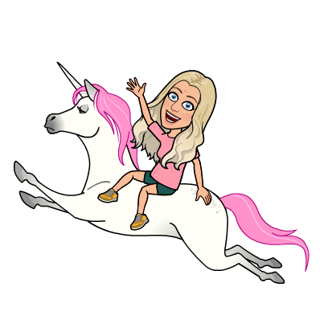
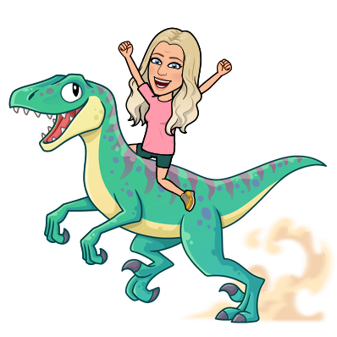
Bell Ringer
Make your mark on the screen!
Be ready to explain your choice.
Would you rather have a pet...
UNICORN
DINOSAUR
Notes:
Teachers- you can add poll options and have students type A, B, C, or D in the chat box.
Content is usually about engagement and rarely about the content. Getting them talking to one another is key in our environment.

Slide 3
Norms
Be PROMPT!
Be PREPARED!
Be PRESENT!
Be RESPECTFUL!
PARTICIPATE!
Notes:
We go over these norms at the beginning of a semester.

Slide 4
Learning Targets
Where are you in your understanding?
Make your marks!
Novice
Apprentice
Expert
I can...
I can...

Slide 5
Success Criteria
I will know that I have met success when I can/have…
____________________________________________
_____________________________________________

Slide 6
Before you leave...
Has your level of understanding changed?
MAKE YOUR MARKS!
Novice
Apprentice
Expert
I can...
I can...

Slide 7
Marching Orders

