Slide 1
Using a Strategy Implementation Guide to Support Continuous Improvement
Notes:
In this presentation you’ll study more deeply the use of a Strategy Implementation Guide to support the continuous improvement cycle. To use this presentation, please read the notes while referring to the accompanying slide in the presentation.

Slide 2
Objectives
1
Review the Michigan Integrated Continuous Improvement Cycle
2
Understand the Planning Process within the continuous improvement cycle
3
Understand the role of a Strategy Implementation Guide within the planning process
4
Identify MAC tools and resources included in the MICIP platform Strategy Bank
Notes:
This presentation will review what we’ve learned about the continuous improvement cycle and the use of data within that cycle. We’ll then move into one key tool that can support the planning process for teams as they prepare for implementation. The Michigan Assessment Consortium has created several Strategy Implementation Guides in the area of assessment for use by districts and buildings. We’ll share how these tools support the continuous improvement cycle and how they have been made available in the MiStrategy Bank within the MICIP platform.

Slide 3
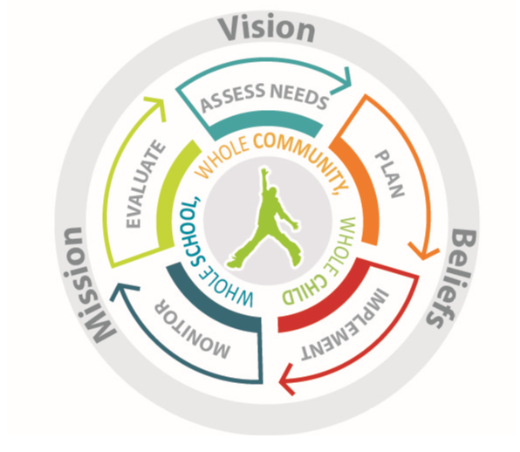
Michigan Integrated Continuous Improvement Process
Collect and analyze multiple types and sources of data
Determine Current Reality
Identify Strengths
Identify Challenges
Conduct Root Cause
Collect and analyze multiple types and sources of data
Evaluate Impact
Evaluate Implementation
Determine Next Steps
Collect and analyze multiple types and sources of data
Monitor Impact
Monitor Implementation
Notes:
In the previous presentation, we talked about the different uses of data to support the continuous improvement cycle. Multiple types and sources of data, used effectively, support the Assess Needs process, and the Monitoring and Evaluating processes within the overall cycle. It is important to note that teams must consider and plan how they will collect both implementation and impact data. Specifically, if you don’t know that you have implemented with fidelity, you aren’t able to determine if the initiative is having an impact – or not. Only when implementation is ensured, can impact be considered relative to the specific strategy. Monitoring helps to inform adjustments that may be needed during implementation.
Finally, teams should plan to evaluate initiatives for continuation/expansion, adjustment and/or discontinuation based upon findings on a regular basis. This role of data was explained in the previous presentation. We’ll now move into the Planning Process.

Slide 4
Notes:
The slide above outlines the Planning Process within the continuous improvement cycle. This presentation will focus on the circled stages; strategy selection and determining how to support the questions of “Can we do it the right way?”
As a team progresses through the Assess Needs process with the identification of challenges and the root cause(s) of those challenges, they will conduct research in order to determine an evidence-based strategy to consider for implementation to address the identified challenges. These possible strategies are then evaluated to determine if they can successfully address the challenge area (Is it the right thing to do?) and if it will fit within the context of the current initiatives of a district/building and if the resources are available to support implementation (Can we do it the right way?).
One tool that can help to make this decision of “fit” is the hexagon tool. This tool is beyond the scope of this presentation, but information can be found here. https://nirn.fpg.unc.edu/resources/hexagon-exploration-tool
The second tool is a Strategy Implementation Guide (SIG).
The Michigan Assessment Consortium has worked to create various strategy guides in the areas of assessment to help to define the “gold standard” for implementation. These will be shared later in the presentation.

Slide 5
Michigan Integrated Continuous Improvement Process
Assess Needs:
Collect and analyze multiple types and sources of data
Determine Current Reality
Identify Strengths
Identify Challenges
Conduct Root Cause
Evaluate:
Collect and analyze multiple types and sources of data
Evaluate Impact
Evaluate Implementation
Determine Next Steps
Plan and Implement:
Identify your strategy to address the challenge area
Review the research to identify critical components
Plan for installation and implementation
Monitor:
Collect and analyze multiple types and sources of data
Monitor Impact
Monitor Implementation
Notes:
Use of the SIG falls in the Planning and Implementation stages of the continuous improvement cycle and helps the team to intentionally plan for implementation by understanding fully what would be needed to implement the strategy with fidelity.

Slide 6
Notes:
Having this understanding can help the team to determine the resources that area needed and possible funding streams to support the implementation. Other resources in terms of materials, time, personnel, space, technology, etc. can also be identified.

Slide 7
Critical Question – Will a district/building be able to follow the research around implementation with fidelity?
Choose a best practice.
Is this the right thing to do?
Can we do it the right way?
Proceed to the Plan stage and develop an action plan.
Yes
Yes
No
No
Choose a different best practice.
Choose a different best practice.
The Hexagon Tool helps here.
Evidence
Usability
Supports
Need
Fit
Capacity
Notes:
By understanding the critical components of a strategy as outlined in the Strategy Implementation Guide (SIG) and evaluating the strategy for alignment to the challenges identified, the team will make a final decision to say, “Yes! This is the right thing to do!” and move into planning to do it the “right way”. This is where the strategy guide becomes instrumental. The flow chart above helps to clarify this process.

Slide 8
A Critical Tool: Strategy Implementation Guides
This protocol/tool is how stakeholders involved with implementation understand the expectations for WHAT and HOW to execute implementation with fidelity so that maximum impact can be obtained.
The Strategy Implementation Guide
bridges the gap between the research and implementation.
Notes:
A SIG serves as the bridge between the research and the implementation. It is created focusing on a single strategy to define what has been identified as the critical components for implementation as identified in the research. This is typically described in a column designated as the “gold standard” to help communicate what a given strategy looks like when implemented with fidelity.

Slide 9
Key Questions:
Where are we now?
What are our strengths and challenges?
What is the root cause? What are we going to do to address the challenges?
Is it the right thing to do?
Can we do it the right way?
Strategy Implementation Guides: Help to define the “right way”
Balanced Assessment System
Interim/Benchmark Assessments
SBAC and Tools for Teachers
Formative Assessment in the Classroom
Grading and Reporting (in process)
Notes:
The Strategy Implementation Guide helps the team to intentionally think about “Can we do it the right way?”
The MAC has created Strategy Implementation Guides in the areas noted above. Each guide not only shares the critical components of the strategy and the gold standard for that components, but also includes many links to tools and resources to study each component more deeply. This will help the teams to easily access training and resources to help them to conduct professional learning to come to a shared understanding of what the expectations for implementation will include. These resources will support teams as they enter into the “getting ready” stage of implementation.
Let’s take a look at a couple of these strategy guides. They are also available on the MAC web page and in the MICIP platform strategy bank.

Slide 10
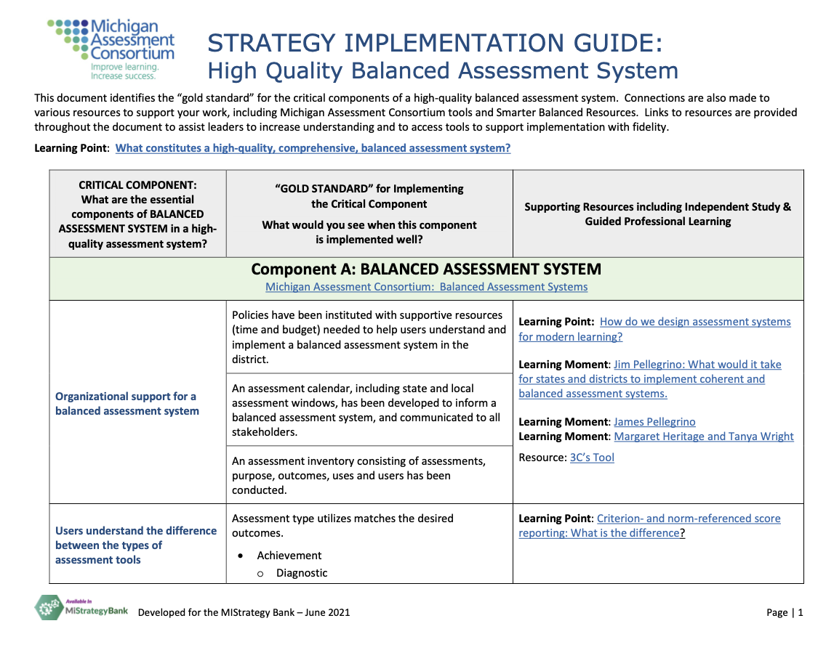
Strategy Guide: High Quality Balanced Assessment System
Notes:
The overarching strategy guide for a High-Quality Balanced Assessment System addresses the critical components of a balanced assessment system including summative and interim/benchmark assessments as well as the formative assessment process. This strategy guide identifies the systems level critical components that should be considered as a district moves to build a balanced assessment system. Supporting resources are linked to support the work needed to understand each component in order to move forward with implementation.

Slide 11
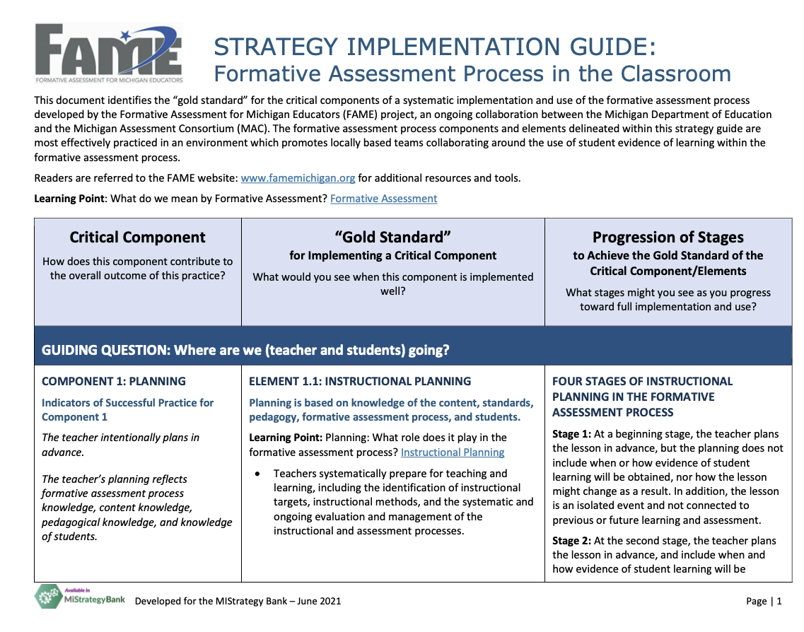
Strategy Guide: Formative Assessment Process in the Classroom
Notes:
The strategy guide for the Formative Assessment Process in the classroom addresses the critical components of the formative assessment process. Aligned with the Michigan FAME project, the components and elements are described in the gold standard. In addition, this guide provide a description of the progression of stages that may be observed during the implementation process. Supporting resources are linked to support the work needed to understand each component in order to move forward with implementation.

Slide 12
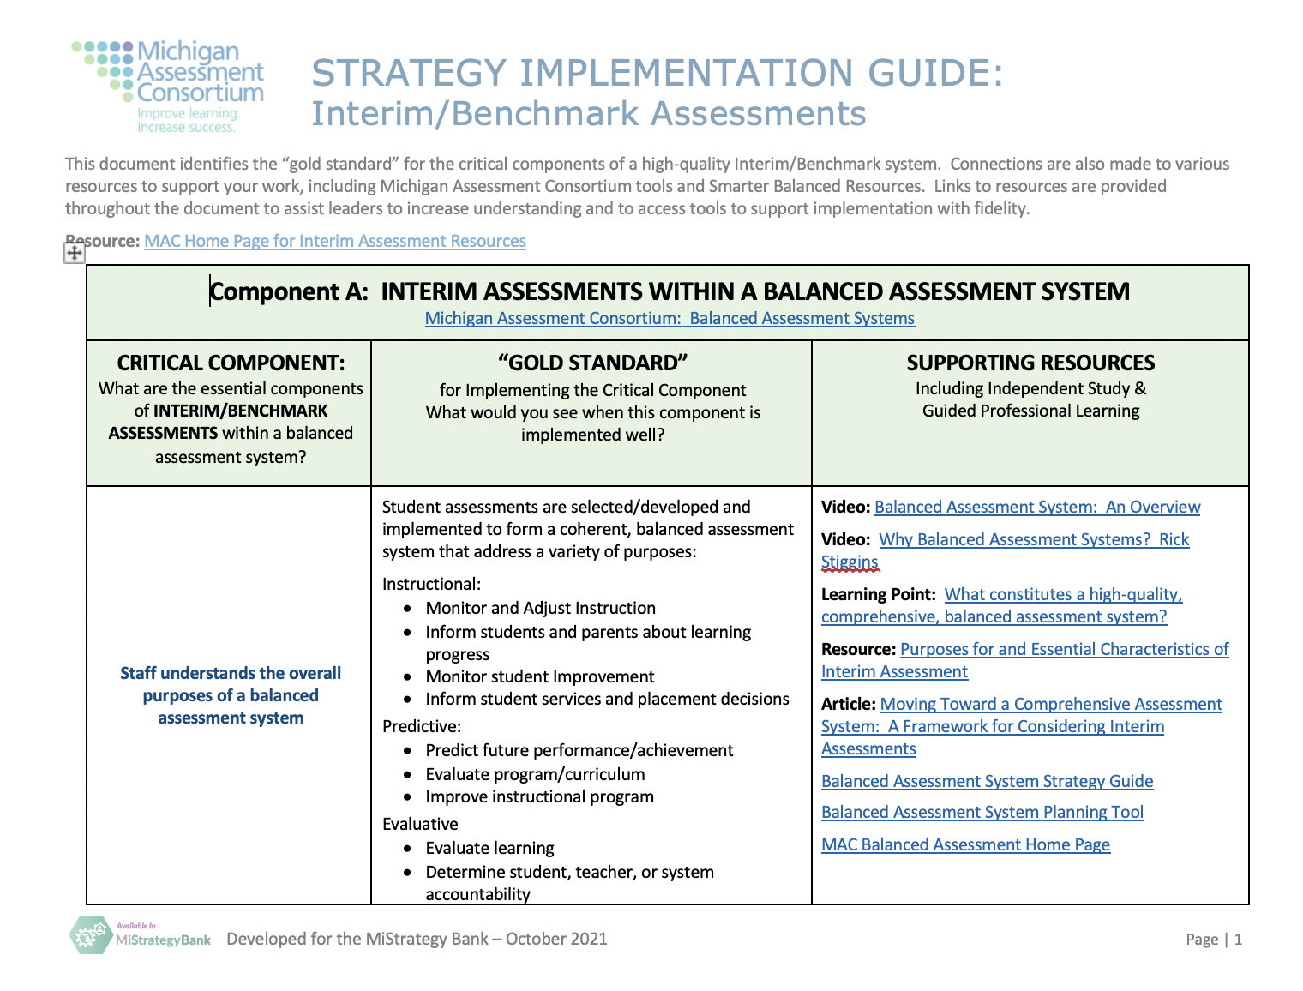
Strategy Implementation Guide: Interim/Benchmark Assessments
Notes:
The strategy guide for a Interim/Benchmark Assessments addresses the critical components of an interim/benchmark assessment as part of a balanced assessment system. This strategy guide identifies the systems level critical components that should be considered as a district moves to implement interim/benchmark assessments. Supporting resources are linked to support the work needed to understand each component in order to move forward with implementation.

Slide 13
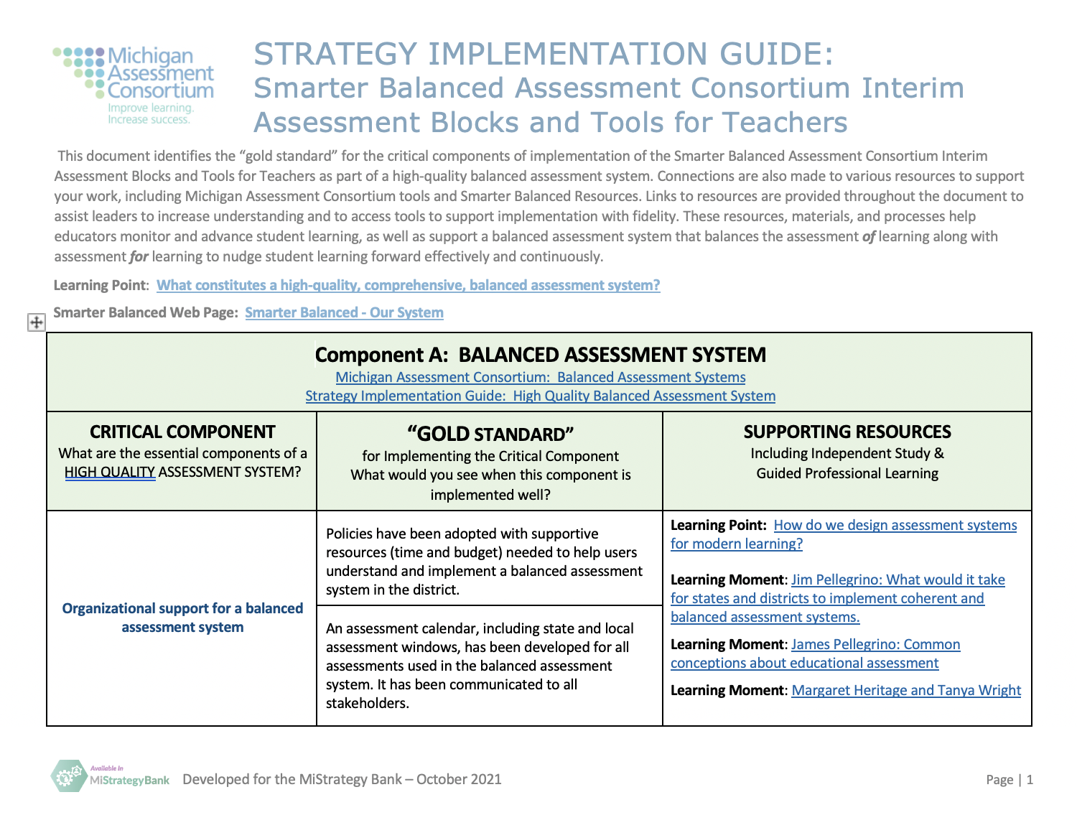
Strategy Implementation Guide: Smarter Balanced Consortium Interim/Benchmark Assessments & Tools for Teachers
Notes:
For those districts working to understand the Smarter Balanced Consortium Interim Benchmark Assessments and Tools for Teachers, this guide helps to place these additional tools within the context of a balanced assessment system. Again, links to tools and resources are included.

Slide 14
Let’s take a look at the MI Strategy Bank Within the MICIP Platform
MICIP Platform
MI Strategy Bank
System
Program
Resource
Practice
Strategy
Activity
Initiative
Instructional Strategy
Process
Notes:
All of these tools are available on the MAC web page, but also as part of the Mi Strategy Bank within the MICIP platform. Simply search for the associated title or look under the Michigan Assessment Consortium (MAC) as the curator.

Slide 15
So what is MiStrategyBank?
It is an electronic clearinghouse of strategies, designed to connect educational data systems, promote and support best practices, and provide information regarding the implementation of strategies in use to support Michigan’s education system.
Notes:
This clearinghouse of strategies is intended to pull together various strategies for districts to consider as they work to address the challenges identified through the Assess Needs process.

Slide 16
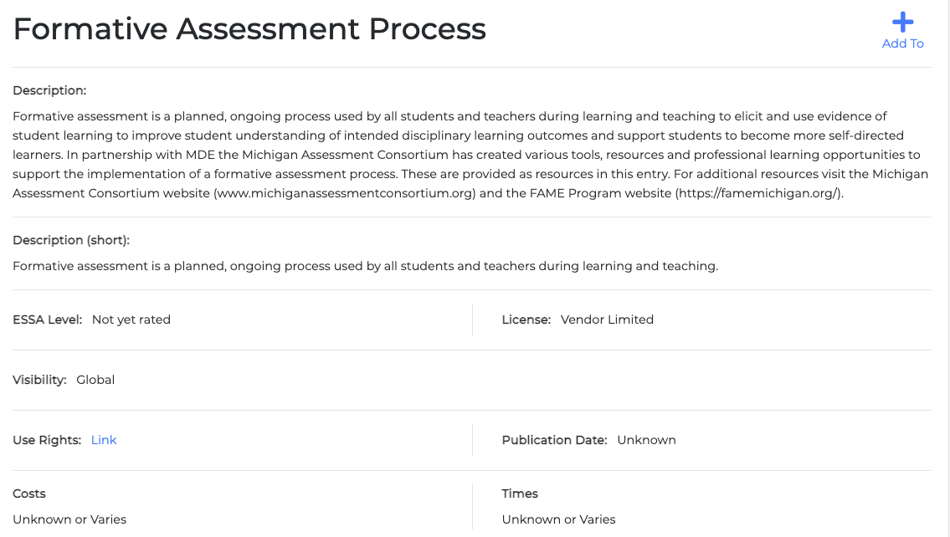
Screenshot of MiStrategy Bank
Description of the Strategy
Notes:
Each of the MAC strategies is entered with a description, as required and shown above.

Slide 17
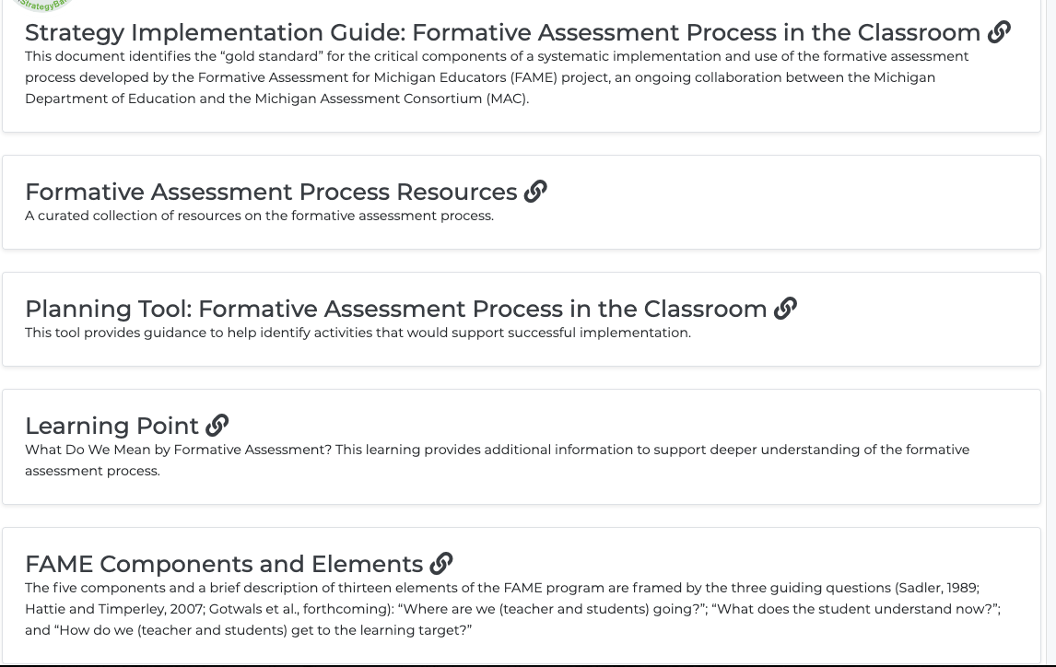
Screenshot of MiStrategy Bank
Tools and Resources
with hyperlinks
Notes:
In addition, links to the supporting tools are included. These tools each contain additional links to the tools and resources associated with the specific critical component within the strategy guide. Some additional resources are also listed within the strategy bank, along with some research links for consideration by the teams.

Slide 18
Critical Question – Will a district/building be able to follow the research around implementation with fidelity?
Choose a best practice.
Is this the right thing to do?
Can we do it the right way?
Proceed to the Plan stage and develop an action plan.
Yes
Yes
No
No
Choose a different best practice.
Choose a different best practice.
The Hexagon Tool helps here.
Evidence
Usability
Supports
Need
Fit
Capacity
Notes:
Ultimately, these tools and resources will help those considering the specific strategies identified to determine the response to these two questions we visited earlier and to put into place the actions needed to implement with fidelity as part of the continuous improvement process.

Slide 19
Michigan Integrated Continuous Improvement Process
Notes:
The next presentation will address one more tool to support districts and buildings as they move through the continuous improvement cycle, the Planning Tool.

