Slide 1
Using a Planning Tool to Support Continuous Improvement
Notes:
In this presentation you’ll learn about the use of a planning tool to support your work within the continuous improvement cycle. To use this presentation, please read the notes while referring to the accompanying slide in the presentation.

Slide 2
Session Objectives
1
Review the Michigan Integrated Continuous Improvement Cycle
2
Understand the Planning Process within the continuous improvement cycle
3
Understand the role of a Planning Tool within the planning process
4
Identify MAC tools and resources included in the MICIP platform Strategy Bank
5
Objective five
Notes:
In this presentation we will continue our journey through the continuous improvement cycle. In the previous presentations we talked about the role of assessment in the continuous improvement cycle. Then we moved into how, through the assess needs process, challenge areas would be identified and the root cause identified. Strategies to address these challenge area are then identified and studied in order to understand the critical components of each strategy during implementation. The use of a Strategy Implementation Guide as part of that process was explored. This final presentation will focus on the use of a Planning Tool to support strategic planning. We will close with how these tools are included in the Michigan Strategy Bank.

Slide 3
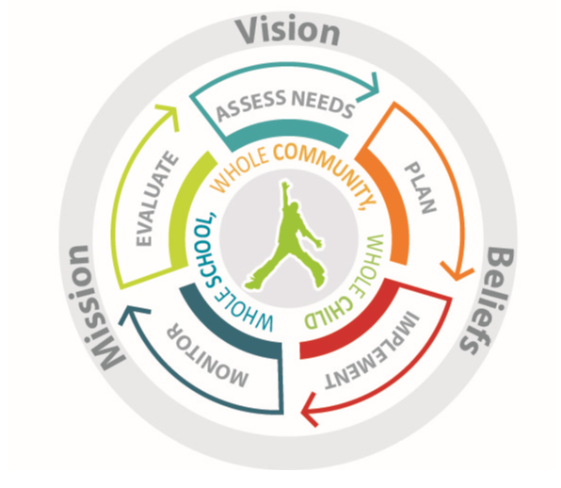
Michigan Integrated Continuous Improvement Process
Assess Needs:
Collect and analyze multiple types and sources of data
Determine Current Reality
Identify Strengths
Identify Challenges
Conduct Root Cause
Evaluate:
Collect and analyze multiple types and sources of data
Evaluate Impact
Evaluate Implementation
Determine Next Steps
Monitor:
Collect and analyze multiple types and sources of data
Monitor Impact
Monitor Implementation
Plan and Implement:
Identify your strategy to address the challenge area
Review the research to identify critical components
Plan for installation and implementation
Notes:
This slide can serve as a summary of the things we have learned so far. Please take the time to review the information presented above. If needed, visit/revisit the other presentations to review the information that may need reinforcement.

Slide 4
Needs Assessment: Where are we now? What are our strengths and challenges?
-What is the root cause? What are we going to do to address the challenges? Is it the right thing to do? Can we do it the right way?
Strategy Implementation Guides: Help to define the “right way”
Balanced Assessment System
Interim/Benchmark Assessments
SBAC and Tools for Teachers
Formative Assessment in the Classroom
Grading and Reporting (in process)
Notes:
This presentation picks up after the needs assessment and after a strategy has been selected and studied and the critical components identified through the use of a Strategy Implementation Guide. In the previous presentation, we reviewed a few of the strategy guides that have been created by the Michigan Assessment Consortium (MAC) and are included in the Strategy Bank within the MICIP platform. The next few slides will review the MAC strategy guides that are available for use.

Slide 5
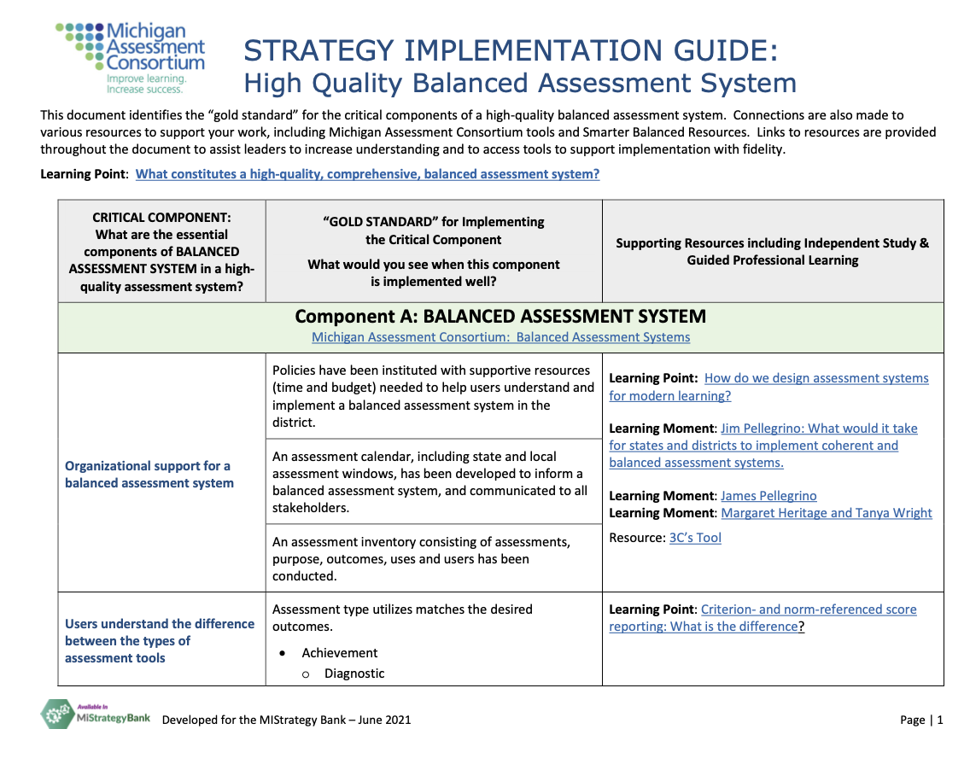
Strategy Guide: High Quality Balanced Assessment System
Notes:
The SIG for a High Quality Balanced Assessment System…

Slide 6
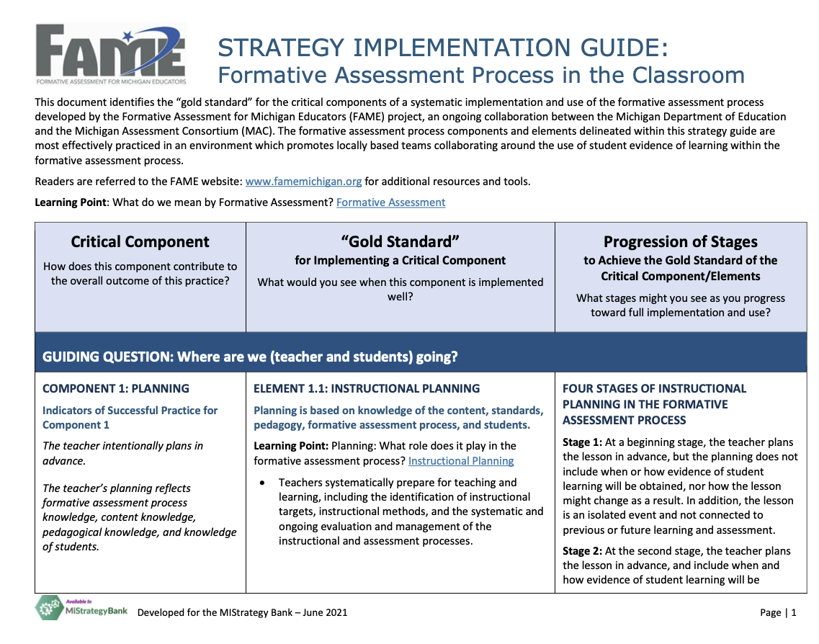
Strategy Guide: Formative Assessment Process in the Classroom
Notes:
The SIG for the Formative Assessment Process in the Classroom…..

Slide 7
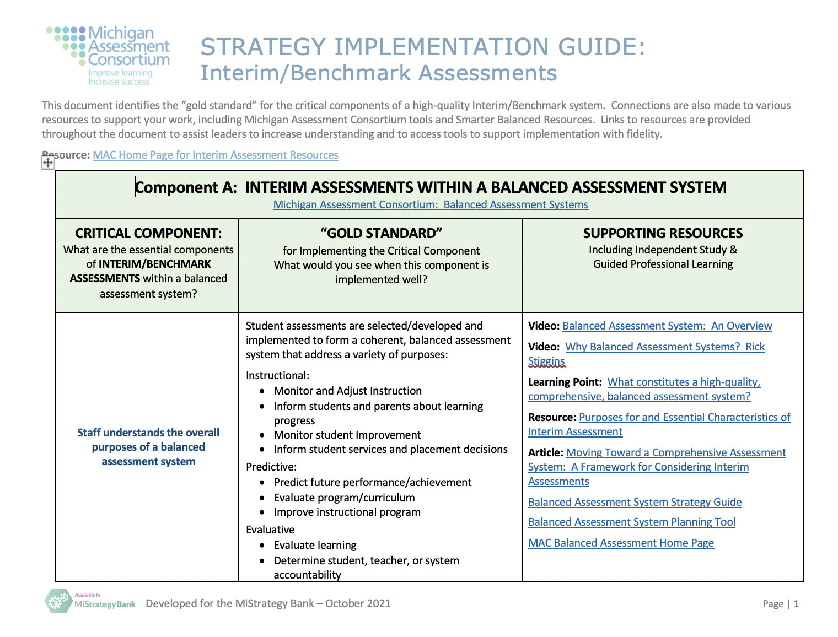
Strategy Implementation Guide: Interim/Benchmark Assessments
Notes:
The SIG for Interim/Benchmark Assessments and….

Slide 8
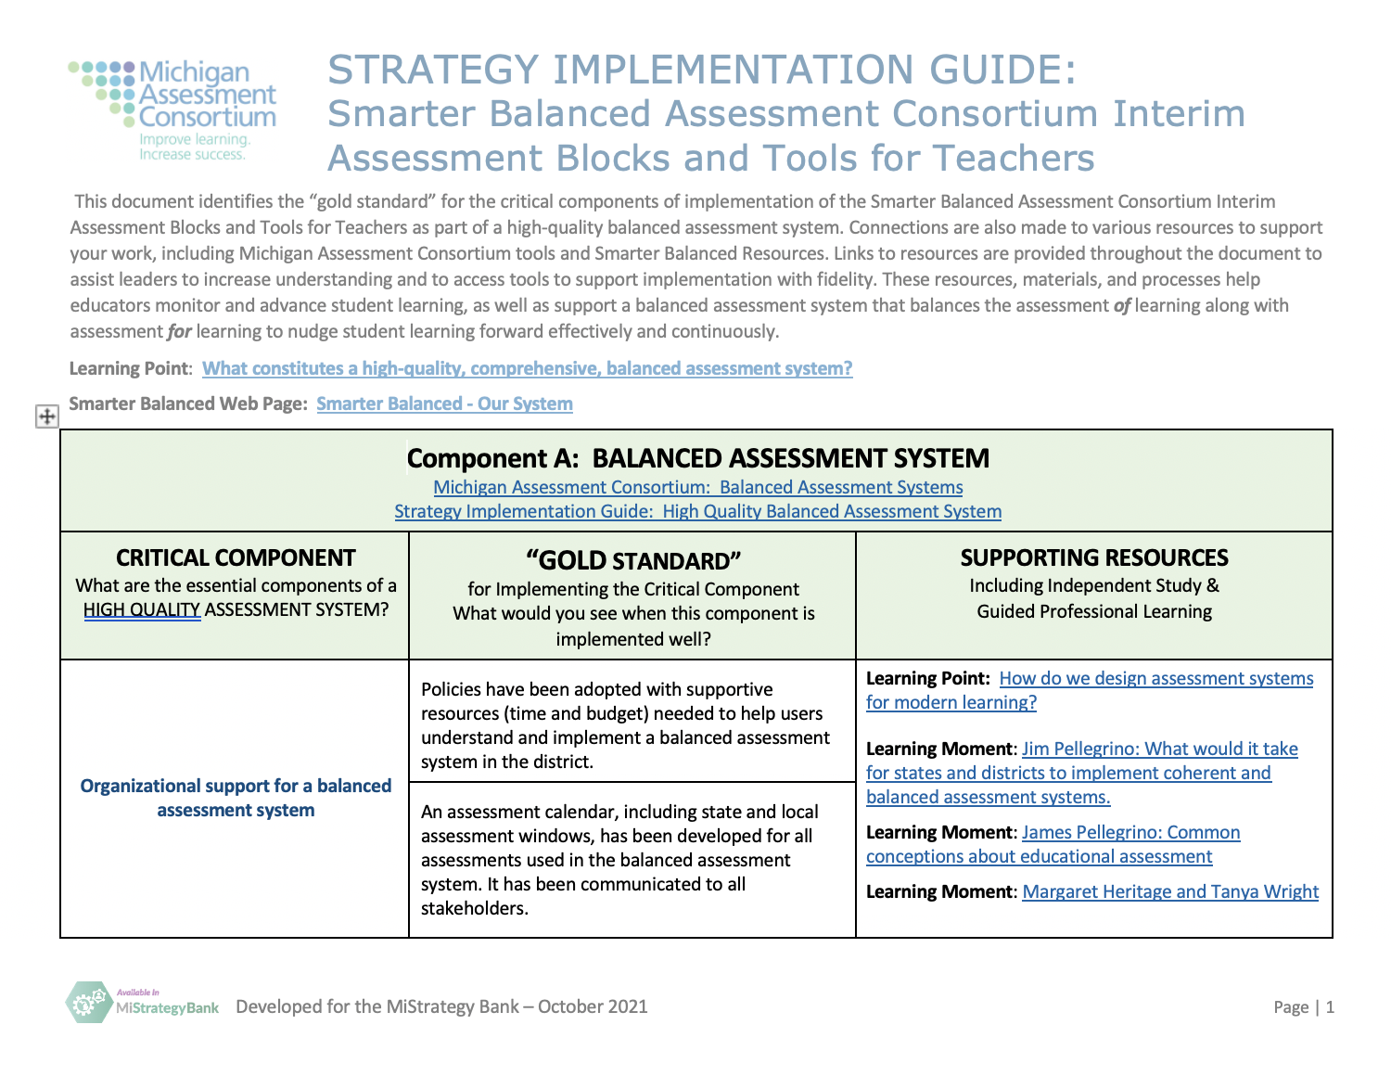
Strategy Implementation Guide: Smarter Balanced Consortium Interim/Benchmark Assessments & Tools for Teachers
Notes:
The SIG for the Smarter Balanced Assessment Consortium Suite of assessments and Tools for teachers.

Slide 9
Notes:
Within the planning process, we’ve reached the point of thinking about how a team will implement, monitor and evaluate the strategy that is being considered for implementation. The team has decided the strategy and is ready to plan for implementation. This requires strategic planning of action steps, timelines and individuals/teams responsible in four stages of implementation: Getting Ready, Implement, Monitor and Evaluate. This planning process is, in many ways, the most important step that will be taken as a team moves into implementation and needs to be done intentionally in order to remove barriers and identify resources needed for successful implementation. It also helps to clearly communicate the goal, timelines and expectations to those that will be involved in the implementation.

Slide 10
Key Questions:
Where are we now?
What are our strengths and challenges?
What is the root cause? What are we going to do to address the challenges?
Is it the right thing to do?
Can we do it the right way?
Strategy Implementation Guides: Help to define the “right way”
Balanced Assessment System
Interim/Benchmark Assessments
SBAC and Tools for Teachers
Formative Assessment in the Classroom
Grading and Reporting (in process)
Planning Tools: Create action steps for these questions:
What are the action steps we need to take in order to it the right way in each implementation stage: Get Ready-Implement-Monitor-Evaluate?
What will it look like when it is implemented as described in a Strategy Guide?
What do we need to do to monitor and adjust implementation and impact? (Monitor)
What do we need to do to continue/modify/stop? (Evaluate)
Notes:
This planning process will help to put into place the action steps that are needed to “do it the right way”, as defined by the research around an identified strategy. Please refer to the questions regarding the Planning Tools that have been added to slide above.

Slide 11
Planning Tool: Formative Assessment Process in the Classroom
Notes:
The Michigan Assessment Consortium has created various Planning Tools for the strategies for the several of the strategies in the area of assessment that have strategy guides. Others are under development. These include: High Quality Balanced Assessment System, Interim/Benchmark Assessments (under development), Smarter Balanced Assessment Consortium Assessments and Tools for Teachers (under development), and the Formative Assessment Process in the Classroom. A screenshot of the first page of each of these is shared in this and upcoming slides. They can be located on the MAC webpage, as well as in the Mi Strategy Band under the associated strategy.
The Planning Tool above indicates the steps that should be considered during each of the implementation stages of Getting Reading, Implementing, Monitoring and Evaluating when a team is working to implement the formative assessment process in the classroom.

Slide 12
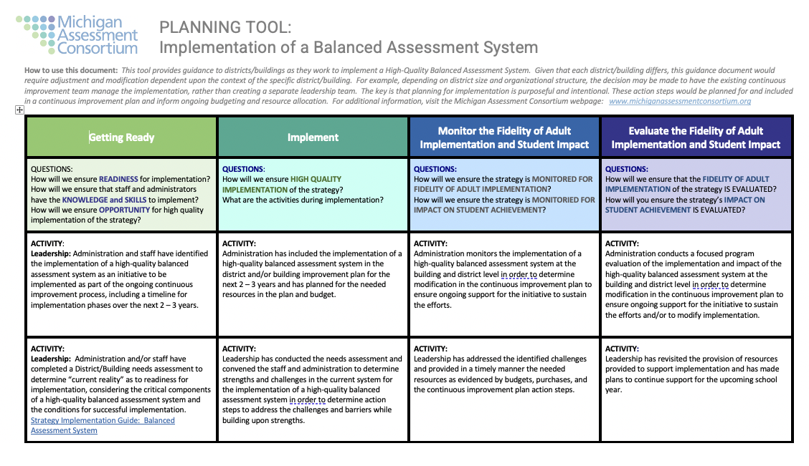
Planning Tool: High Quality Balanced Assessment System
Notes:
This Planning Tool addresses the implementation of a High Quality Balanced Assessment System.

Slide 13
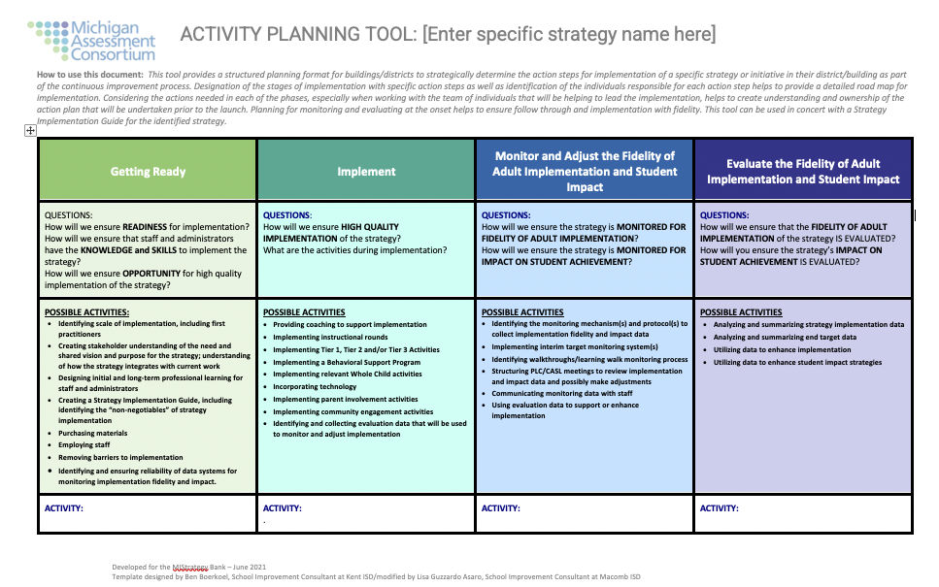
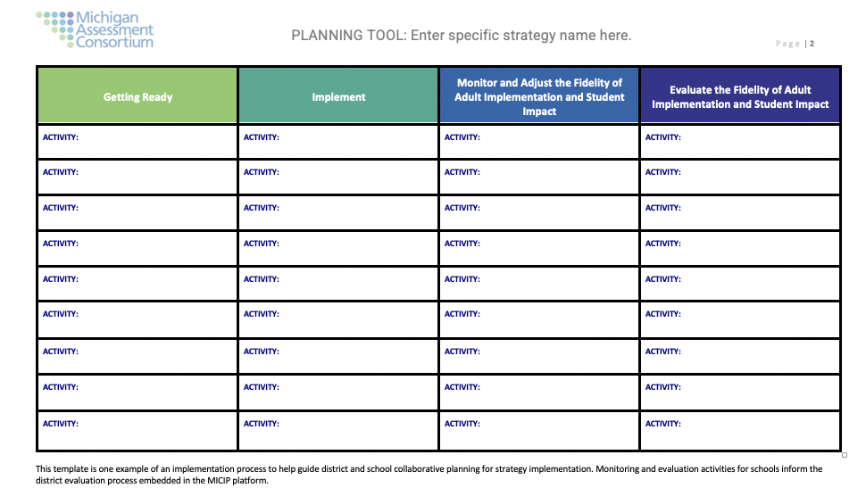
Planning Tool Template
Notes:
The template above provides an idea of some of the key questions a team would consider in each of the implementation stages as they plan. It is important during this planning process to determine, up front, how the implementation will be monitored and evaluated, as well as the expected impact on students. Knowing this at the onset of implementation helps the team to put into place the systems and process to collect and organize the data and information needed to make data informed decision as to needed adjustments, and whether to continue an initiative or if it should be abandoned during the final evaluation phase of the continuous improvement cycle.

Slide 14
Critical Question – Will a district/building be able to follow the research around implementation with fidelity?
Choose a best practice.
Is this the right thing to do?
Can we do it the right way?
Proceed to the Plan stage and develop an action plan.
Yes
Yes
No
No
Choose a different best practice.
Choose a different best practice.
The Hexagon Tool helps here.
Evidence
Usability
Supports
Need
Fit
Capacity
Notes:
Planning strategically using the Planning Tools provided and including various stakeholders that will be responsible for implementation in the planning process helps to ensure that you will be working to “do it the right way” and avoid unintended consequences and false starts due to missing components during implementation. Involvement of other stakeholders also helps to build understanding of the initiative and ownership of the work that will need to occur during the implementation process.

Slide 15
Let’s take a look at the MI Strategy Bank Within the MICIP Platform
MICIP Platform
MI Strategy Bank
System
Program
Resource
Practice
Activity
Initiative
Instructional Strategy
Process
Notes:
The MAC planning tools are also included in the MICIP platform strategy bank under the resources section of the identified strategy.

Slide 16
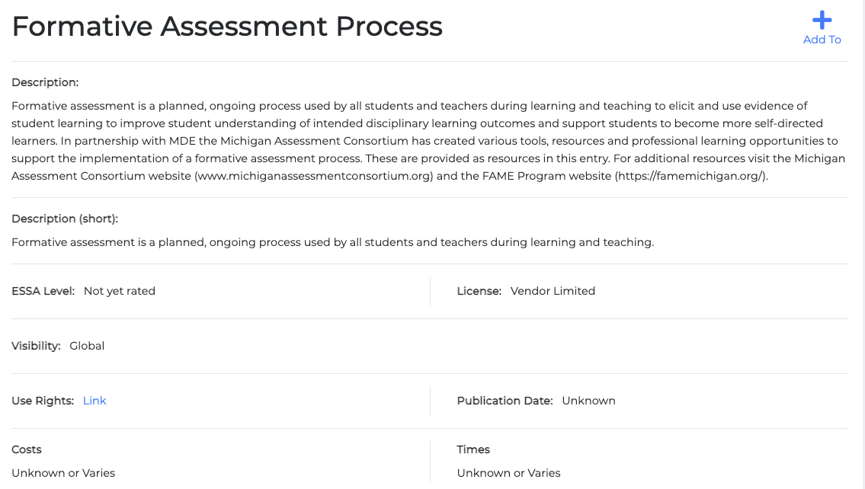
Screenshot of MiStrategy Bank
Description of the Strategy
Notes:
This screenshot shows the first page of a strategy which includes the description of the strategy and some identifying information.

Slide 17
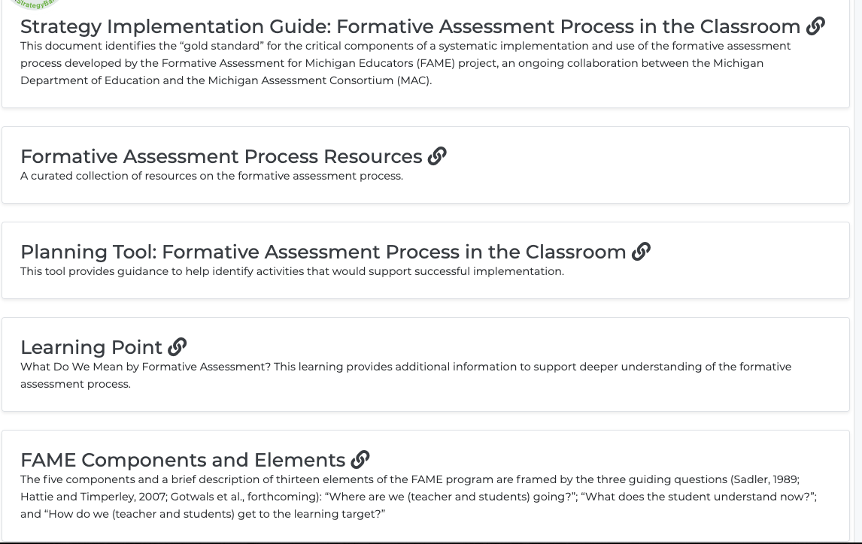
Screenshot of MiStrategy Bank
Tools and Resources
with hyperlinks
Notes:
This screen shot shows the inclusion of the Planning Tool for the identified strategy.

Slide 18
Michigan Integrated Continuous Improvement Process
Notes:
Use of the Planning Tools in concert with the Strategy Implementation guides can build a strong foundation for districts to successfully move through the continuous improvement cycle, implementing with fidelity and supporting students with evidence-based practeces.

