Slide 1


D5: Developing Assessment Literate Practices for Non-Tenure Teachers and their Mentors; Community of Practice (CoP) Approach
Feb 13, 2020; 10:20 am – 11:35 am
Presenter: Terri Portice a Board of Director for the Michigan Assessment Consortium

Slide 2
Who is in the room?
If the following describes your position, stand up and say, “Just like me.
I am an assessment director/coordinator
I am a building administrator
I am a district office administrator
I am a teacher
I am an instructional content area/ professional development consultant at an “Intermediate School District/RESA, etc.
I am a State Level Director or Consultant
Who did we miss?

Slide 3
Presenter: Terri Portice
Representing the Michigan Assessment Consortium; I have served on the Board of Directors for the Michigan Assessment Consortium for almost 10 years.
My background includes the following: team/teacher, special education teacher, special education teacher consultant, building level administrator, Director of Teaching and Learning for Kent ISD, K-12 district administrator (Curriculum, Instruction, Assessment), adjust professor, and currently I work 1-2 days a week as instructional coach around literacy. I also continue to be an active member of the Michigan Assessment Consortium.

Slide 4
Michigan Assessment Consortium (MAC)
The Michigan Assessment Consortium (MAC) is a non-profit organization of Michigan educators designed to promote greater understanding around assessment. The goal of the MAC is to help educators use assessment to improve teaching and student learning.

Slide 5
The Mission of the MAC: Improve student learning and achievement through a system of coherent curriculum, balanced assessment, and effective instruction.
We do this by collaboratively, by…
promoting assessment knowledge and practice,
providing professional learning, and
producing and sharing assessment tools and resources.

Slide 6

Assessment Literacy Defined by the MAC…
“Assessment literacy is the set of beliefs, knowledge, and practices about assessment that lead a teacher, administrator, policymaker, or students and their families to use assessment to improve student learning and achievement.” (Link)

Slide 7
What MAC materials can be used to help you lead this work?
Assessment Literacy Standards (Link)
Learning Points (Link)
ALM Online Module(s): Content is housed on MVU (level I & Level II Courses) (Link)
ALN: video and print materials from the statewide events; and or from the Assessment Literacy Summer Institute. (Link)
Curated materials by topic for specific groups
Content/Ideas from today’s session.

Slide 8
Sharing One District’s Story

Slide 9
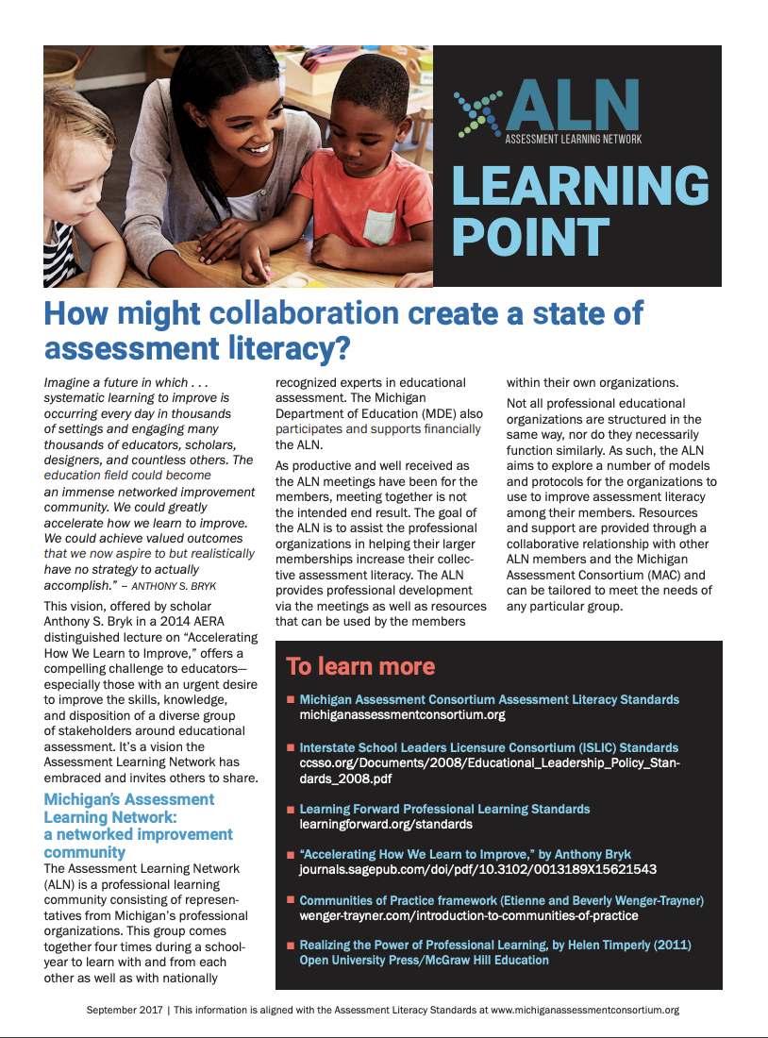
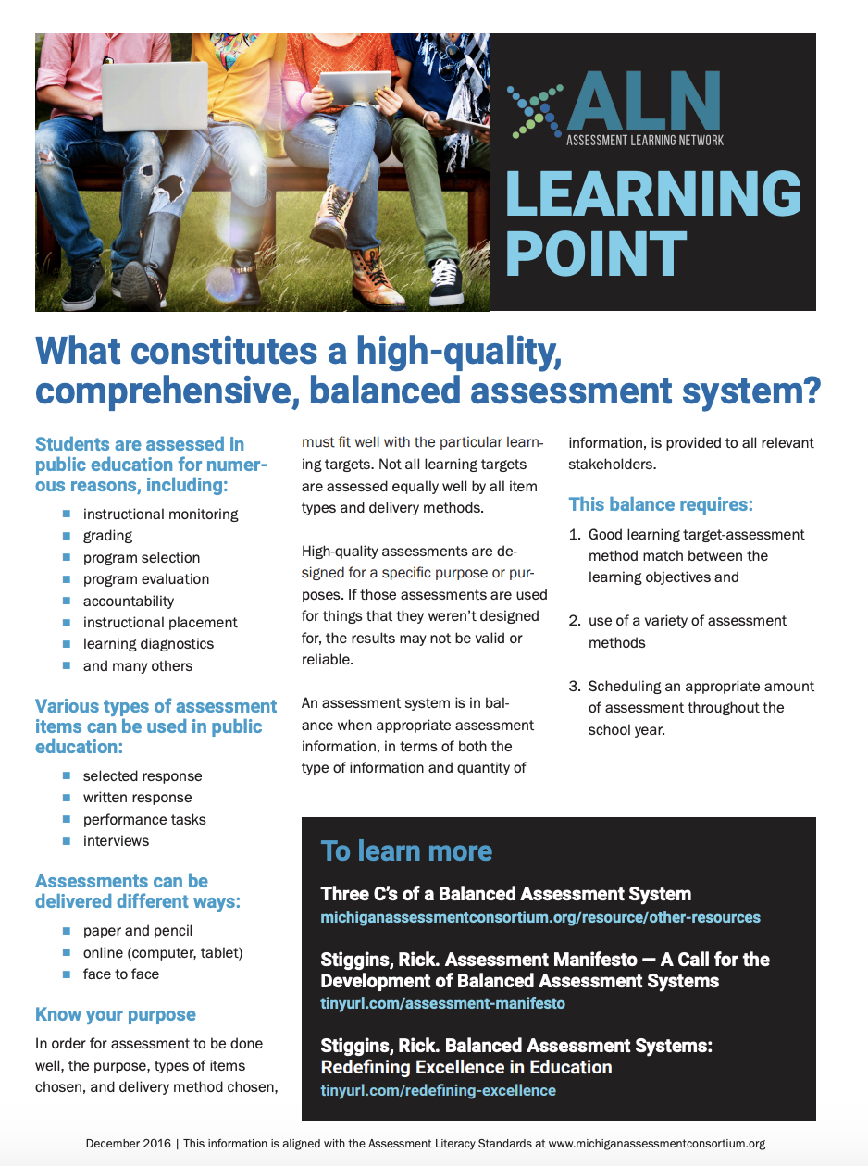
Time to Move: Jigsaw Reading
(15-20)
Group 1: Assessment
Group 2: Formative Assessment
Group 3: Questioning/Feedback/Agency
Process: Each group will decide who will read which article in their given packet. Each person will read their assigned article silently (approximately 5 minutes) and then will share out highlights of the content (in 1-2 minutes) to your team. Each person in the group will repeat the process, using the article they read. By the end of the session, each person will have the general information obtained from each of the articles in your packet.
**If you want the articles that you did not receive today, go to the MAC booth and pick them up to take with you. Or go to the MAC website and download the articles. (LINK)

Slide 10
Blended Learning Ideas from a Local District
Reeths-Puffer Schools
Creating an Assessment Learning Culture:
My goal was to provide ongoing professional learning in order to build an assessment literate culture within our system. We did this thru ongoing professional learning with the…
  Administrative Team
  Administrative Team and Teacher Leaders
  Non-tenure Community of Practice
    Non-tenure staff and their mentor
  K-5 integrated formative assessment learning connected to the new reading curriculum
  Content teams ready for the next level of learning
  Summer Institute Learning Sessions (multiple years)

Slide 11
  Professional Learning Process: Administrative Team then
  Administrative Team & Teacher Leader Group and simultaneously other Targeted Groups
Administrative Team Learning Sessions:
Multiple years of targeted learning with multiple sessions each year (goal: to build common knowledge and understanding)
As well as
Administrative Team and Building Level Teacher Teams from each building
multiple days offered each year as a part of summer institute (goal: to build a wider group with common understandings)
As well as
Targeted Groups:
Use of Early Release Time for Professional Learning Sessions (goal: to build knowledge with specific groups of educators around specific assessment learning topics)
  Time for learning with follow-up conversations around how these new learning ideas fit into our curriculum, instruction and assessment practices.
As well as
Non-Tenure Staff
  Non-Tenure Orientation (sprinkle ideas)
  Non-Tenure Community of Practice (CoP) Sessions (goal: to build common skills and understandings as new educators came into the district)

Slide 12
Administrative Team
Administrative Learning sessions were held first then we moved to…
  Administrative Team with Teacher Leaders Sessions

Slide 13
Administrative Team & Teacher Leader 2 Day Session (high level overview of the session)
Module Focus: Formative Assessment
Concept 1: Define Formative Assessment (article: What do we mean by Formative Assessment?)
  Utilized multiple slides from the module that included summaries around the research
  Highlighted High Leverage Strategies (activity & discussion)
  Balanced Assessment System (MAC Article What Constitutes High Quality Balanced Assessment System) (Link) and connected the learning conversation back to our own Balanced Assessment System. (3-C’s document)
Concept 2: Components of Formative Assessment
  Use of slides from the module for common learning/conversation (MVU unit)
  Handout: The FA Process Graphic (Link)
  What Do We Mean by FA? (Link)
    MAC Article Reading & Activity; FAME Planning Document
  Learning Targets: Use module slides and video examples; Learning Target; Learning Point article (Link)
  FA Tool List – Activity: participants coded which FA tools were currently being used vs. those that were new ideas
  Formative Feedback vs. Ego/Evaluative Feedback (Link)
    Module Video: Feedback Dylan Williams

Slide 14
Non-Tenure Community of Practice
(Multiple Sessions per year)
Non-Tenure Orientation (Sprinkle ideas)
Non-Tenure Community of Practice (CoP) Sessions
Today’s Goal: Sharing high-level ideas/overviews of how you can use the MAC’s materials to support new learning within your learning context.

Slide 15
Non-Tenure Community of Practice (CoP) Session 1 (slide 1 of 2)
Module Focus: Becoming Assessment Literate Community of Practice
Setting the purpose for our time together:
Introductions (K-12 non-tenure teachers; staff did not necessarily know one another)
Norms of Collaboration
Grounding Activity - Visual Synectic
New Learning and Sharing: Five different MAC Articles (Jigsaw Reading and Activity)
What Do We Mean by Assessment Literacy
What Do We Mean by Formative Assessment
What Conditions Are Necessary for FA Implementation;
What Constitutes a High-Quality Comprehensive System;
Start with a Purpose When Choosing an Assessment
Understanding the Difference between Assessment of vs. Assessment for Learning
Use module slides for background knowledge; Article reading & jigsaw activity after reading; Data collection tools
Analyzing data (data protocol activity)

Slide 16
Non-Tenure Community of Practice (CoP) Session 1 (Slide 2 of 2)
Learning Activities Continued:
Clear Learning Targets (used
module content) and LP (Link)
Connections to 5-D Rubric
Making Connections from
tonight’s learning to his/her
classroom
Closing Activity:
From today’s learning, commit to one thing that you will do in your classroom around formative assessment and bring back to our next session to share with others. (We started off by sharing out at the next session)

Slide 17
Non-Tenure Community of Practice (CoP)
Session 2
Share the strategy personally set in previous session, and share outcomes w/teammates
Review Assessment for Learning vs. Assessment of Learning
Read Article: What Do We Mean by Assessment Literacy? (Link)
Margaret Heritage Video: Video Assessment for Learning
Connections made to the importance of students being involved in the process (5-D Rubric connections)
21^{st Century Learning Video} from Module
High Leverage Strategies Activity and Reflections
Module Content Slides: Key Concept 2: Implications for Assessment
Poster creation by table team as closing activity
Components of a 21st Century Classroom

Slide 18
Multiple cycles of learning continued to be built up each year; leading to more cycles of learning occurring each year but with different groups.
Administration
Community of Practice (CoP)
New Learning
Support for implementation
Non-Tenure Staff
Community of Practice (CoP)
New Learning
Support for implementation

Slide 19
Action Planning Process
Jot ideas of things that you have already done to build assessment literacy skills within your area of influence.
Document new ideas that you can use back in your district from today’s session.
Note new ideas you gathered from the conversations with those in your discussion groups.
Take a specific sample from today (ALN article, idea, approach, concept, etc.) and write down a few ideas to help you build a draft plan that you can take back to share with others in your district.

Slide 20
Gathering More Ideas… share out
Stand Up/Team Up/Share Ideas: (5-7 minutes)
Get up and find three other people from around the room to share your thinking and gather additional ideas from those you are talking to.
Stop and Jot: (3-5 minutes)
Record the new ideas you learned from your most recent group.
Add to any notes you had previously taken.
Reminder of our Goal: We want you to leave with specific ideas to take with you as you plan how you will use the information to increase the assessment literacy skills of those within your realm of influence.

Slide 21
Eight Considerations for Establishing and Promoting a Strong Data Culture
Create effective data sharing teams
Ensure assessment literacy of all team members
Get the right data in the hands of the data team
Create/Provide appropriate data displays
Engage in a cycle of collaborative inquiry
Examine multiple data types
Embed use of data within the work of the organization
Document and communicate widely resulting decisions

Slide 22
9 Fundamental Beliefs for an Assessment Data Usage System

Slide 23
Thank you! If you need more information or have any questions, please contact me.
Contact Information:
Terri Portice
Terri.portice@gmail.com
Cell: (616) 889-7303
MAC Website: https://www.michiganassessmentconsortium.org/

