Slide 1
Michigan Arts Education Instruction and Assessment
Assessment Communities of Practice:
MAEIA project leads the way
Michigan School Testing Conference February 12, 2020
Notes:
Welcome to this Introduction to the Michigan Arts Education Instruction and Assessment Collaborative Scoring System Pilot Project.
This webinar provides an overview of this pilot project, provides a quick overview of this MAEIA project and how teachers can use this system to score the work of their students. It outlines the desired outcomes of the pilot and participant roles and responsibilities.

Slide 2
Introductions
Presenters
Heather Vaughan-Southard
Professional Learning Director, Michigan Arts Education Instruction & Assessment Program
Andrea Murray
Music Educator, Ann Arbor Public Schools
Jeffrey Cuff
Chief Operating Officer, MZ Development
www.michiganassessmentconsortium.org
Notes:
We have approximately XX (could say we are hoping to confirm teams of not more than 30 teachers for each VA and Music) pilot participants – a combination of arts teachers and supervising administrators – from districts across the state and representing music and visual arts K-12. A roster of participants is available.
The MI Assessment Consortium is a non-profit, non-partisan education organization focused on promotion of quality assessment systems and practices – we have been commissioned by the MDE to make the resources and tools available through this program.
For the pilot project you are served by – Kathy Dewsbury-White, MAC CEO and MAEIA Project Director, Ed Roeber MAC, and MAEIA Project Assessment Director, and Jason O’Donnell executive assistant and project support.

Slide 3
Overview of the Presentation
Introduction to MAEIA
Communities of Practice in Professional Learning
Experiencing Performance Assessment
Overview of MI-Collaborative Scoring System
Overview of the MI-CSS Software
Registering in the MI-CSS system
Uploading student work into the system
Teacher scoring of their students’ work
Scoring student work of other teachers
Reporting of student assessment scores to teachers
Impact on Educator Practice in Teaching, Demonstrating Educator Effectiveness, Community Building
Notes:
ER

Slide 4
MAEIA: Advancing Creativity in Education
Improve the quality of your arts education program
Monitor and improve student learning in the arts
Support professional practice and improve teacher effectiveness
Advance arts as a core element of public education
Notes:
HVS:
Advancing Creativity in Education
-Adaptable use for Arts Educators, Core Educators, Building and Central Admin
-Adaptable to other content areas as learning becomes more 3-D and experiential
——New science standards
——Integrity in the content area while also examining for cost-effective ways to score assessments in a scaleable way

Slide 5
Welcome to MAEIA . . .
MAEIA Resources
We are the Michigan Arts Education Instruction and Assessment (MAEIA) project.
We're changing the landscape of arts assessment for students, educators, and programs.
Arts Blueprint & a Program Review Tool
360 arts assessments in dance, music, theatre, and visual art & a community of like-minded professionals
Notes:
Let’s start with a quick overview of the MAEIA project and resulting tools and resources for arts educators.
We have created…
An arts education blueprint, with supporting research
A program review tool to help you measure your arts instructional program
over 350 arts performance assessments in dance, music, theatre, and visual art , suitable for students from kindergarten through grade 12
And, a community of like-minded professionals who are beginning to use the maeia-artsednetwork.org

Slide 6
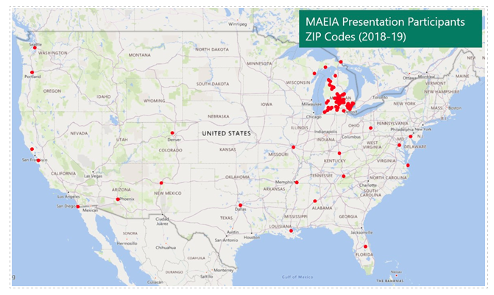
MAEIA on the Map
Notes:
MAEIA leads state-wide and nationally in resources for arts assessment. Our presence at national conferences for assessment and arts education continue to validate the value of the MAEIA tools and resources as well as the level of support from our state department of education. Though arts educators commonly feel left out or left behind in regard to support provided in district for professional learning and assessment guidance, MAEIA challenges that rhetoric in the support received from the Michigan Department of Education and Michigan Council for Arts and Cultural Affairs to continue to innovate and support arts educators and arts students.

Slide 7
MAEIA Resources
Program
Improvement
Promote Student Learning
Blueprint of a Quality Arts Education Program
Research and Recommendations
Arts Education Program Review Tool
Michigan Arts Education Assessment Specifications
360 Model Performance Arts Assessments in Dance, Music, Theatre, Visual Arts (K-2, 3-5, 6-8, and High School)
Notes:
HVS

Slide 8
Types of Assessment Items
The model assessments are
a combination of performance tasks, events, and
related constructed and selected response items.
They are intended to be used over the course of a year, in conjunction with arts instruction.
Notes:
There are several types of model MAEIA assessments – a combination of performance tasks, performance events, and constructed and selected response items included in the tasks ad events
These assessments are intended to be used by arts educators over the course of the school year, a few by each teacher.

Slide 9
Building the Experience
The MAEIA resources include:
Model Arts Education Assessments for Grades K-8
Model Arts Education
Assessments for
High School
These assessments are available in three grade bands (grades K-2, 3-5, and 6-8) in dance, music, theatre, and visual arts.
These assessments are available in three levels, suitable for first-year, second-year, and third- & fourth-year students in dance, music, theatre, and visual arts.
Notes:
THE major resource for arts educators are the over 350 arts education performance assessments that have bee created.
There are model assessments suitable for dance, music, theatre, and visual arts, for students in grades K-2, 3-5, 6-8, and high school
At the high school level, there are model assessments in dance, music, theatre, and visual arts for first-year, second-year, and third- & fourth-year students I each discipline.

Slide 10
How can teachers use MAEIA Assessments?
MAEIA assessments can be used in several ways:
to inform current instruction
to improve student learning and achievement
as a portion of educator
effectiveness demonstration
to improve future instruction and program improvement
Notes:
There are several ways that the MAEIA assessments can be used:
to inform current instruction
to improve student learning and achievement
as a portion of your demonstration of your effectiveness as an educator
to improve future instruction and program improvement

Slide 11
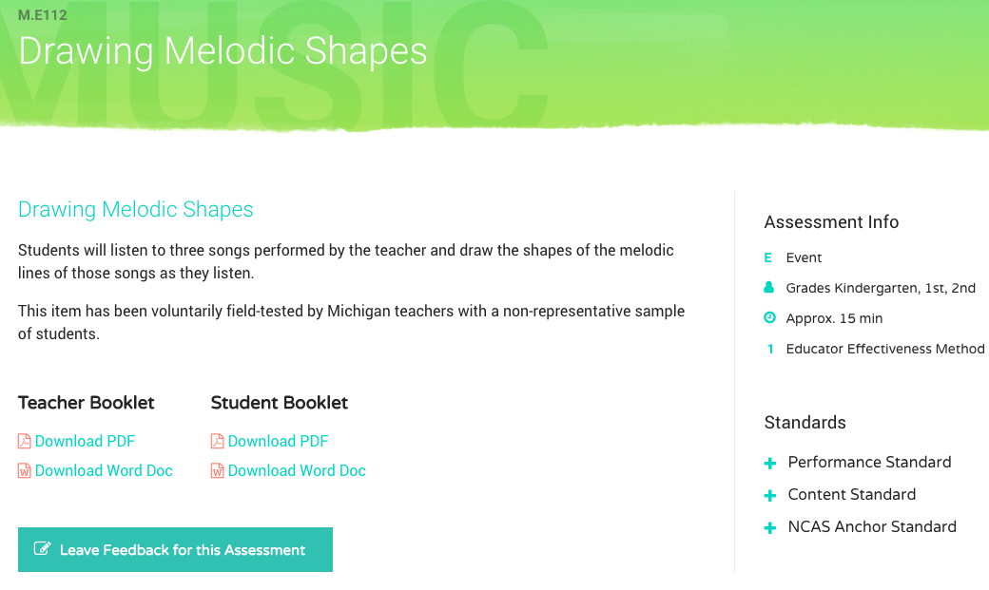
MAEIA Assessment:

Slide 12
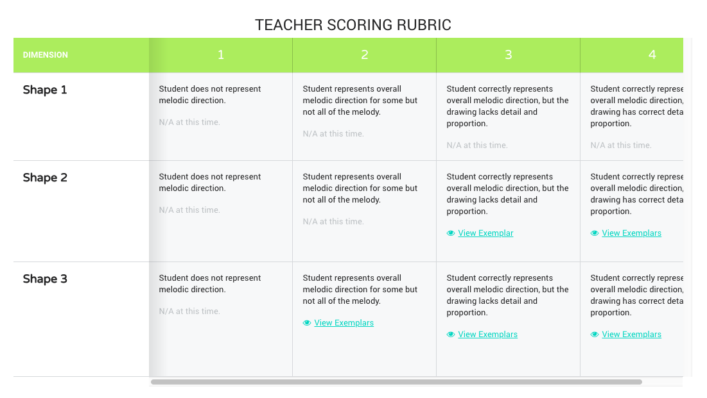
Rubrics with Embedded Exemplars

Slide 13
MAEIA Communities of Practice
Notes:
For years, we have been focused on building and developing the MAEIA community- a group of people who have contributed to the creation of the MAEIA resources and those who use them. We are now exploring MAEIA Communities of Practice which are subsets of these community members related to region, discipline, and project participation.

Slide 14
MI-CSS Communities of Practice
Arts educators are often isolated within small districts and may not have opportunity to collaborate with colleagues in large districts.
WHO: individual educators, teams of educators
WHERE: rural, suburban, urban districts
WHAT: The goal of MI-CSS is to provide independent teacher scoring of student written work and performances at a lower cost than central scoring WHILE engaging educators in deeply meaningful professional learning.

Slide 15
For the Educators
Educators participating in the MI-CSS experience might address the following questions and more:
How do I know what is good quality in my discipline?
Do other educators see quality the same way I do?
What biases do I hold when scoring the work of my own students?
How can I gain more objectivity in the scoring process?
How do I build reliable data into my educator effectiveness portfolio?
Where do I find like-minded educators who are interested in improving their assessment practice?

Slide 16
Michigan–Collaborative Scoring System (MI-CSS)
www.michiganassessmentconsortium/mi-css.org

Slide 17
Why Develop MI-CSS?
Zoom in
Results from teacher scoring of their own students may not be considered trustworthy sources of information for educators to use in demonstrating their effectiveness in educator evaluation systems (no independent verification)
Yet, teacher scoring of student work is some of the strongest professional learning educators participate in
Zoom out
Central scoring (via an independent vendor) produces much more trustworthy scores, but is very expensive
Resources are available for assessment at federally-mandated grade levels, content areas, and grade levels

Slide 18
Why Develop MI-CSS?
Zoom out
Assessment resources for non-required content areas (i.e., the arts) and grade levels (i.e., off-grades in science) are often quite limited
Assessments such as MAEIA would be incredibly expensive to centrally score
The goal of this project is to provide independent scoring of student work by Michigan’s teachers at lower cost than central scoring – which is both a process and a technical issue

Slide 19
Overview of MI-CSS
www.michiganassessmentconsortium.org
Features of the MI-CSS software

Slide 20
The MI-CSS process in short
Team assignment: a group of independents, a team of colleagues
Each teacher uploads and scores their student work
A second scorer scores the work
If needed, a resolution scorer scores the work
Reports are provided which provide valuable data, assist in conversations with building administrators and others
While the scoring is blind; professional dialogue can exist throughout the process resulting in the refining of the educator’s eye and/or ear

Slide 21
Broader Questions to Ponder
How might MI-CSS, used in areas such as ELA, mathematics, science, and social studies to impact district assessment and instruction?
A mechanism for use of state-funded/developed assessment prompts and scoring rubrics provided to LEAs
Off-load some of the expensive item types to LEAs for their use to enhance/balance the overall assessment system in the state
Enhance the quality of the assessments used by local districts, with state support but at minimal cost
Promote use of performance assessment in all grades and content areas, thus enhancing student learning – support for competency-based education
Permit the state to use its limited resources to bring more “balance” to balanced assessment systems
https://tinyurl.com/y7jggo2d

Slide 22
Broader Questions to Ponder
Teachers may be able to use MI-CSS to document their own effectiveness (for educator evaluation)
Provide a new tool to assist educators to demonstrate their effectiveness, without more state testing
Videos of their instruction - full class, small group, individual student
Scans of commendations; parent letters/e-mails; student notes
Selected student accomplishments, awards, and achievements
https://tinyurl.com/yburxpkg

Slide 23
Demonstration of MI-CSS
MZD will show how the MI-CSS powered by OSCAR Classroom works

Slide 24
Teacher Registration
Teachers self-register for MI-CSS access via the Michigan Assessment Consortium website
Indicate their contact information
Define individual district and system information
District
Content Area(s)
Grade(s)
Scoring Role
Teacher
Second Reader
Teacher + Resolution
Resolution Reader

Slide 25
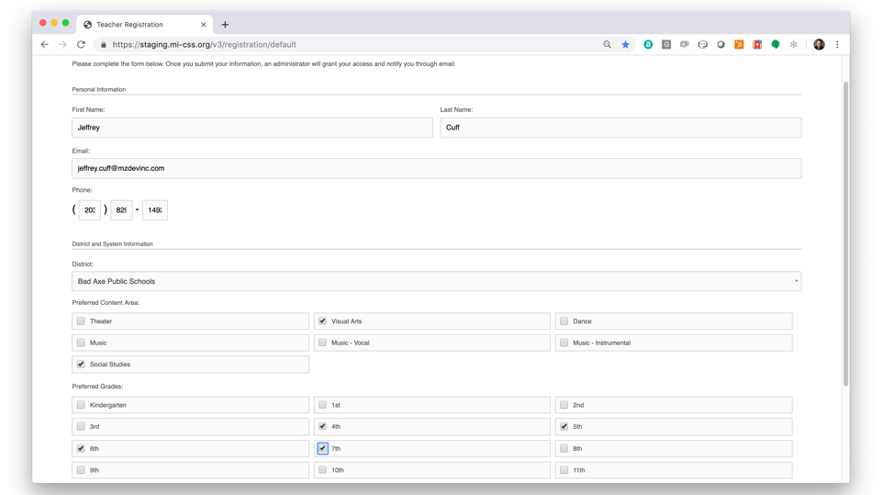

Slide 26
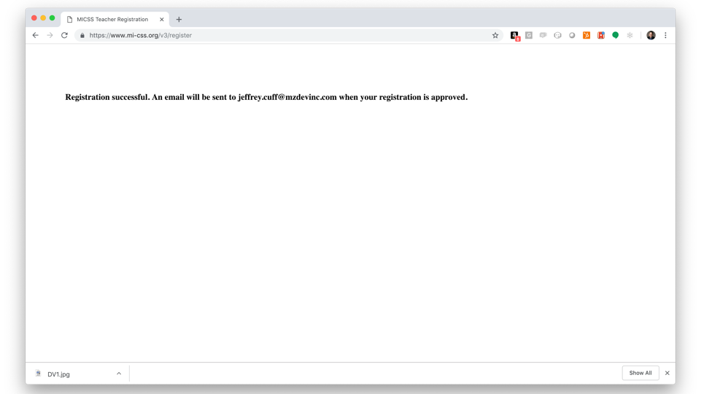

Slide 27
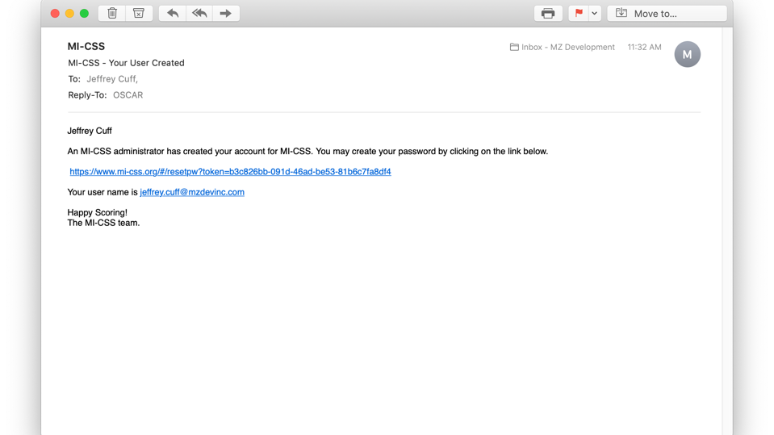
Notes:
After confirmation by MAC administrators, teachers registrations are ‘approved” and a notice is emailed to the teacher.

Slide 28
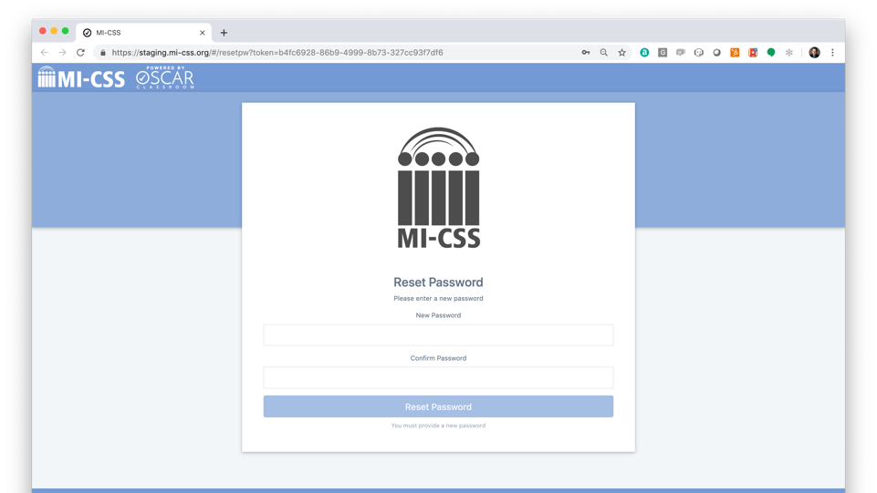
Notes:
The teacher provides password information and is directed to the MI-CSS log-in page.

Slide 29
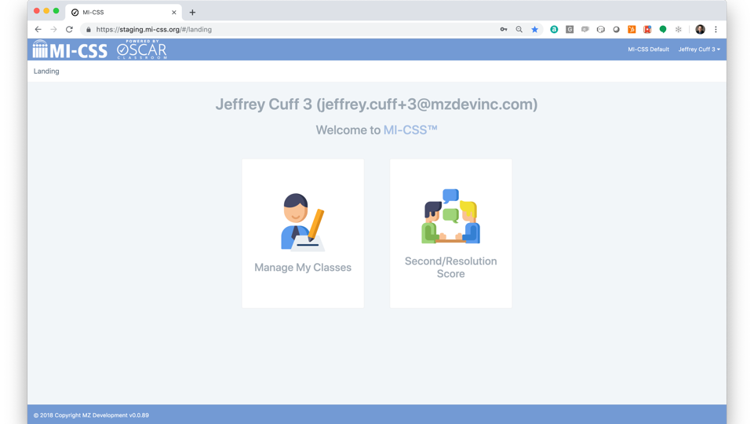
Notes:
Depending on the user Role, different options may be available to each user.
Upon initial access to MI-CSS, teachers have to:
Configure your Class(es)
Add students to the class(es)
Upload work for each student in the class
Select Manage My Classes from the MI-CSS home page to begin MI-CSS Configuration

Slide 30
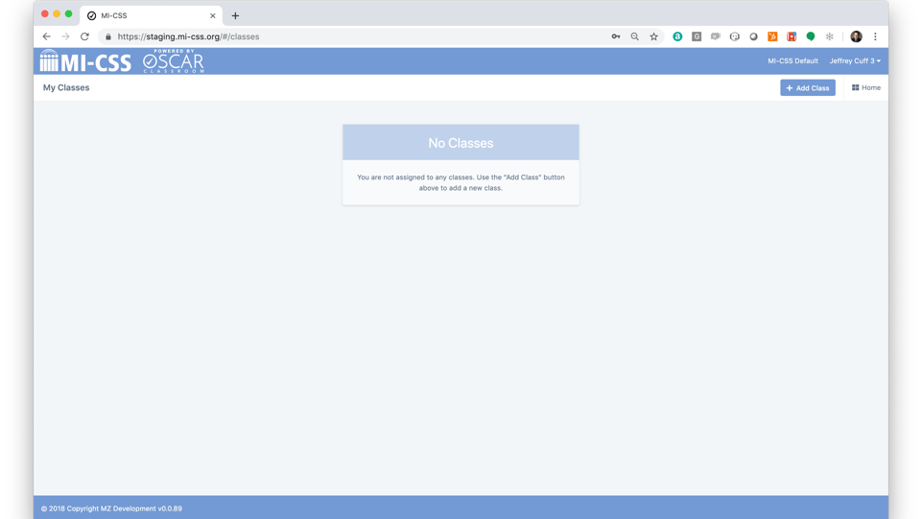

Slide 31
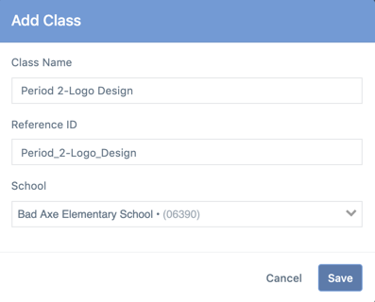
MI-CSS Configuration – Add Class
Select Manage My Classes from the Landing page
Select + Add Class button from the upper right hand of the My Classes page
Complete the following fields
Class Name
Reference ID (optional)
School
The list of schools available in the drop-down list is determined by the District selected during registration
If the list is not correct, please contact a MI-CSS administrator
Select Save to add the class

Slide 32
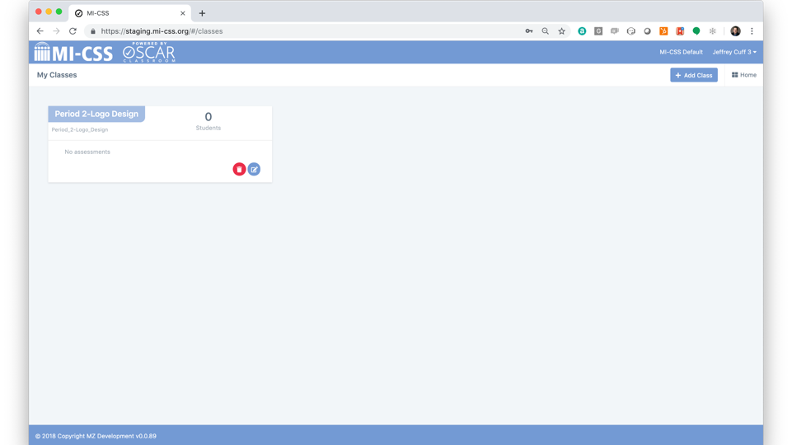

Slide 33
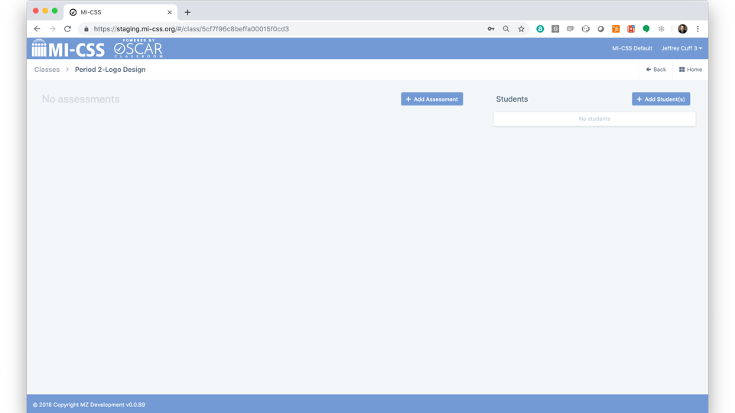
Notes:
From the Class page you can add assessments and add students to the class
To add an assessment, select the + Add Assessment button
To add student(s), select the + Add Students button

Slide 34
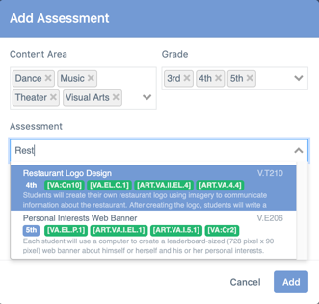
MI-CSS Configuration – Add Assessment
Select the + Add Assessment button from the class page
The Content Area and Grade fields are pre-populated with information provided as part of your initial registration
Under Assessment, type in the name of the assessment you are attempting to add
The list of available assessments is filtered based on Content Area and Grade selections
Edit Administration Name for custom description (optional)
Select Pre-test/Post-test (optional) to add multiple administrations for this assessment
Add Administration Notes
Custom directions available to other scorers for this particular assessment administration
Select Add to complete assessment configuration

Slide 35
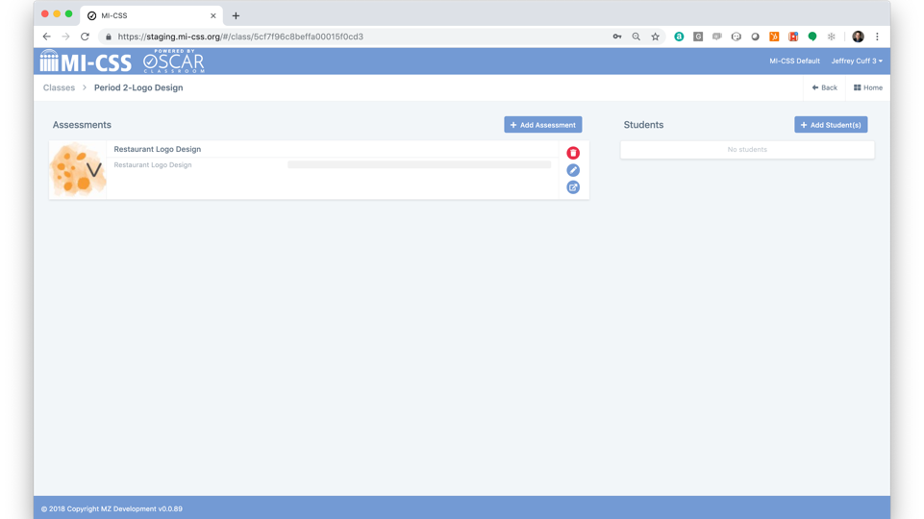

Slide 36
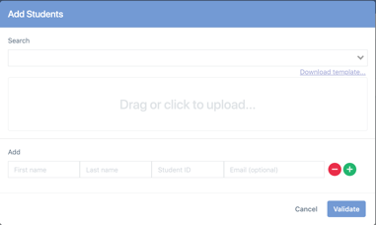
MI-CSS Configuration – Add Students
Select the + Add Students button from the class page
There are three ways to add students to a class
Search for an existing student
Upload student data from a CSV file (template provided)
Add student data individually
New student records are validated against existing student records (via Student ID) in the district to ensure students are not duplicated in the system

Slide 37
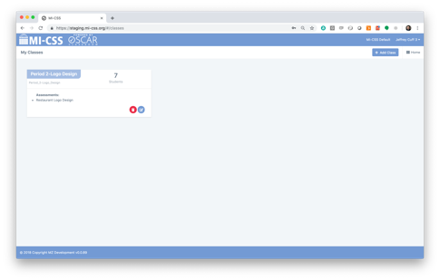
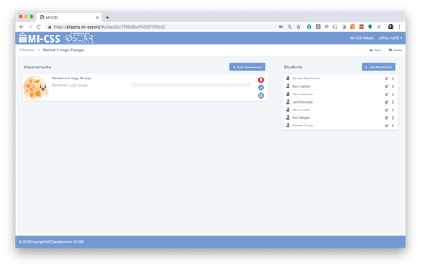
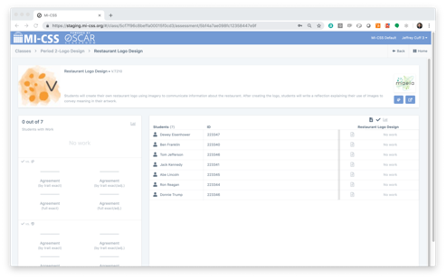
My Classes
My Assessments
My Assessments - Detail
Notes:
After successfully adding an Assessment and adding Students, student work can be uploaded for scoring
From the My Classes page, select the Class you want to upload work to
From the Class detail page, select the Assessment you want to upload work to
From the Assessment detail page, select the Upload Work icon at the upper right corner of the student list

Slide 38
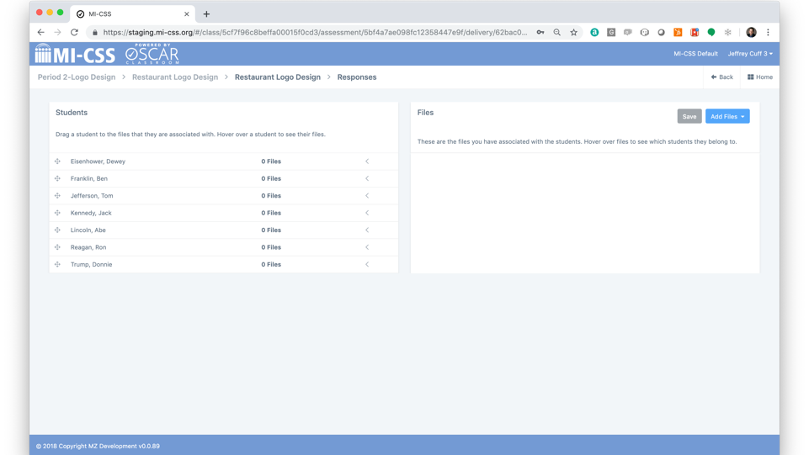
Notes:
Student work can be uploaded directly from the computer or can be uploaded from an associated Google Drive
From the list of student work files, drag a file onto the corresponding student name or drag student onto the file to assign the work to that specific student
Multiple files can be assigned to a single student
The same file can be assigned to multiple students
Hovering over a student or a file name will indicate what has been assigned
After all assignments of the uploaded work have been made be certain to select Save to upload the files to the platform for scoring

Slide 39
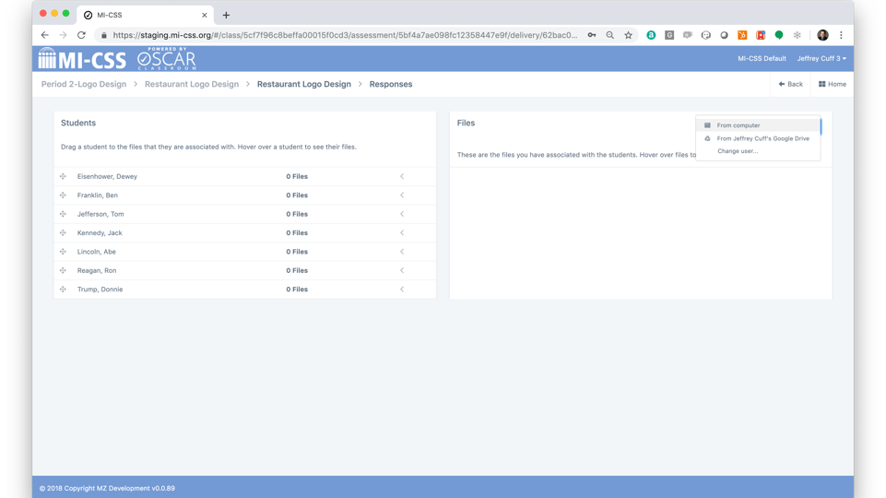

Slide 40
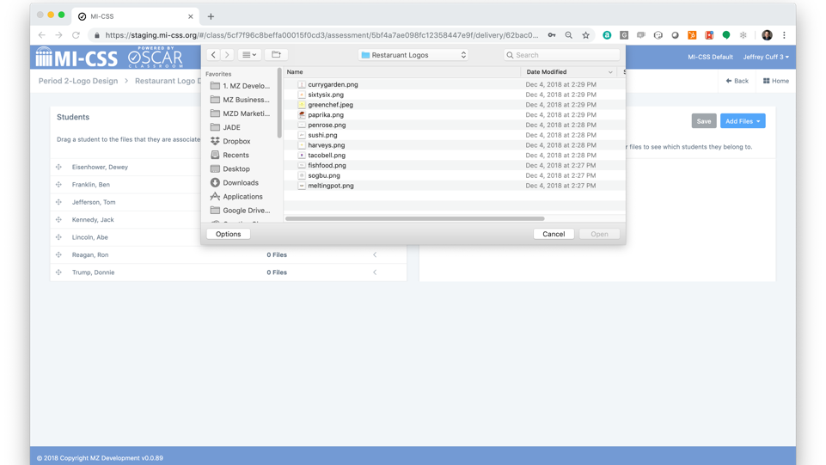

Slide 41
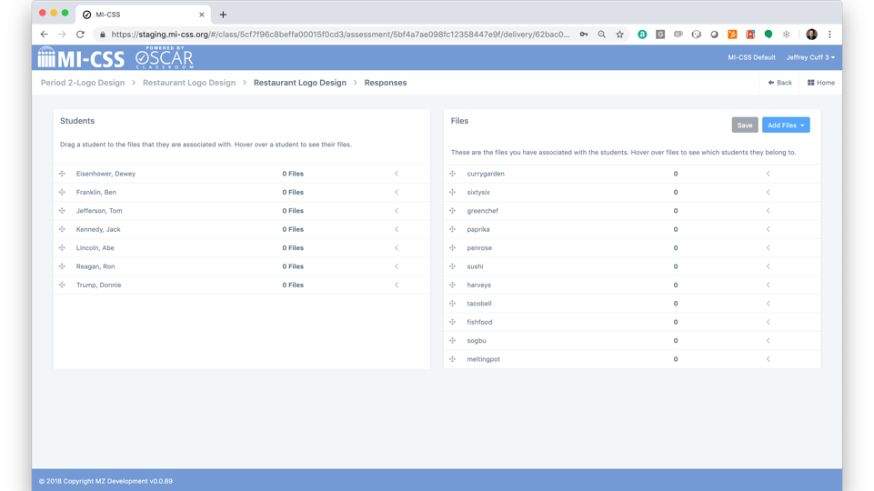

Slide 42
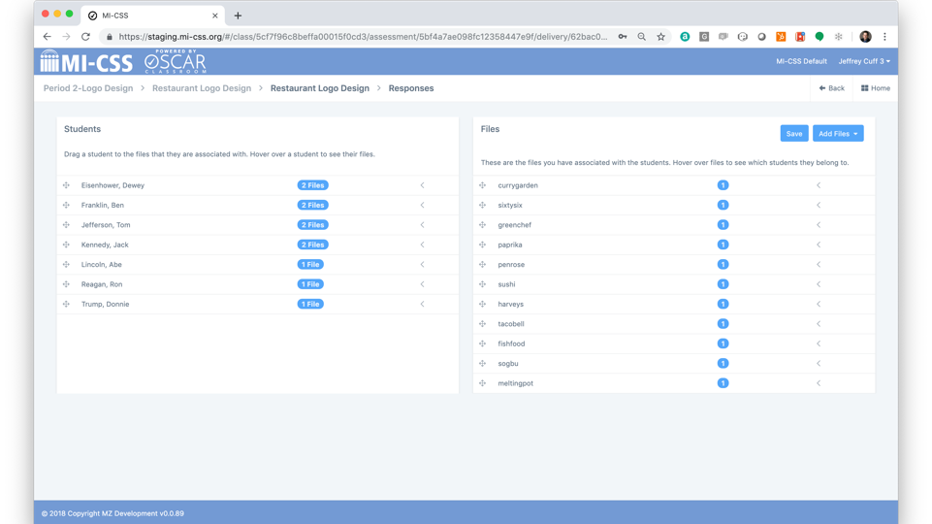

Slide 43
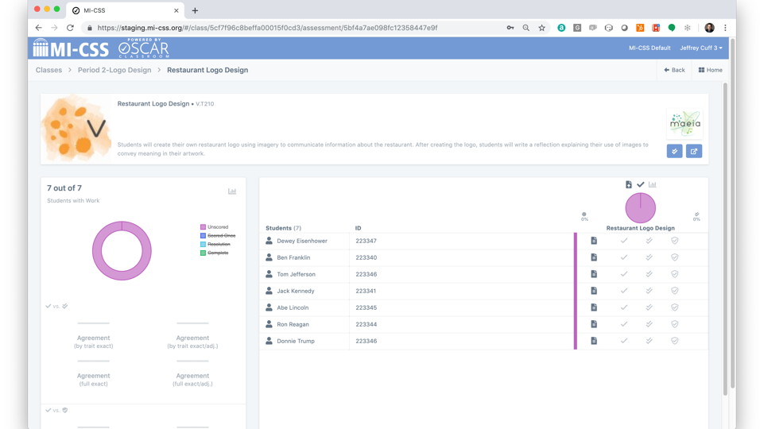
Notes:
Select Manage My Classes from the Landing page
From the My Classes page, select the Class tile that you intend to score
From the Class page, select the Assessment you intend to score
From the Assessment detail page, select the Score icon at the upper right corner of the student list
Note: This is not the Score: Other teachers administrations of this assessment button
A new window will open to display the first student artifact will be presented to score

Slide 44
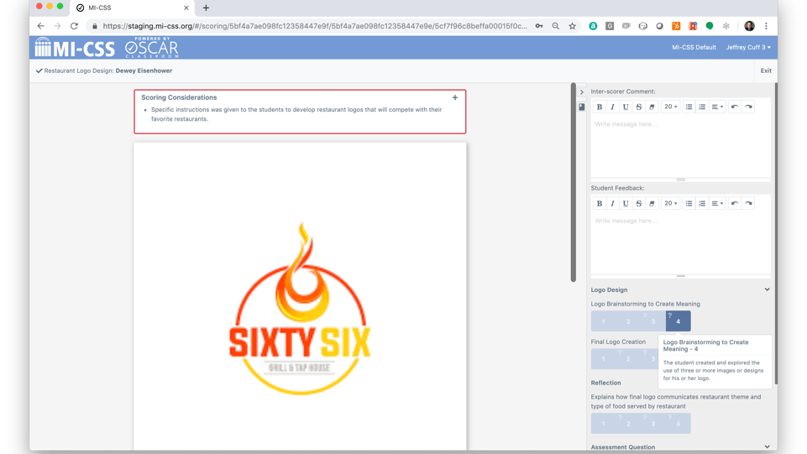
A.
H.
D.
B.
F.
C.
E.
G.
Notes:
From the Scoring window there are several areas of interest:
Assignment Name and Student Name
Scoring Considerations – Customized notes from the teacher who administered the assessment that may provide additional insight on the specific assessment for 2nd and Resolution scorers
Student work to be scored - Be certain to scroll down to ensure you are able to review the complete submission or multiple artifacts for scoring
Inter-scorer Comment – Area to provide comments about the score(s) provided available for other scorers to review and collaborate on reports
Student Feedback – Area to provide comments about the score(s) provided available for the student and on the student report
Show Item Resources – Click on the bookmark page icon to expand a tab that displays available MAEIA resources that are relevant to the assessment as well as respective Exemplars for each score point where available
Scoring - Area to provide the score(s) as they relate to the associated rubric for each assignment
Note: “Hovering” or ”Rolling-over” a score point will provide a pop-up with additional information about the specific score point
Exit – Select Exit when you have completed your scoring activities or if you wish to pause scoring activities

Slide 45
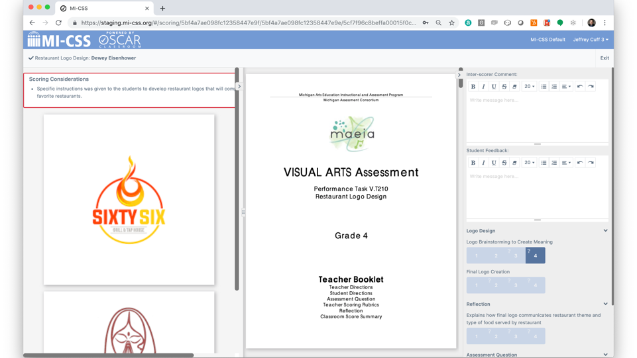
Notes:
For Scoring:
Review the uploaded artwork
Review any available comments from other scorers
Review Scoring Considerations
Review and necessary Resources including available Exemplars
Finally, after carefully reviewing the Teacher Scoring Rubric apply score(s)
Select the green checkmark at the bottom of the scoring column to submit the score

Slide 46
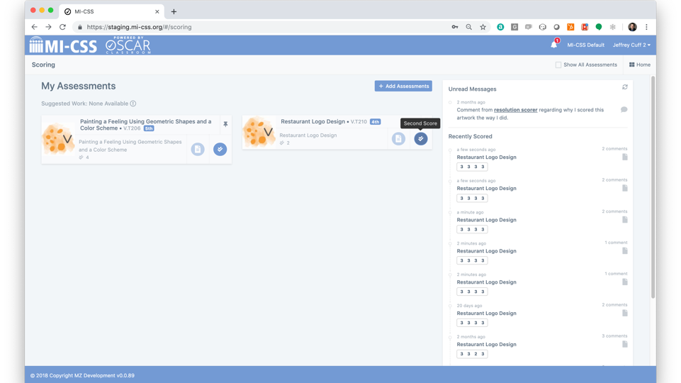
Notes:
For 2nd Scoring (after successfully creating account)
Select Second/Resolution Scoring from the Landing page
Select +Add Assessment or choose a Suggested Work assessment from the list populated at the bottom of the screen
The Suggested Work list is populated with existing assessments that have been created by Teachers and match the criteria submitted as part of your MI-CSS registration
Select the Second Score icon (checkbox) on any assessments listed under My Assessments
For Second Scorers, this is the only option, for Resolution Scorers, select between Second Score or Resolution form the dropdown list
Follow the Teacher Scoring instructions for actual scoring

Slide 47
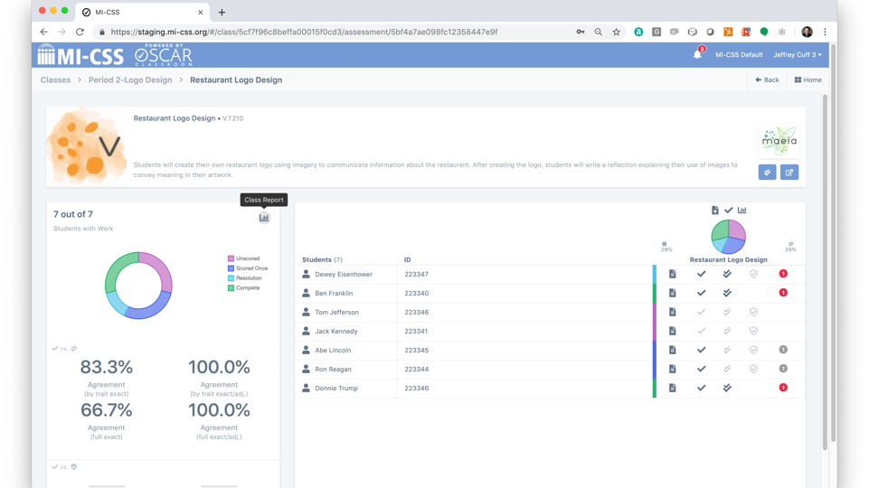
Notes:
From the Assessment window, select the graph icon in the upper right-hand corner of the reporting tile

Slide 48
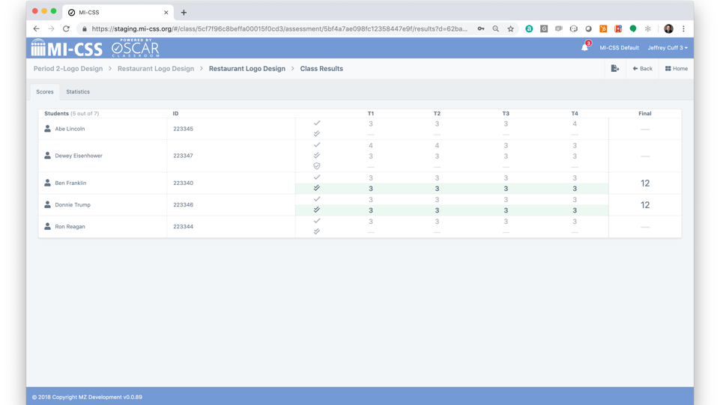
Notes:
Scores Report – Provides an overview of all completed student scored work
Selecting any individual student provides a detailed review of the scores applied by each scorer and the scoring comments provided

Slide 49
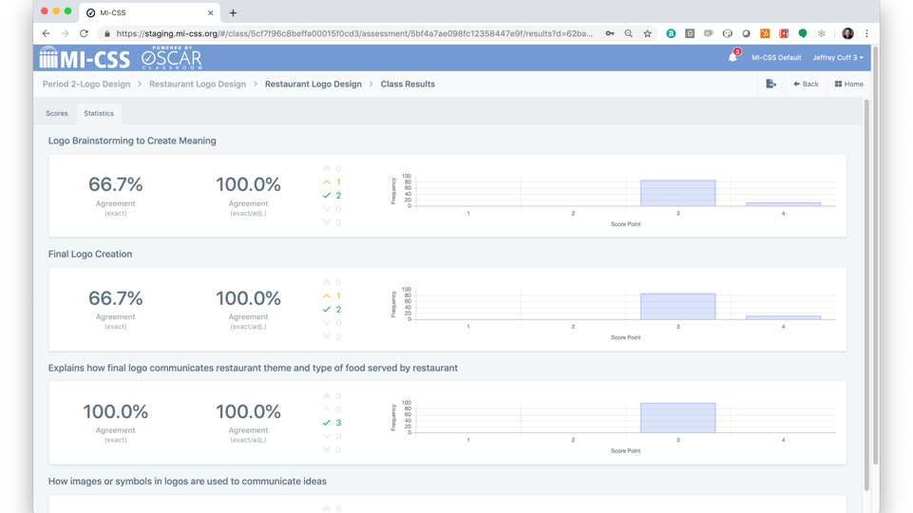
Notes:
Statistics Report – Provides insights on the score distribution across the different dimensions and score points

Slide 50
So What?

Slide 51
MAEIA Institute: June 22-Aug 3
One page talking-points specific to each of the MAEIA resources used in demonstrating educator effectiveness
A virtual experience with flexibility for summer travel and 1 f2f meeting

Slide 52
Contact Us
MAEIA Project
517-816-4520
maeia.artsed@gmail.com
Heather Vaughan-Southard
hvsouthard@gmail.com

