Slide 1



Creating and Implementing Online Learning Lessons with Student Engagement in Mind
June 16, 2020
Notes:
Kim Add FAME logo

Slide 2

Welcome and Webinar Reminders
Mute your audio if lines are open
Turn off your video to save bandwidth
Use the chat feature to post thoughts and ask questions
This session and breakouts will be recorded (including all use of the Chat)
Notes:
Kim

Slide 3
Session Outcomes
1
2
3
Understanding of what makes effective learning plans
Increased awareness of online learning strategies that engage students
Appreciation for the role planning plays in the delivery of online lessons
Notes:
Kim

Slide 4
How does FAME define the formative assessment process?
“Formative assessment is a planned, ongoing process used by all students and teachers during learning and teaching to elicit and use evidence of student learning to improve student understanding of intended disciplinary learning outcomes and support students to become more self-directed learners.”
(CCSSO FAST SCASS, revised June 2017)
Notes:
Ellen

Slide 5
Thinking back and moving forward

Slide 6
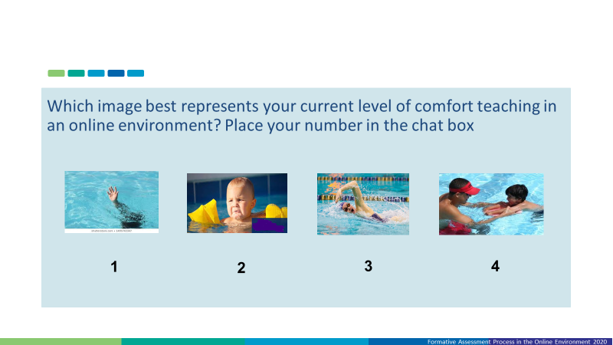
Think back on Session 1 April 23rd..

Slide 7
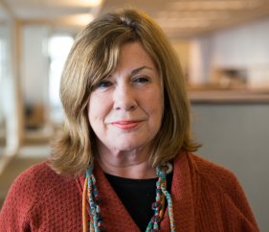
In the chat box…
In a few words, how would you describe your current state of providing online learning?
Margaret Heritage reminds us……
“Making major changes does not necessarily mean that teachers need to learn afresh how to teach. Instead, they need to use their existing skills and knowledge differently for a new purpose.”

Slide 8
Session Expectation
Select one of three groups. Each has a unique connecting link
  Elementary: Theresa Moore
  Middle School – Donna Wright
  High School – Lindsey Howe/Jay Schreur
Facilitated by FAME Lead and MAC Tech Support
End today’s webinar in a breakout

Slide 9
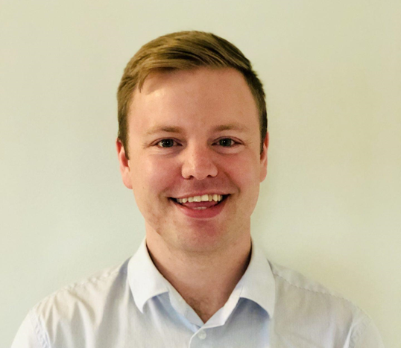
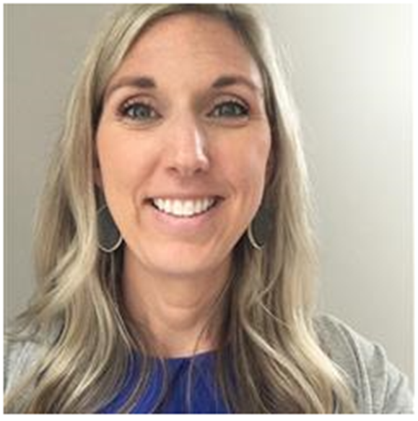
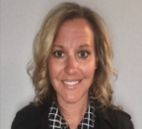
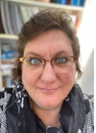
Michigan Great Lakes Academy
Notes:
Kim

Slide 10
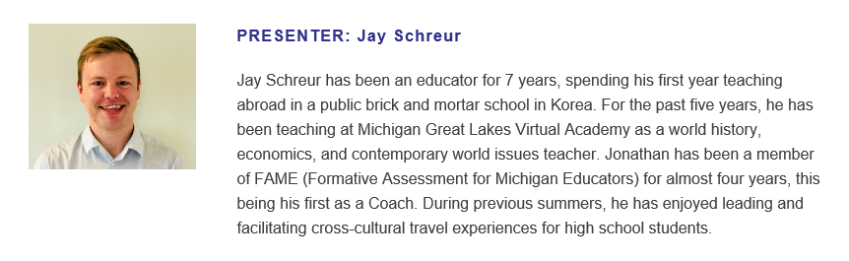

Slide 11
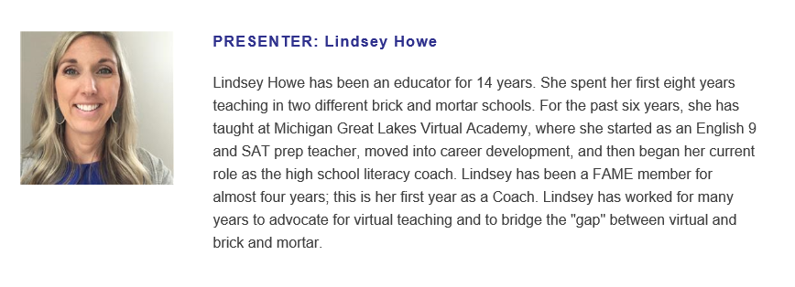

Slide 12
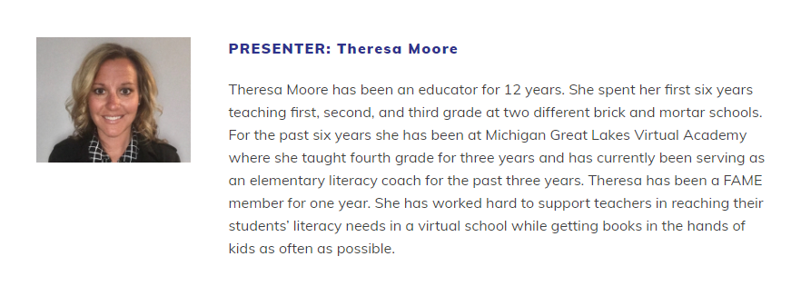

Slide 13
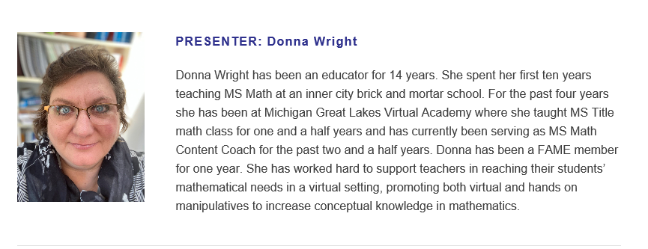

Slide 14

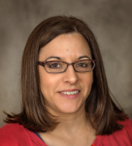




MAC & FAME

Slide 15

Classroom Code
Be an active participant
Be respectful
Be prompt
Be thoughtful in providing feedback

Slide 16
Transition

Slide 17

Introduce in the Chat Box
Who are you?
What do you do?
In what district do you work?

Slide 18
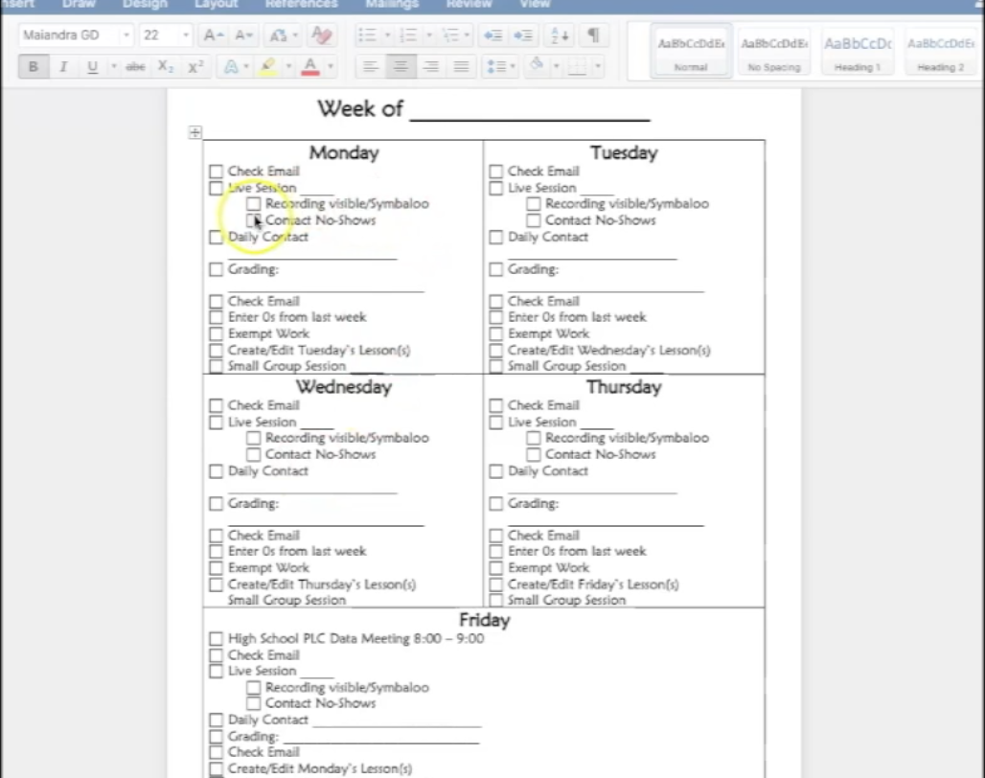
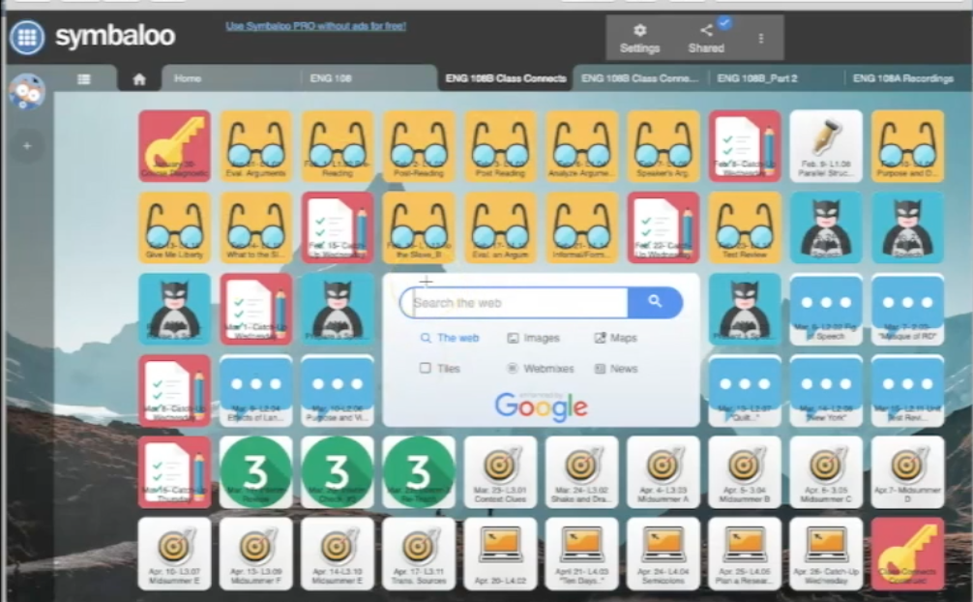
Organization
What are some other ways that you organize your day?
Notes:
https://padlet.com/MACandFAME/ts7clqa67c5xkz8h

Slide 19
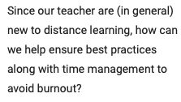
Avoiding Burn-out
Structure each day.
Rely on one’s PLC.
Use lesson templates
What is your district doing/considering?

Slide 20
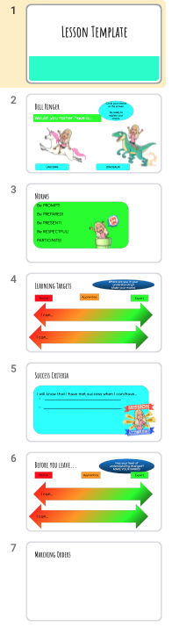
Lesson Planning (setup of lessons)
How has lesson planning changed for you as you have settled into virtual instruction?
Notes:
https://docs.google.com/presentation/d/1fbNVlL6ydU6hrPhvIhkHS2gis63AeRQNeFdxopPkcVE/edit?usp=sharing

Slide 21
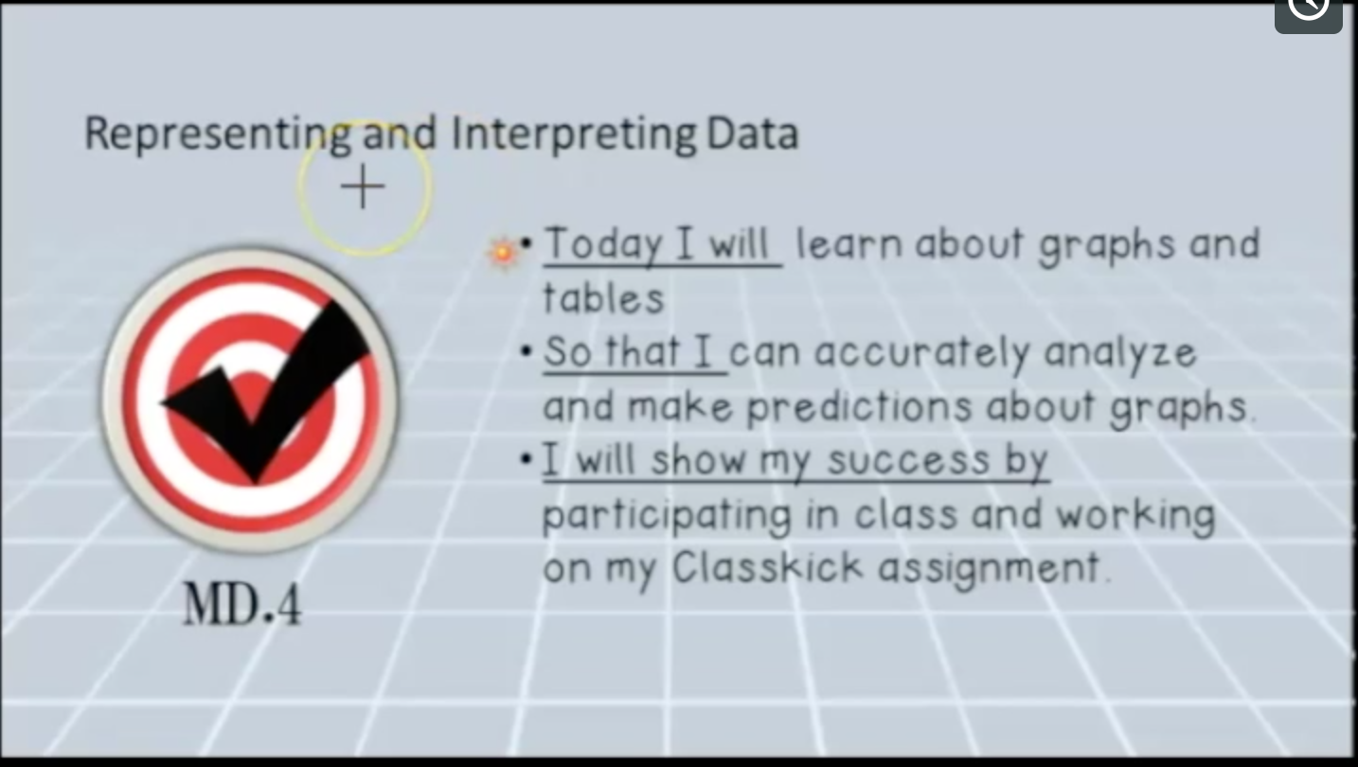
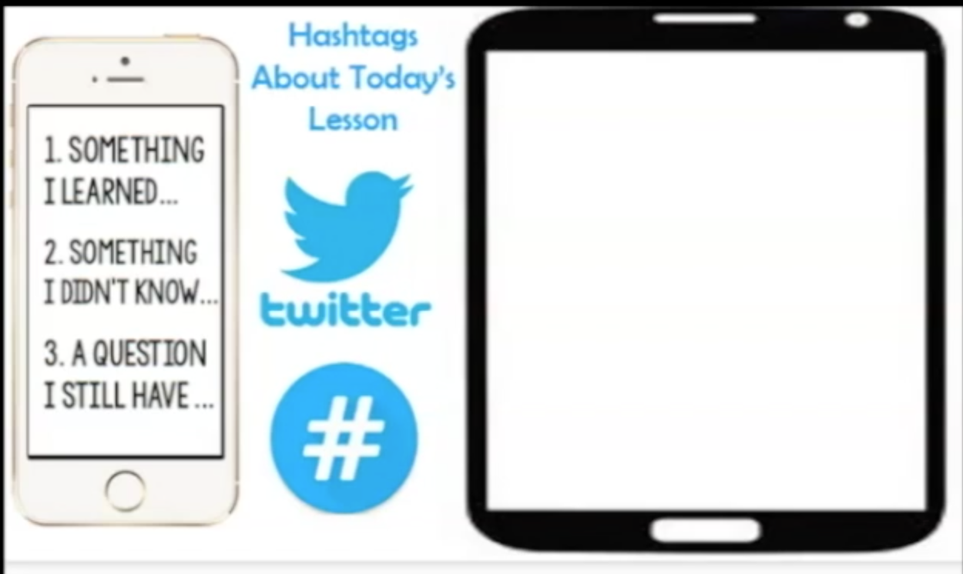
Learning Targets
How have you seen learning target use change in this new teaching environment?
What questions might this bring up?

Slide 22
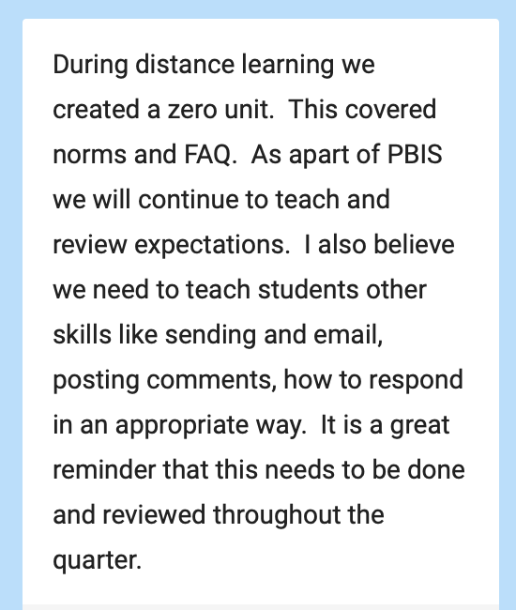
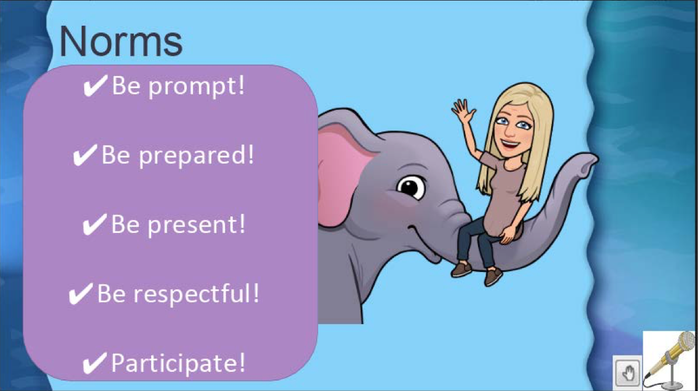
Session Expectations
What are some other ways your district has been addressing classroom expectations?
Response for consideration

Slide 23
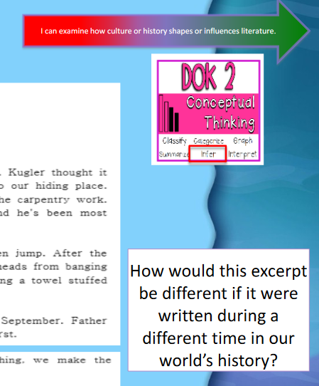
Incorporating Depth of Knowledge in Live Sessions
How can you incorporate
different DOK levels within your
live sessions?

Slide 24
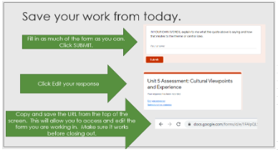
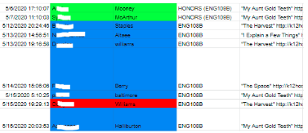
Collection of Quality Evidence
What tools and activities might provide evidence of student achievement in your live classes?

Slide 25

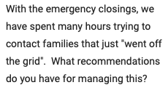
Contacting Students
What tools and methods are you thinking about in regards to staying in contact with students?

Slide 26

High School Breakout Room
This time is set aside for you to ask questions regarding distance learning in high school.
What questions might you have?

Slide 27
Webinar Location
Once the webinar is finished and rendered, it will be uploaded to the MAC website and available for viewing.
Don’t forget to check out the other valuable resources on the MAC website:
  https://www.michiganassessmentconsortium.org
and the FAME website:
  https://famemichigan.org
Notes:
Kathy

Slide 28
Thank you!
Thank you to all of you for joining us this afternoon; we appreciate your involvement today and throughout the series
Thanks to Wayne RESA and
Special thanks to Michigan Great Lakes Virtual Academy.
Notes:
Kathy

Slide 29
Exit Ticket
Respond in the chat box to the following prompt:
Notes:
Ellen

Slide 30
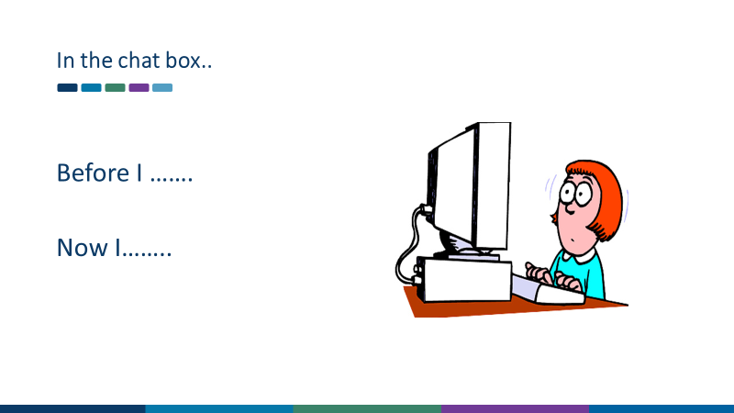

Slide 31
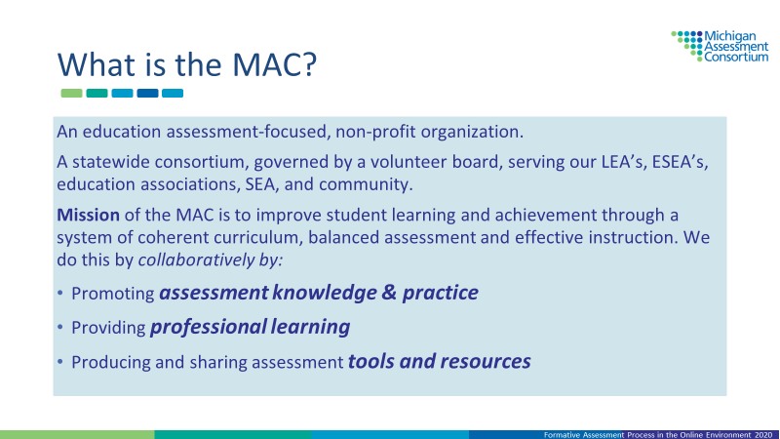

Slide 32
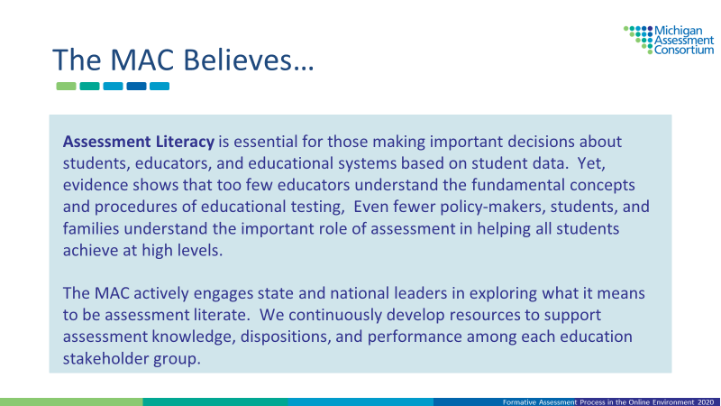

Slide 33
