Slide 1
Creating and Implementing Online Learning Lessons with Student Engagement in Mind
June 16, 2020
Notes:
Kim Add FAME logo

Slide 2
Welcome and Webinar Reminders
Mute your audio if lines are open
Turn off your video to save bandwidth
Use the chat feature to post thoughts and ask questions
This session and breakouts will be recorded (including all use of the Chat)
Notes:
Kim

Slide 3
Session Outcomes
1
2
3
Understanding of what makes effective learning plans
Increased awareness of online learning strategies that engage students
Appreciation for the role planning plays in the delivery of online lessons
Notes:
Kim

Slide 4
How does FAME define the formative assessment process?
“Formative assessment is a planned, ongoing process used by all students and teachers during learning and teaching to elicit and use evidence of student learning to improve student understanding of intended disciplinary learning outcomes and support students to become more self-directed learners.”
(CCSSO FAST SCASS, revised June 2017)
Notes:
Ellen

Slide 5
Thinking back and moving forward

Slide 6
Think back on Session 1 April 23rd..

Slide 7
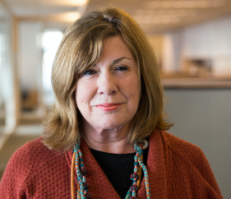
In the chat box… In a few words, how would you describe your current state of providing online learning?
Margaret Heritage reminds us……
“Making major changes does not necessarily mean that teachers need to learn afresh how to teach. Instead, they need to use their existing skills and knowledge differently for a new purpose.”

Slide 8
Session Expectation
Select one of three groups. Each has a unique connecting link
Elementary: Theresa Moore
Middle School – Donna Wright
High School – Lindsey Howe/Jay Schreur
Facilitated by FAME Lead and MAC Tech Support
End today’s webinar in a breakout

Slide 9
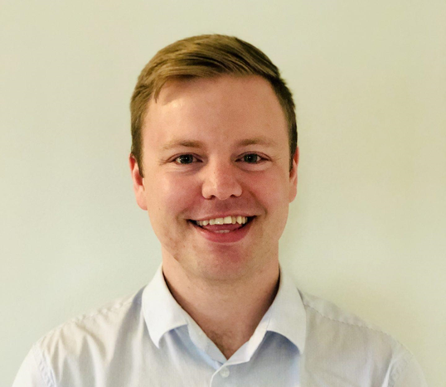
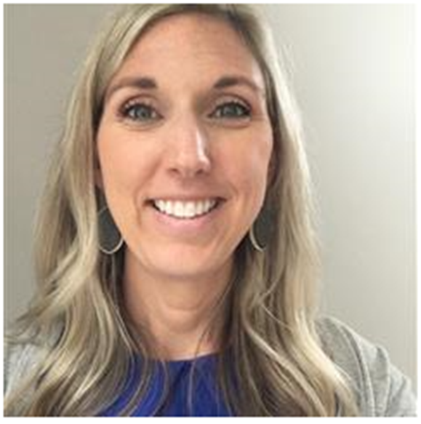
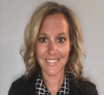
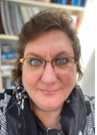
Michigan Great Lakes Academy
Notes:
Kim

Slide 11
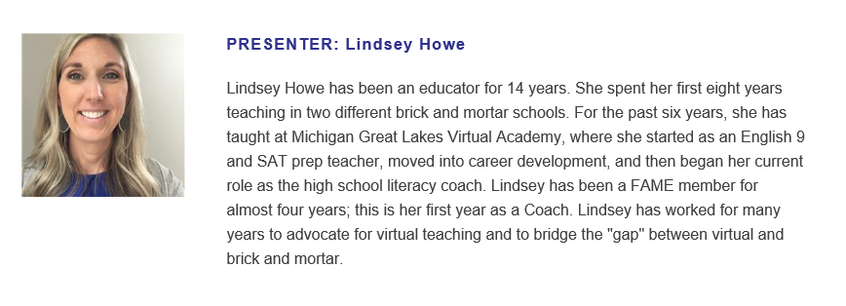

Slide 12
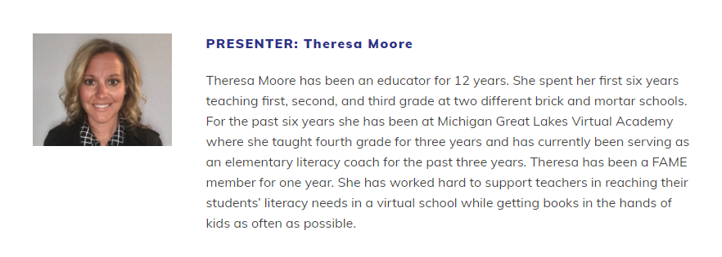

Slide 13
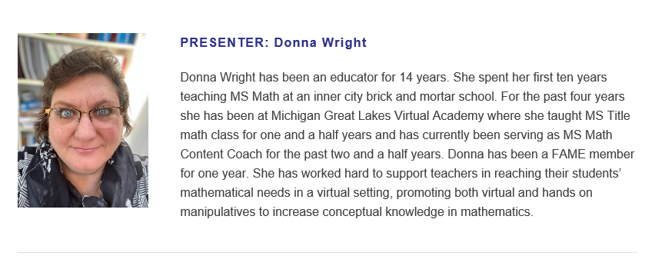

Slide 14
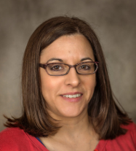
MAC & FAME

Slide 15
Classroom Code
Be an active participant
Be respectful
Be prompt
Be thoughtful in providing feedback

Slide 16
Transition

Slide 17
Introduce in the Chat Box
Who are you?
What do you do?
In what district do you work?

Slide 18
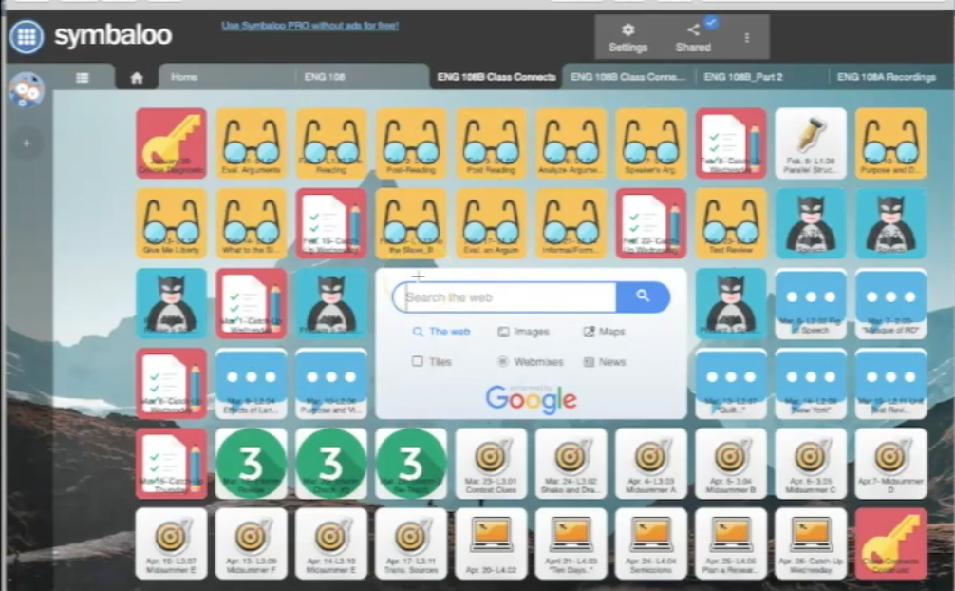
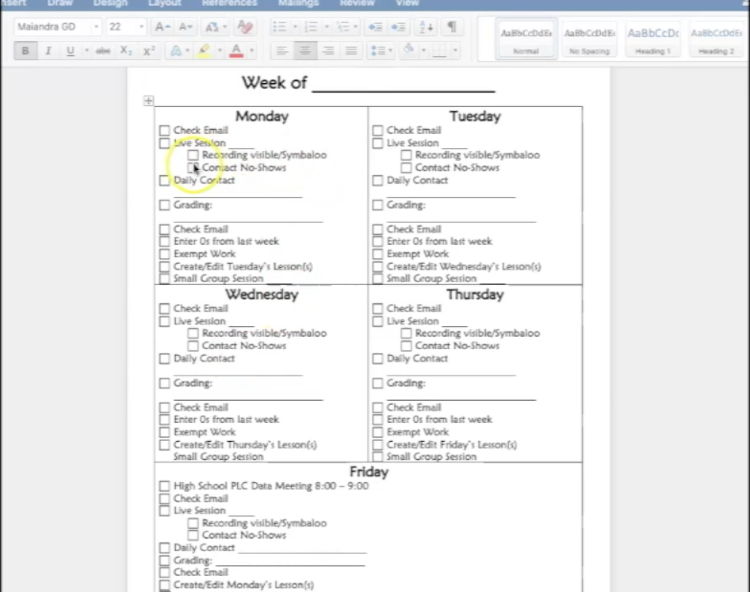
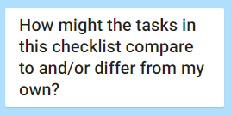
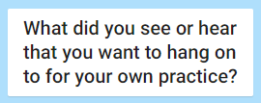
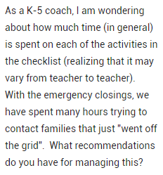
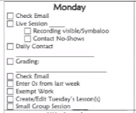
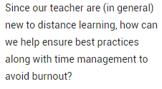
Organization
Similar to lesson plans.
Schedule on the whiteboard.
Crucial to ensure things are getting done and time management.
Extremely important to have a system. (teachers and students)
Weekly, daily (allow time for planning, parent contact, email, professional learning)
Notes:
https://padlet.com/MACandFAME/ts7clqa67c5xkz8h
Question: As a K-5 coach, I am wondering about how much time (in general) is spent on each of the activities in the checklist (realizing that it may vary from teacher to teacher). With the emergency closings, we have spent many hours trying to contact families that just "went off the grid". What recommendations do you have for managing this? Since our teacher are (in general) new to distance learning, how can we help ensure best practices along with time management to avoid burnout?
Question from Lindsey - What are some other ways that you organize your day?

Slide 19
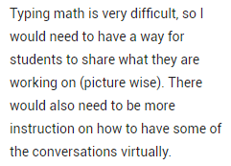
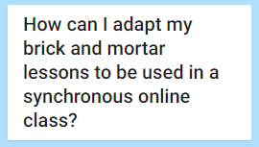
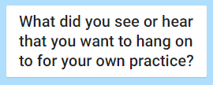
Lesson Planning (setup of lessons)
Be flexible!
Waterfall with student responses.
Clear goals of lesson.
Road to mastery.
Think outside the box.
Turn and talk.
Self Assessment.
List of strategies for student evidence.
Tech tools that help you reach your learning target.
Learning targets, students self assess.
Practice, practice, practice!
Courage
Interactive: Classkick, Seesaw, Padlet
Notes:
https://padlet.com/MACandFAME/4kgobnlyt1318s0s
https://docs.google.com/presentation/d/1fbNVlL6ydU6hrPhvIhkHS2gis63AeRQNeFdxopPkcVE/edit?usp=sharing – lesson plan template from a previous webinar.
Question:Typing math is very difficult, so I would need to have a way for students to share what they are working on (picture wise). There would also need to be more instruction on how to have some of the conversations virtually.
Struggling with efficient ways to get kids talking in BOR’s. –model and practice and do more of it – have some type of assignment/task to check their work – reach out after if not completed – extra accountability piece.
Lindsey Question - How has lesson planning changed for you as you have settled into virtual instruction?

Slide 20
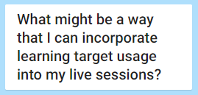
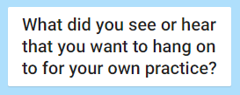
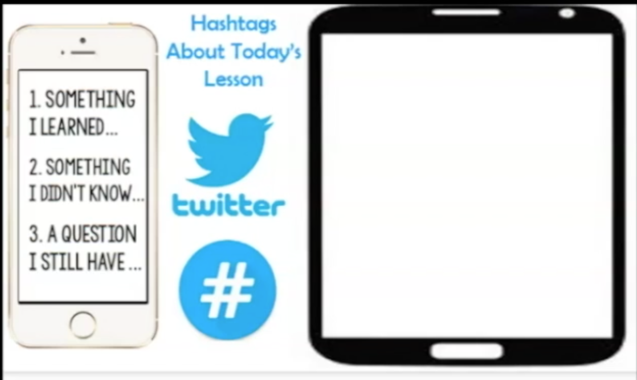
Learning Targets
Administrator – holding PD’s.
Coach – PLC’s.
Self assess before and after.
Visual reminder helps with focus of kids and teacher.
“Why I need this” – helps buy in and students understand why they are learning.
“Why I need this”.
Explain to students the success criteria.
Arrow visual with colors is a continuum and more than a “got it” or “not”.
PD needed around Learning Targets and Success Criteria.
Referencing more than once in a lesson.
Notes:
https://padlet.com/MACandFAME/n8no880k3fqu8gb7
Lindsey question - How have you seen learning target use change in this new teaching environment? What questions might this bring up?

Slide 21
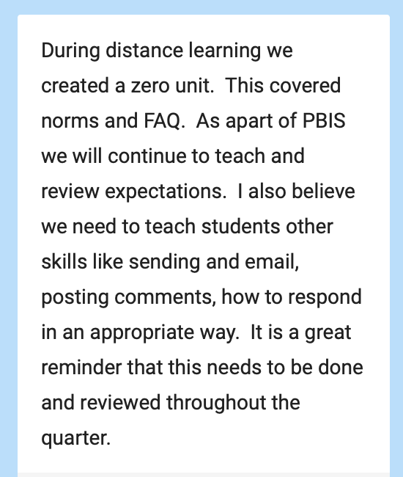
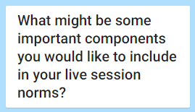
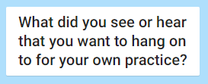
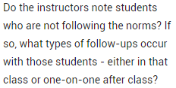
Session Expectations
Response for consideration
Students reading learning targets/norms.
School wide norms for parents with multiple siblings.
Consistent – behaviors must be taught and reinforced.
LEARN acronym.
Mic, raise hand, participate.
Distraction free (family).
Safe space-routines and expectations.
Go over norms in every session.
Notes:
https://padlet.com/MACandFAME/difx31ecrqyzgush
Do the instructors note students who are not following the norms? If so, what types of follow-ups occur with those students - either in that class or one-on-one after class?
Question from Lindsey - What are some other ways your district has been addressing classroom expectations?

Slide 22
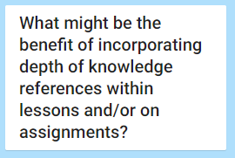
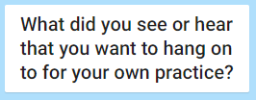
Incorporating Depth of Knowledge in Live Sessions
Visual snips are helpful.
LT and DOK snips are reminders in lesson and place value on the learning.
DOK snip can also show how quick a question might be answered.
Instructional coach – use this to share with teachers after observations – level of questions in their class.
Make sure teachers are asking a variety of leveled questions.
Challenges students.
Visual is a good reminder of what we are working on.
Emphasis on thinking and learning versus completion.
Students know expectations.
Notes:
https://padlet.com/MACandFAME/qm3aoojyj7qd5zj4
Lindsey question - How can you incorporate
different DOK levels within your
live sessions?

Slide 23
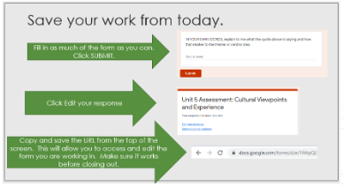
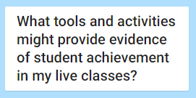
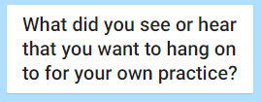
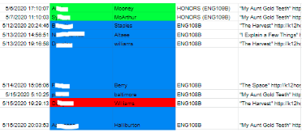
Collection of Quality Evidence
Google forms
Padlet
Google slides
Desmos
Jamboard
Ed Puzzle
Pear Deck
Flipgrid
BOR’s
Classkick
Structure of the lesson.
Notes:
https://padlet.com/MACandFAME/b58qorpzjzlx6x7c
From Lindsey: What tools and activities might provide evidence of student achievement in your live classes?

Slide 24
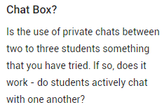
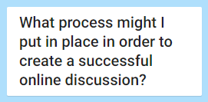
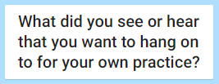
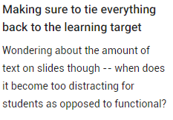
Creating Online Discussions
No matter the platform, clear expectations are a must!
Protocols-discussion prompts, sentence starters.
Structure
Templates
Discussions can be video chat or commenting.
Students must feel safe and comfortable to share.
Discussions can be less formal than a Zoom session. (Padlet)
Procedures and expectations are crucial for online discussions.
Notes:
https://padlet.com/MACandFAME/o1wibxf5bicnaag8
Lindsey - What tools and methods are you thinking about in regards to staying in contact with students?

Slide 25
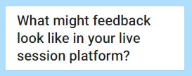
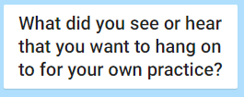
Providing Feedback in Live Sessions
Needs to be specific and moving student towards the target.
Classkick recording option.
Push students in their thinking by asking targeted questions.
Varied – video and typing
Mic, chat, Zoom
Immediate feedback and clear.
Notes:
https://padlet.com/MACandFAME/s134xcbxafmipeo7

Slide 26
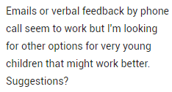
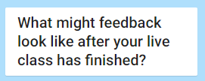
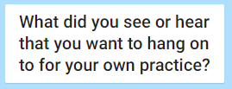
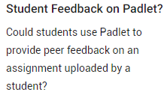
Providing Feedback Outside of Live Sessions
Google Classroom
Email
Phone call
Written and verbal depending on the grade level.
Video of teacher works better than written feedback.
Grading scale with feedback.
Want to check out Classkick.
Padlet
A tool that is easy to use and teachers incorporate into regular practice.
Stickers
Needs to be more than, “good job”.
Mote – audio recording
Notes:
https://padlet.com/MACandFAME/cl8lyz0lfxe7cya9

Slide 27
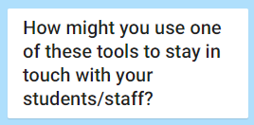
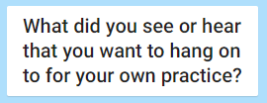
Contacting Students
Google Voice can be used via computer, not just phone.
Give the students more than one way to contact the teacher.
Class Dojo
Google Voice
Remind 101
Bloomz
Email
Notes:
https://padlet.com/MACandFAME/zkiofhiw4947m2zv
Lindsey question - What tools and methods are you thinking about in regards to staying in contact with students?

Slide 28
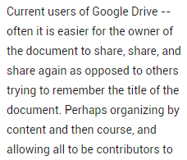
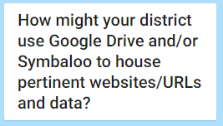
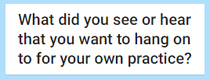
Lesson/Data Housing
Google Drive – need more PD
Symbaloo
Google Suite
Shared drive of some kind is a must!
Symbaloo – want to look into it more.
Enjoy learning about other options.
Notes:
https://padlet.com/MACandFAME/nl9a3n7ebjxsciwd

Slide 29
Elementary Breakout Room
This time is set aside for you to ask questions regarding distance learning at the elementary school level.
What questions might you have?

Slide 30
What questions might you have?

Slide 31
Webinar Location
Once the webinar is finished and rendered, it will be uploaded to the MAC website and available for viewing.
Don’t forget to check out the other valuable resources on the MAC website:
https://www.michiganassessmentconsortium.org
and the FAME website:
https://famemichigan.org
Notes:
Kathy

Slide 32
Thank you!
Thank you to all of you for joining us this afternoon; we appreciate your involvement today and throughout the series
Thanks to Wayne RESA and
Special thanks to Michigan Great Lakes Virtual Academy.
Notes:
Kathy

Slide 33
Exit Ticket
Respond in the chat box to the following prompt:
Notes:
Ellen

