Slide 1
EARLY LITERACY ASSESSMENT SYSTEM (ELAS) PROJECT
OVERVIEW
A project commissioned by Michigan Department of Education and coordinated by Michigan Assessment Consortium

Slide 2
Overview Objectives
1
2
3
4
Understand purpose of the ELAS project and the project design
Understand relationship of this project to other literacy initiatives in Michigan
Obtain some foundational understanding about assessment systems & literacy development
Review format and Content of full Guide

Slide 3
THE PURPOSE
1

Slide 4
Support development of district early literacy assessment systems (ELAS) that promote Learning
Curriculum
Improved Literacy
Assessment
Instruction
Notes:
Across Michigan, it is recognized that literacy rates among our students should be better than they are. At the same time, there is recognition that improved literacy requires focused attention at all levels of development and instruction, but most critically on early literacy development.
We have excellent foundation and momentum to improve literacy instruction in the state.
We lack an understanding of the role assessment plays in supporting learning.
Districts are required by law to implement “assessment systems” that should help to improve literacy rates, however…a collection of assessments and an assessment system are not the same thing.
There is a need for assessment literacy support that enables educators at all levels to implement assessment systems that improve literacy achievement for Michigan’s children.

Slide 5
THE RELATIONSHIPS
2

Slide 6
Excellent Foundation to Improve Literacy Instruction and Assessment Practice
MAISA/GELN
Early Literacy Task Force
Notes:
Fortunately, we have an excellent foundation and momentum to improve literacy instruction in the state, led in large part by the Michigan Department of Education (MDE) and the Literacy Essentials work developed and supported by the Michigan Association of Intermediate School Administrators (MAISA) General Education Leadership Network (GELN) Early Literacy Task Force (ELTF). The Literacy Essentials offer a Literacy Theory of Action and undergirds an active program of professional learning across Michigan. The Michigan Assessment Consortium provides leadership and services to advance quality, balanced assessment practices and systems through research, resources, and professional learning. The FAME program is a professional learning initiative jointly offered by MDE and MAC. For more than a decade, FAME has promoted teacher collaboration and planning for effective formative assessment practice.

Slide 7
ELAS Principal Contributor Group
Jim Pellegrino
Learning Sciences Research Institute – Co-Director
Ed Roeber
Michigan Assessment Consortium- Assessment Director
Kathy Dewbury-White
MAC/CEO
Brandy Archer
Michigan Department of Education- Literacy Manager
Adrea Truckenmiller
Michigan State University- Assistant Professor
AnneMarie Palinscar
University of Michigan- Professor
Miranda Fitzgerald
University of Michigan
Post Doc Fellow
Nell Duke
University of Michigan- Professor
Eunsoo Cho
Michigan State University- Assistant Professor
Tanya Wright
Michigan State University- Associate Professor
Amy Colton
Center for Collaborative Inquiry- Director
Learning Forward Michigan-Executive Director
Linda Wacyk
MAC
Communications
Melissa Usiak
Michigan State University- Assistant Professor
Michigan ASCD- Executive Director
Notes:
Principal Contributors brought to this project a wide range of expertise in cognitive science, educational assessment, literacy development, professional learning, and organizational development. Principal Contributors were responsible for researching, drafting, reviewing, and revising all content in this Guide.
The group is chaired by Jim Pellegrino, Ph.D., Distinguished Professor of Psychology and Education, and Co-director of the Learning Sciences Research Institute at the University of Illinois at Chicago.
Jim Pellegrino (chair), Co-Director, Learning Sciences Research Institute
Brandy Bugni, Literacy Manager, Michigan Department of Education (MDE)
Eunsoo Cho, Assistant Professor, Michigan State University
Amy Colton, Executive Director, Learning Forward - MI
Kathy Dewsbury-White, CEO, Michigan Assessment Consortium (MAC )
Nell K. Duke, Professor of Education; University of Michigan
Miranda Fitzgerald, Assistant Professor in Reading and Elementary Education, University of North Carolina-Charlotte
Annemarie Palinscar, Chair, Educational Studies, Professor of Education , University of Michigan
Ed Roeber, Assessment Director, MAC
Adrea Truckenmiller, Assistant Professor, Michigan State University
Melissa Usiak, Executive Director, MI-ASCD
Linda Wacyk, Communications/Publications Director, MAC
Tanya Wright, Associate Professor, Michigan State University

Slide 8
Responder Group
Michelle McManus, MDE
Nikki Mosser, MDE
Julie Murphy, MDE
Liz Newell, MDE
Naomi Norman, Washtenaw ISD
Jen Orton, West Shore ESD
Jeannine Oynoian, Dearborn Public Schools
Sarah Scott, MI EXCEL Statewide Field Team, Calhoun ISD
Susan Townsend, MAISA
Mindy Westra, MDE
Mellissa Wilson, Wayne RESA
Kim Young, MDE
Nadra Shami, Dearborn Public Schools
Rashell Bowermann, MDE
Lisa Brown, MDE
Erin Brown, MAISA
Kelli Cassaday, MDE
Grant Chandler, Calhoun ISD
Steve Goodman, MIBLSI
Kristine Griffor, Troy School District
Tom Johnson, Kalamazoo RESA
Noel Kelty, MDE
Dave Krebs, MAISA
Sean LaRosa, MIBLSI
Cheyne LeVasseur, MIBLSI
Paul Liabenow, MEMSPA
Brian Lloyd, MDE
Lisa Lockman, Wexford- Missaukee ISD
Notes:
In addition to the Principal Contributors, a Responder Group also provided feedback on the design and development of the Guide.

Slide 9
Early Literacy Assessment System Process
Literacy Assessment
Assessment Systems
Literacy Instruction
Principal Contributors
Responder Group
Researchers
Literacy
Assessment
Systems
First line users of the state guidance
Drafts were created, shared, and revised between the groups until complete.
Step 1: Bring together the knowledge needed to design early literacy assessment systems.
Step 2: Use a process that builds shared knowledge while gathering usability feedback.

Slide 10
FOUNDATIONAL UNDERSTANDING
3

Slide 11
Assessment Systems
Literacy
Curricula
Unit & Lesson
Planning
Focus on important aspects of literacy and its development
Serve the needs of different stakeholders
Are conceptually and operationally coherent
Daily Classroom Instruction
Local Summative (& Interim) Assessment
Classroom Interim & Summative Assessment
Ongoing Formative Assessment
Notes:
As we shall point out, assessment systems are much more than arbitrary collections of assessments; the components of such systems must be carefully chosen so that they:
focus on important aspects of literacy and its development,
serve the needs of different stakeholders, and
are conceptually and operationally coherent.

Slide 12
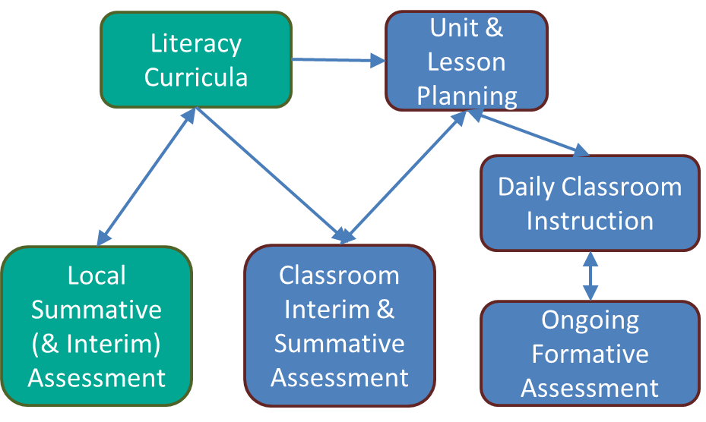
a collection of assessments does not entail a system
any more than a pile of bricks constitutes a house
~Coladarci, 2002
Notes:
It is essential to note that “a collection of assessments does not entail a system any more than a pile of bricks constitutes a house” (Coladarci, 2002).

Slide 13
Building Analogy
Items Needed to Build a House
Site Plan
Blueprint
General contractor
Materials
Skilled craftsmen
Items Needed to Build an Assessment System
System approach
Design architecture
Literacy development expertise
Assessment tools & processes
Professional learning and support
Notes:
The system must be composed of elements that work together in terms of the intended functions and interpretive uses. Let’s use the analogy of building a house. Before you begin building you need to have a blueprint drawn up. When building an assessment system you need to develop a plan. Next you need the materials such as bricks, boards, etc. In an assessment system you need to have the actual assessments that will be used. Once you have the blueprint and materials you need a general contractor to oversee and organize the work. In an assessment system this would be the leadership team that would oversee and organize the system. Lastly but definitely not least when you begin the actual building of the house you need skilled labor such as plumbers, carpenters, etc. When implementing an assessment system you need a skilled team of teachers and administrators to administer the assessments and analyze the results.

Slide 14
FORMAT AND CONTENT OF GUIDE
4

Slide 15
The Guide
Foundation for the development of:
Policy
Resources
Professional Learning Opportunities
Notes:
This Guide is intended to serve as the foundation for the development of policy, resources, and professional learning opportunities that serve to outline assessment systems and practices that effectively support literacy development.

Slide 16
Structure of The Guide
Introduction | Section I Principles & Recommendations for Developing an ELAS | Section II Principles in Action | Section III Research & Supporting Science | Glossary & References
Challenge Purpose of Guide Critical Assumptions Theory of Action Who Will Find this Guide Helpful? Early Literacy in SOM Structure of Guide | Background Principles & Recommendations: Three Phases Planning & Designing Implementing Supporting & Monitoring | How to learn from the Portraits Introduction to the 3 children Portraits of student experiences pre-K through Grade 2 Third Grade challenge | Necessary Conditions and Structures Assessment System Architecture Literacy Development & Learning Purposes, Users, and Technical Adequacy of Assessment Professional Learning Programs | Glossary of Key Assessment and Literacy Terms References for Introduction, Section I, and Sections III-1 through III-5 Landscape of Literacy Initiatives Across Michigan Contributors to the Guide
The “WHAT”
The “WHO”
The “WHY & HOW”
Notes:
This Introduction establishes the overall context for this Guide, including how it fits within the larger Michigan Literacy Theory of Action.
This Guide itself consists of three main sections, each of which can be read on its own to meet the needs and goals of different stakeholders. The three sections also complement each other in helping the reader to understand what an early literacy assessment system should include, how it might function, and whom it would serve, as well as several of the details associated with planning for, designing, implementing and supporting such a system.
Section I presents five key Organizing and Design Principles to guide districts in creating an Early Literacy Assessment System (ELAS). These five Principles need to be understood individually and collectively as districts work to create an ELAS. Each Principle includes a brief description of the major ideas that give rise to and necessitate adherence to that Principle in the design and implementation of an assessment system. The Principles are clustered in terms of three Implementation
Phases:
Phase I: Planning for and Designing an Early Literacy Assessment System
Phase II: Implementing an Early Literacy Assessment System
Phase III: Supporting and Monitoring an Early Literacy Assessment System
Each Implementation Phase concludes with Recommendations for action.
Section II features a series of Portraits that follow the literacy development of three children from pre-kindergarten through grade 2. The Portraits were designed to provide a rich, descriptive picture of early literacy development and its assessment that simultaneously highlights aspects of each of the five Organizing and Design Principles. In the Portraits, each child enters pre-K and continues their schooling journey with a unique array of cultural and linguistic backgrounds and experiences, interests, assets, and literacy-learning needs.
Section III contains five chapters, each of which provides relevant research and supporting science related to one of the five major Organizing and Design Principles described in Section I and exemplified by aspects of the Portraits in Section II. Each chapter elaborates on key details and information that provide the background and justification for the related Principle and associated Recommendations provided in Section I. Each chapter ends with a list of suggested tools and resources that could support schools as they carry out the Recommendations described in the chapter.
The Guide concludes with a Glossary of assessment related terms, sets of References associated with the content of the Guide, and a brief description of the landscape of related literacy initiatives across Michigan.

Slide 17
Organizing and Design Principles
Phase I – Planning for and Designing an Early Literacy Assessment System (ELAS)
Phase II – Implementing an Early Literacy Assessment System (ELAS)
Phase III – Supporting and Monitoring and Early Literacy Assessment System (ELAS)
Principle #1: The ELAS must be designed to ALIGN AND INTEGRATE WITH ALL SCHOOL – AND DISTRICT-LEVEL SYSTEMS; this includes the systems of curriculum, instruction, professional learning, as well as the overall assessment system.
Principle #3: The ELAS must reflect what we know from theory, research, and practice about LITERACY DEVELOPMENT.
Principle #5: The ELAS must be supported and monitored by a sustained program of collaborative, inquiry-based PROFESSIONAL LEARNING and FEEDBACK.
Principle #4: The ELAS must reflect what we know about the PURPOSES, USERS, AND TECHNICAL ADEQUACY OF EARLY LITERACY ASSESSMENTS.
Principle #2: The ELAS must reflect ASSESSMENT SYSTEM DESIGN FEATURES that make it coherent, comprehensive, and continuous across time and contexts of use.
Notes:
The Guide represents the work of a diverse group of scholars and practitioners who have identified five key Organizing and Design Principles to guide districts in creating an Early Literacy Assessment System (ELAS) as seen in this chart. These five Principles can be understood individually and collectively as districts work to create an ELAS. Each Principle gives rise to a set of related Recommendations through Three Phases: planning & design, implementation, and support & monitoring of a district’s ELAS. The Principles and Recommendations are described in greater detail—and supported with suggested resources—in a full-length Guide available at www.MichiganAssessmentConsortium.org/ELAS. The next three slides show the recommendations for each phase.

Slide 18
Phase I
Principle 1:
The ELAS must be designed to ALIGN AND INTEGRATE with ALL SCHOOL and DISTRICT LEVEL Systems; this includes the systems of curriculum, instruction, professional learning as well as the overall assessment system.
Planning for Designing an Early Literacy Assessment System (ELAS)

Slide 19
Principle 1 – Necessary Conditions and Structures
District and school level conditions support coherent systems among:
Work needs to be integrated with other initiatives and is:
Complex
Long Term
Curriculum
Assessment
Instruction
PL
Intentional
Deliberate
Human capital is needed
Engage students and families in authentic ways
Leadership Team
Notes:
Big Ideas
Complex systems call for necessary conditions and structures that support coherence among Curriculum/Assessment/instruction/PL
Policies, procedures, and practices enable acquisition and use of appropriate resources
Coherence has implications for PL programs
District and school level conditions to support coherent systems among:
Curriculum
Assessment
Instruction
PL
Work is complex, long term, intentional, deliberate – needs to be integrated with other initiatives
Human capital needed, including composing a leadership team
Need to engage students & families in authentic ways

Slide 20
Phase I
Principle 2:
The ELAS must reflect ASSESSMENT SYSTEM DESIGN FEATURES that make it coherent, comprehensive, and continuous across time and contexts of use.
Planning for Designing an Early Literacy Assessment System (ELAS)

Slide 21
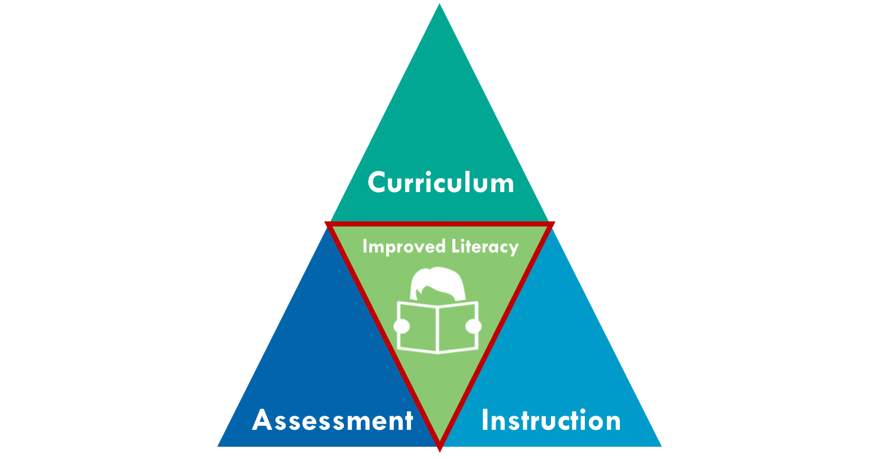
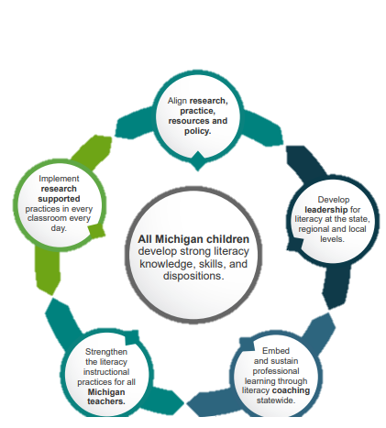
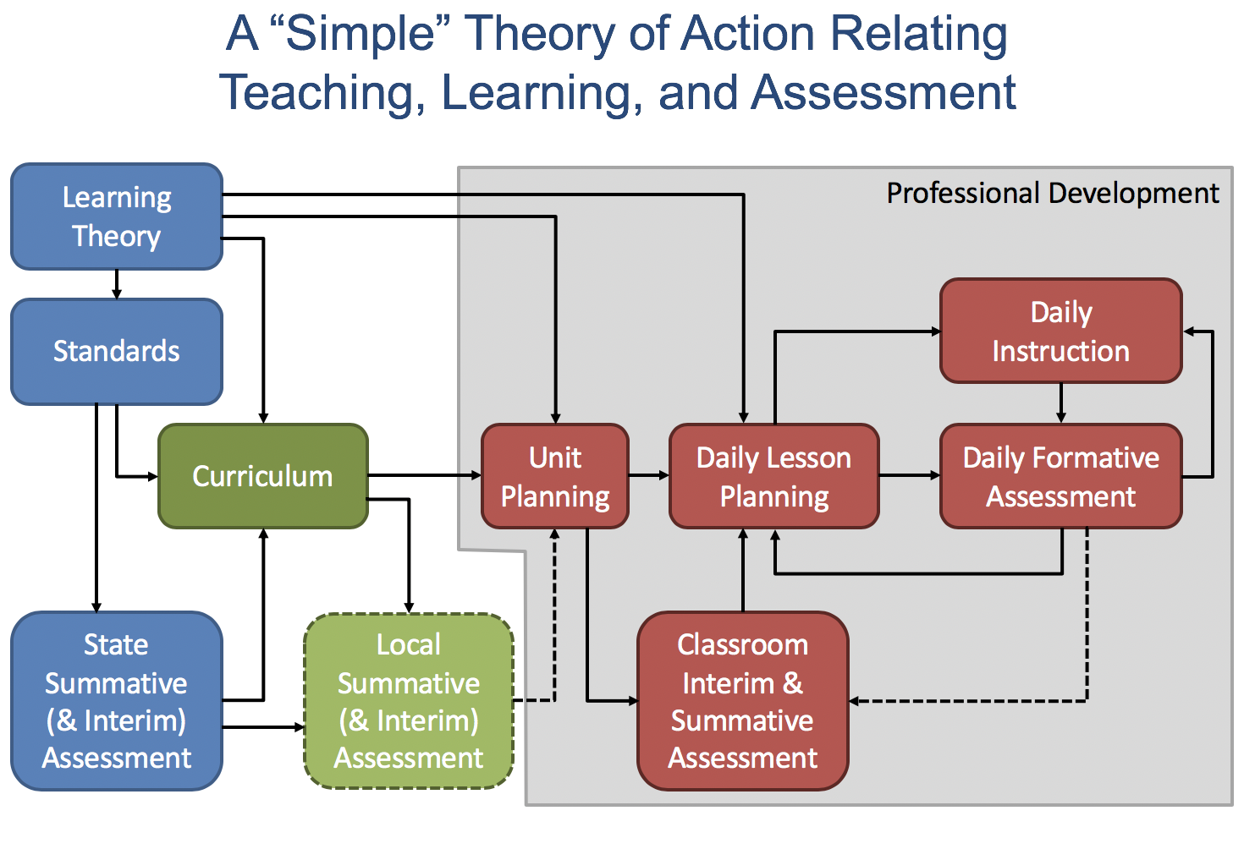
Principle 2- Assessment System Architecture
Assessment Triangle
Assessment Tools and Practices focus on Literacy Development
Observation
Interpretation
Cognition
3 Essential Design Principles to Having a “System”
The Role of a Theory of Action and a Logic Model
Comprehensiveness
Coherence
Continuity
Notes:
[I wonder if we can shorten the text on the slide, and add the detail to the notes]
BIG IDEAs:
Assessment is process of reasoning from evidence driven by cognitive models and data about key aspects of literacy development
A system is composed of multiple literacy assessments that are intentionally selected to work together.
Three design principles need to be followed to construct and operate a balanced system of literacy assessments.
Need to develop a theory of action and logic model to guide design, implementation and evaluation of the system of assessments
Chapter describes
The assessment triangle that represents the process of reasoning from evidence that underlies all assessments
The central role of theories, models, and data on literacy development in defining the foci of the assessment tools and practices within the system
The three major design principles — comprehensiveness, coherence, and continuity—essential to having a “system”
The role of a theory of action and a logic model to structure system development

Slide 22
Phase I – Planning and Design Recommendations
1.1. DISTRICT LEADERS should form an ELAS Leadership Team charged with guiding the Planning and Design, Implementation, and Support and Monitoring Phases of the ELAS.
The ELAS LEADERSHIP TEAM should:
1.2: Establish compatibility and coordination of the ELAS with other district- and state-level systems of curriculum, instruction, assessment, professional learning, and accountability.
1.3: Plan thoughtful strategies for engaging with families and the community as key participants in the ELAS process, both as contributors to and recipients of assessment data.
1.4: Develop and adopt a logic model and theory of action for the structure, functioning, and evaluation of the proposed ELAS.
Notes:
1.1. DISTRICT LEADERS should form an ELAS Leadership Team charged with guiding the Planning and Design, Implementation, and Support and Monitoring Phases of the ELAS.

Slide 23
Phase I – Planning and Design Recommendations
1.1. DISTRICT LEADERS should form an ELAS Leadership Team charged with guiding the Planning and Design, Implementation, and Support and Monitoring Phases of the ELAS.
The ELAS LEADERSHIP TEAM should: (continued)
1.5: Identify the educational decisions to be made, assessment information needed to support those decisions, and the stakeholder(s) who will be making the decision(s).
1.6: Construct a framework for the ELAS that includes clearly articulated relationships among the assessment tools and practices relative to a model of competency development in reading, writing, speaking, or listening.
1.7: Use the framework to conduct an audit of all existing district- and school-level assessment tools and practices currently in use to determine whether they meet criteria for inclusion and should remain part of the system.
Notes:
1.1. DISTRICT LEADERS should form an ELAS Leadership Team charged with guiding the Planning and Design, Implementation, and Support and Monitoring Phases of the ELAS.

Slide 24
Phase II
Principle 3:
The ELAS must reflect what we know from theory, research, and practice about LITERACY DEVELOPMENT.
Implementing an Early Literacy Assessment System (ELAS)

Slide 25
Principle 3 – Literacy Development and Learning
Eight required features of an ELAS:
1
2
3
4
Developmentally sensitive
Identifies receipt of quality instruction
Identifies risk factors
Yields information to equip teaching to strengths and challenges
5
6
7
8
Accounts for range of processes and factors explaining literacy achievement
Considers complexity and dynamic development of comprehension
Capitalizes on student interests
Applies an asset orientation
Notes:
Big Ideas
Literacy develops in multiple contexts
Literacy competencies are many and interconnected
Contemporary definitions of literacy reflect and require features of an early literacy assessment system that take into account 8 features

Slide 26
Phase II
Principle 4:
The ELAS must reflect what we know about the PURPOSES, USERS, AND TECHNICAL ADEQUACY OF EARLY LITERACY ASSESSMENTS.
Implementing an Early Literacy Assessment System (ELAS)

Slide 27
Principle 4 – Purposes, Users & Technical Adequacy of Assessment
A balanced assessment system includes:
Factors to consider when choosing assessment tools and practices
Assessment for Learning
Assessment of Learning
SYSTEM OF ASSESSMENTS
Users
Decisions
Technical Adequacy
Content
The formative assessment process involves teachers and students and occurs during the learning process
All of this happens within the context of literacy domains
Reading
Writing
Speaking
Listening
Notes:
Big Ideas
Different purposes for assessment
Users of assessment and decisions made informed by purpose
Shared understanding above and lack of clarity account for mis-use

Slide 28
Phase II – Implementation Recommendations
2.1 ELAS LEADERSHIP TEAM should use the logic model and theory of action (called for in Phase I) to guide the selection and implementation of assessment tools and resources for inclusion in the system.
To accomplish Recommendation 2.1, the ELAS LEADERSHIP TEAM, in collaboration with PRINCIPALS AND TEACHERS, should:
2.2: Select individual assessment resources on the basis of evidence of their capacity to provide construct-relevant and instructionally valuable information about a student’s literacy development and growth in a given literacy domain – reading, writing, speaking, or listening.
2.3: Select individual assessment resources on the basis of evidence that they are developmentally appropriate and respectful with regard to the cognitive, social, emotional, cultural, and performance demands they place on children.

Slide 29
Phase II – Implementation Recommendations
To accomplish Recommendation 2.1, the ELAS LEADERSHIP TEAM, in collaboration with PRINCIPALS AND TEACHERS, should:
(Continued)
2.4: Select individual assessment resources on the basis of evidence of appropriate levels of technical quality with respect to validity, reliability, and fairness given the intended interpretive use(s) and the potential consequences for students:
High-stakes judgments call for high levels of technical quality.
Lower stakes decisions require sufficient levels of technical quality
2.5: Provide assistance and guidance to the system’s various assessment users to help assure that they can select assessments that best meet their information needs and then use the results from those assessments in appropriate and technically defensible ways.

Slide 30
Phase III
Principle 5:
The ELAS must be supported and monitored by a sustained program of collaborative, inquiry-based PROFESSIONAL LEARNING and FEEDBACK.
Supporting and Monitoring an Early Literacy Assessment System (ELAS)

Slide 31
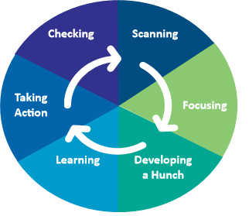
Principle 5 – Professional Learning Programs
6 assumptions of PL programs
An active process
Allows for educator agency
Relevant and content specific
Best situated in cultures of collaboration
Sustained
Requires organizational systems and structures of support
6 phases of collaborative inquiry process
Alignment of collaborative inquiry to assessment literacies
Conditions in a school necessary to support collaborative inquiry and to use an evaluation plan to formatively monitor & adjust implementation of ELAS and professional learning
Collaborative Inquiry
Assessment Literacies
Notes:
Big Ideas
Create PL programs/systems designed to develop deep literacy and assessment expertise
Understand teacher embeds formative assessment process into instructional process
Collaborative inquiry-based professional learning influences teacher practice
Evaluation plan is necessary to formatively monitor and adjust implementation of ELAS and PL program

Slide 32
Phase III – Support and Monitoring Recommendations
3.1 ELAS LEADERSHIP TEAM should use the logic model and theory of action to develop plans for professional learning and formative evaluation of the ELAS.
To accomplish Recommendation 3.1, the ELAS LEADERSHIP TEAM, in collaboration with PRINCIPALS AND TEACHERS, should:
3.2: Gather information about the current level of knowledge and capacity related to literacy, assessment, and professional learning (strengths and gaps) among staff (teachers, administrators, coaches), students and their families, and local policymakers, and use these data to guide the implementation and support of an ELAS.
3.3: Create a cohesive master professional learning plan (Michigan’s Professional Learning Policy and associated Standards for Professional Learning) to support all stakeholders responsible for early literacy development and assessment. The plan should address early literacy development and assessment and meet the learning needs of children and instructional needs of teachers based on evidence of need as well as research.

Slide 33
Phase III – Support and Monitoring Recommendations
To accomplish Recommendation 3.1, the ELAS LEADERSHIP TEAM, in collaboration with PRINCIPALS AND TEACHERS, should:
(Continued)
3.4: Budget for and plan to provide substantive resources and support for content-focused professional learning about early literacy development and assessment that is collaborative, intensive, sustained, and job-embedded.
3.5: Participate in statewide efforts to prepare, support, and generate teacher leaders and instructional coaches to promote effective early literacy development and assessment practices, with an emphasis on the use of classroom formative assessment practices.
3.6: Develop a plan for formative evaluation of the ELAS that includes ongoing monitoring and feedback from the field about the quality, utility, and effectiveness of the assessment system as it is implemented and becomes operational.

Slide 34
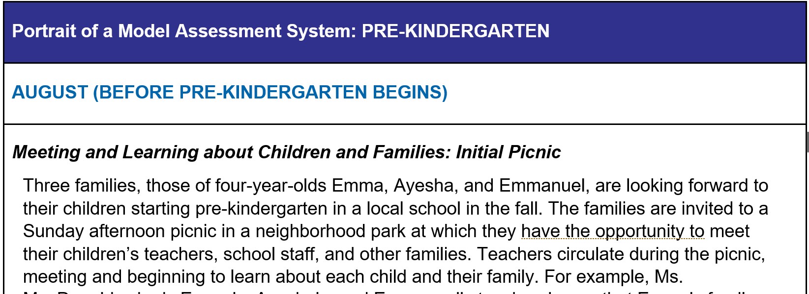
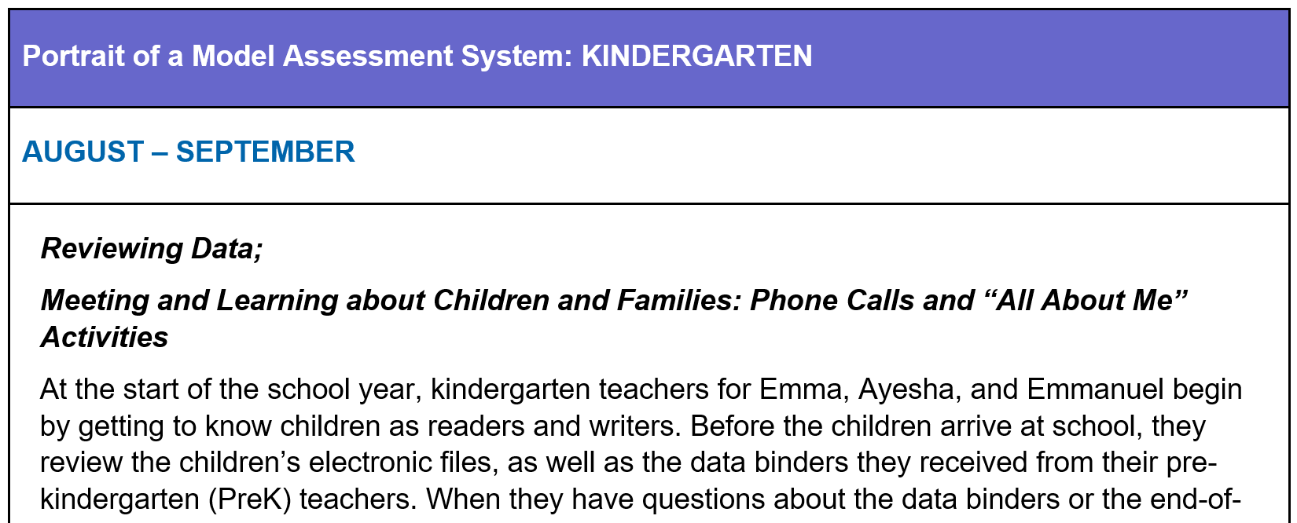
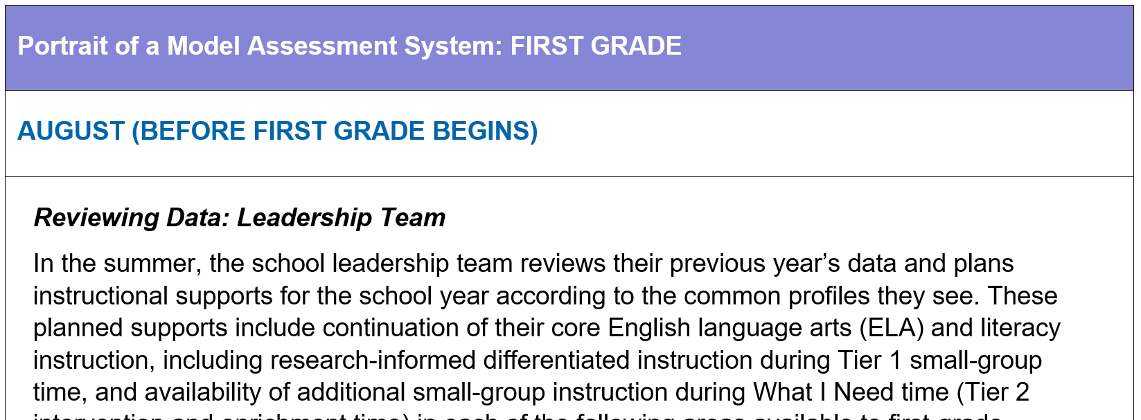
Portraits
3 Students
Emma
Ayesha
Emmanuel
Student experiences with literacy instruction and assessment from PreK – Third Grade
Notes:
Section II features a series of Portraits that follow the literacy development, assessment, and instruction of three children – Emma, Ayesha, and Emmanuel - from pre-kindergarten (PreK) through second grade. The Portraits have been designed to illustrate different paths that these children take toward literacy, while simultaneously showing how a balanced early literacy assessment system (ELAS) can serve individual children. In the Portraits, each child enters PreK and continues their schooling journey with a unique array of cultural and linguistic backgrounds, experiences, interests, assets, and literacy-learning needs. Throughout each of their school-based, early literacy learning experiences, their teachers and a constellation of other service providers strategically employ a variety of methods of observation and assessment of the children’s literacy skills and practices in order to build upon their assets and target areas for needed growth in reading, writing, and oral language. The Portraits illustrate the many ways that children’s literacy knowledge and skills can vary even when they are the same age. Furthermore, these Portraits illustrate the multiple contexts in which educators can acquire information that is useful in planning instruction.
It is important to note that this series of Portraits does not attend fully to all aspects of the three children's literacy development. Rather, the Portraits focus primarily on reading development, instruction, and assessment, with only limited attention to writing and oral language development. This does not suggest, however, that classroom teachers and other service providers should not provide systematic assessment and instruction in these crucial areas of literacy development in pre-K-3 classrooms.
You will see examples of ELAS features as framed in this Guide’s five Organizing and Design Principles.

Slide 35
What’s Next?
Raise awareness
Promote use of the Guide among school leaders, policy-makers, and practitioners
Share available resources to support the work at www.MichiganAssessmentConsortium.org/ELAS
Support districts
Conduct pilot(s) with districts to develop models and examples
Build capacity and assessment literacy among literacy coaches and specialists

Slide 36
Explore the Report
www.MichiganAssessmentConsortium.org/ELAS
Questions about the ELAS Guide and ongoing support can be directed to:
MAC: Kathy Dewsbury-White, kdwhite@michiganassessmentconsortium.org
MDE: Brandy Bugni, bugnib@michigan.gov

