Slide 1
Student Growth Models Available for Michigan Schools
Michigan School Testing Conference
February 20, 2020

Slide 2
Why Do We Measure Student Growth?
Let’s open a browser and go to http://sli.do
Enter event code MSTCSG2 and join.
What is the purpose of measuring student growth in educator evaluations?
What does Michigan educator evaluation legislation require for measuring student growth?

Slide 3
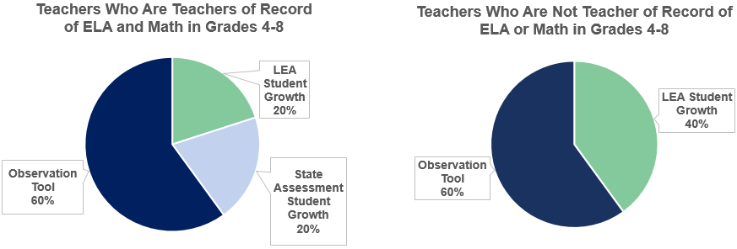
EDUCATOR EVALUATION LEGISLATION OVERVIEW
Michigan Educator Evaluations FAQs (updated September 2019)
Educator Evaluation Legislation
Notes:
Teachers of record for ELA and math in grades 4-8 are required to include state assessment student growth as 20 percent of end of year ratings, 20 percent student growth from LEA selected student growth, and 60 percent from observation tools. Teacher who are not teachers of record for ELA and math in grades 4-8 include LEA selected assessment student growth using multiple measures as 40 percent and observation tool as 60 percent of student growth.

Slide 4
The Michigan Council on Educator Evaluation (MCEE)
Legislatively initiated
Worked for a full year designing a recommended system
Final report available at http://bit.ly/33gaYa2

Slide 5
MCEE Vision - September 2013
Develop a fair, transparent, and feasible evaluation system for teachers and school administrators. The system will be based on rigorous standards of professional practice and of measurement. The goals of this system are to contribute to enhanced instruction, improve student achievement, and support ongoing professional learning.

Slide 6
MDE EDUCATOR EVALUATION PRIORITIES (NOT IN ORDER)
Evaluations which:
Are rigorous, transparent, and fair.
Provide cyclical actionable feedback of teacher practice to improve student outcomes.
Are aligned to the definition of success for students, teachers, and administrators.
Inform professional learning plans for educators.
Facilitate a continuous improvement process for educators.

Slide 7
Improving Practice
Let’s open a browser and go to http://sli.do
Enter event code MSTCSG2 and join.
Ideally, my district would improve our student growth measurement practice by...
Post how you would finish the sentence above. You can “like” the ideas and questions of others, and it will prioritize the most liked posts to the top of the list.

Slide 8
Challenging Issues to Consider
What is our purpose for using student growth in educator evaluation anyway?

Slide 9
Challenging Issues to Consider
What is our purpose for using student growth in educator evaluation anyway?
Student
Learning
Time

Slide 10
Challenging Issues to Consider
What is our purpose for using student growth in educator evaluation anyway?
Student
Learning
Time

Slide 11
Challenging Issues to Consider
What is our purpose for using student growth in educator evaluation anyway?
Student
Learning
Time
You
are
here

Slide 12
Challenging Issues to Consider
What is our purpose for using student growth in educator evaluation anyway?
Student
Learning
?
Time
You
are
here

Slide 13
Challenging Issues to Consider
What is our purpose for using student growth in educator evaluation anyway?
Student
Learning
Time
You
are
here

Slide 14
Challenging Issues to Consider
What is our purpose for using student growth in educator evaluation anyway?
Student
Learning
Time
You
are
here
Change
of
Theory

Slide 15
So, what is on the path to the desired outcome?
Student
Learning
Time
You
are
here
Theory of Change

Slide 16
So, what is on the path to the desired outcome?
Let’s address the elephant in the room.
Student
Learning
Time
You
are
here
Theory of Change

Slide 17
So, what is on the path to the desired outcome?
Let’s address the elephant in the room.
Firing poor educators
Student
Learning
Time
You
are
here

Slide 18
So, what is on the path to the desired outcome?
Why is firing poor educators not a viable path to improved student learning?
Supply and Demand.
Firing poor educators
Student
Learning
Time
You
are
here

Slide 19
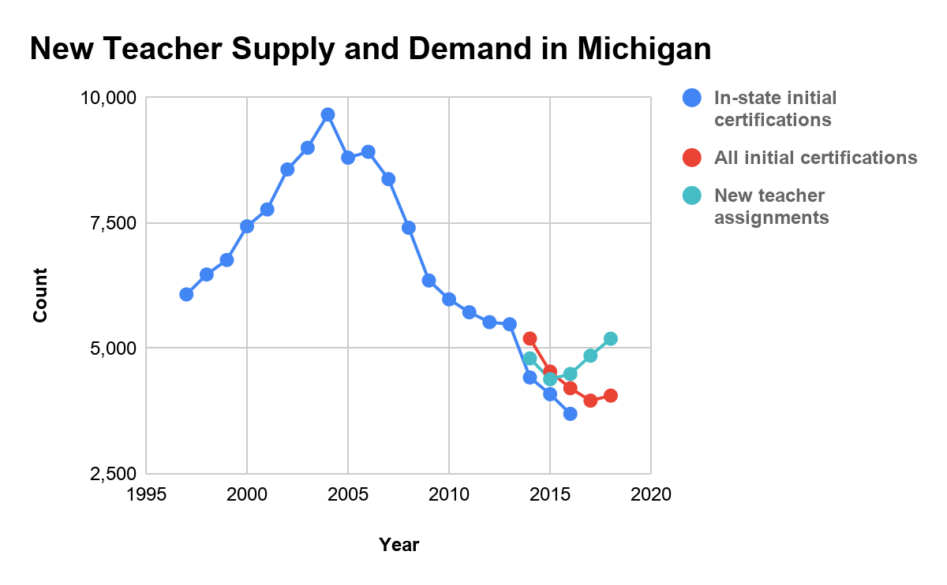
Michigan Department of Education Office of Educator Excellence. (2019). Educator Workforce Report, 2018-2019. Lansing, MI: Michigan Department of Education. Retrieved 12-26-2019 from http://bit.ly/2018-19FullReport.
Stackhouse, S. A. (2017). Trends in Michigan Teacher Certification: Initial Certificates Issued 1996-2016. Lansing, MI: Michigan Department of Education. Retrieved 12-26-2019 from
https://www.michigan.gov/documents/mde/Final_Draft_5-year_certificate_trend_with_endorsement_code_appendix_ada_601771_7.pdf.

Slide 20
For many years, Michigan was a major new-teacher exporter.
Anecdotally, we heard from deans of Michigan colleges of education that many elementary and secondary education graduates went to California, Texas, and Florida which were major importers.

Slide 21
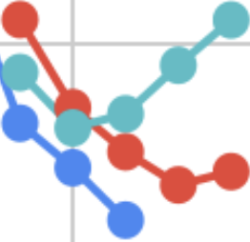
The last few years show a supply and demand reversal from being an exporter state to being an importer state.

Slide 23
Michigan has recently become a new-teacher importer.
New teacher assignments
have recently outpaced

Slide 24
Michigan has recently become a new-teacher importer.
New teacher assignments
have recently outpaced
initial certifications of
new-teacher candidates
from in-state institutions

Slide 25
Michigan has recently become a new-teacher importer.
New teacher assignments
have recently outpaced
initial certifications of
new-teacher candidates
from in-state institutions
and
initial certifications of
new-teacher candidates
from both in-state and
out-of-state institutions

Slide 26
So, what is on the path to the desired outcome?
Why is firing poor educators not a viable path to improved student learning?
Supply and demand.
Research on effective assessment- related teaching interventions.
Firing poor educators
Student
Learning
Time
You
are
here

Slide 27
Identifying and firing poor educators is an intervention with an implied goal of improving student growth.
But it is without a coherent theory of change.

Slide 28
The implied theory of change is that by firing poor educators we can improve the overall quality of teaching and thus increase student growth.
This assumes that available replacement teachers are equipped to succeed where their predecessors did not, an assumption for which we do not have good evidence.

Slide 29
What assessment-related teaching practices do we know of that when implemented well actually improve student growth?

Slide 30
What is
taught about assessment in educator preparation programs and ongoing professional learning

Slide 31
What is
taught about assessment in educator preparation programs and ongoing professional learning
What is modeled in educator preparation programs and ongoing professional learning

Slide 32
What is
taught about assessment in educator preparation programs and ongoing professional learning
What is modeled in educator preparation programs and ongoing professional learning
Practices/interventions with the potential to improve student
learning

Slide 33
What is
taught about assessment in educator preparation programs and ongoing professional learning
What is modeled in educator preparation programs and ongoing professional learning
Practices/interventions with the potential to improve student
learning
This is the sweet spot where we
get the greatest bang for the buck

Slide 34
What assessment-related teaching practices might live in that sweet spot?
We know of only one.
What is
taught about assessment in educator preparation programs and ongoing professional learning
What is modeled in educator preparation programs and ongoing professional learning
Practices/interventions with the potential to improve student
learning

Slide 35
Formative instructional and assessment practices focusing intently on building a virtuous feedback cycle between teacher and learner.

Slide 36
Formative instruction and assessment practices focusing intently on building a virtuous feedback cycle between teacher and learner.
Key features:
Shared ownership of learning.
Transparent learning targets.
Frequent data collection.
Data-based feedback about current knowledge and next steps.
Data-based instructional adjustments allowing for both teacher and learner to correct course before summative judgment (i.e., graded work).

Slide 37
Teacher ↔︎ student is the key relationship for building a virtuous feedback cycle
Teacher
Student

Slide 38
Teacher ↔︎ student is the key relationship for building a virtuous feedback cycle.
But the teacher ↔︎ coach relationship can also be a key for modeling a good feedback cycle.
Teacher
Coach
Student

Slide 39
Teacher ↔︎ student is the key relationship for building a virtuous feedback cycle.
But the teacher ↔︎ coach relationship can also be a key for modeling a good feedback cycle.
And the teacher ↔︎ teacher relationship can be a collaborative learning opportunity.
Teacher
Coach
Teacher
Student

Slide 40
But what does this have to do with student growth in general, and with using student growth data for educator evaluation in particular?
Teacher
Coach
Teacher
Student

Slide 41
But what does this have to do with student growth in general, and with using student growth data for educator evaluation in particular?
What is the spirit of the law?
Teacher
Coach
Teacher
Student

Slide 42
But what does this have to do with student growth in general, and with using student growth data for educator evaluation in particular?
What is the spirit of the law?
Teacher
Coach
Teacher
Student

Slide 43
But what does this have to do with student growth in general, and with using student growth data for educator evaluation in particular?
What is the spirit of the law?
Teacher
Coach
Teacher
Student

Slide 44
But what does this have to do with student growth in general, and with using student growth data for educator evaluation in particular?
What is the spirit of the law?
What would I do if I were a district leader?
Teacher
Coach
Teacher
Student

Slide 45
But what does this have to do with student growth in general, and with using student growth data for educator evaluation in particular?
What is the spirit of the law?
What would I do if I were a district leader?
Teacher
Theory of
change
Coach
Teacher
Student
I would make the connection between the spirit of the law and formative assessment/instructional practices as a means for improving student growth.

Slide 46
But what does this have to do with student growth in general, and with using student growth data for educator evaluation in particular?
What is the spirit of the law?
What would I do if I were a district leader?
Teacher
Theory of
change
Coach
Teacher
Student
Spirit of the law is a theory of change. Formative assessment is the only assessment-related practice we know can address incoming differences in preparation.

Slide 47
But what does this have to do with student growth in general, and with using student growth data for educator evaluation in particular?
What is the spirit of the law?
What would I do if I were a district leader?
Teacher
Theory of
change
Coach
Teacher
Student
I would negotiate with teachers using the degree and quality of formative assessment practices for eliciting student growth as the primary component of student growth in teacher evaluation.

Slide 48
But what does this have to do with student growth in general, and with using student growth data for educator evaluation in particular?
What is the spirit of the law?
What would I do if I were a district leader?
Teacher
Theory of
change
Coach
Teacher
Student
I would negotiate with administrators using the degree and quality of support for formative assessment practices as the primary component of student growth in administrator evaluation.

Slide 49
But what does this have to do with student growth in general, and with using student growth data for educator evaluation in particular?
What is the spirit of the law?
What would I do if I were a district leader?
Teacher
Theory of
change
Coach
Teacher
Student
This jives with student learning objectives, if implemented well. More on this later from Brian.

Slide 50
But what does this have to do with student growth in general, and with using student growth data for educator evaluation in particular?
What is the spirit of the law?
But what is the letter of the law?
Teacher
Theory of
change
Coach
Teacher
Student

Slide 51
But what does this have to do with student growth in general and with using student growth data for educator evaluation in particular?
What is the spirit of the law?
But what is the letter of the law? Actual student growth scores as part of educator evaluation.
Teacher
Theory of
change
Coach
Teacher
Student

Slide 52
But what does this have to do with student growth in general and with using student growth data for educator evaluation in particular?
What is the spirit of the law?
But what is the letter of the law? Actual student growth scores as part of educator evaluation.
So what would I do if I were a district leader?
Teacher
Theory of
change
Coach
Teacher
Student

Slide 53
But what does this have to do with student growth in general and with using student growth data for educator evaluation in particular?
What is the spirit of the law?
But what is the letter of the law? Actual student growth scores as part of educator evaluation.
So what would I do if I were a district leader?
I would favor the spirit of the law as described previously, but also negotiate to include actual student growth scores as a small part of educator evaluation.
Teacher
Theory of
change
Coach
Teacher
Student

Slide 54
But what does this have to do with student growth in general and with using student growth data for educator evaluation in particular?
What is the spirit of the law?
But what is the letter of the law? Actual student growth scores as part of educator evaluation.
So what would I do if I were a district leader?
Teacher
Theory of
change
Coach
Teacher
Student
But I am not an attorney. To avoid unacceptable risk, I would also consult legal counsel about ramifications were I pressed on the letter of the law.

Slide 55
So, what is on the path to the desired outcome?
Communication and negotiation between teachers and administrators around one particular key tension inherent in using student growth for educator evaluation
Student
Learning
Time
You
are
here
Theory of Change

Slide 56
An elementary administrator’s
responsibility for student growth

Slide 57
An elementary administrator’s
responsibility for student growth
Teacher A’s
responsibility
A typical elementary-school, single-grade teacher responsible for most subjects

Slide 58
An elementary administrator’s
responsibility for student growth
Teacher C’s
responsibility
A co-teaching single-grade team responsible for different subjects
Teacher B’s
responsibility
Teacher A’s
responsibility

Slide 59
An elementary administrator’s
responsibility for student growth
A special-subjects teacher shared across schools
Teacher C’s
responsibility
Teacher B’s
responsibility
Teacher D’s
responsibility
Teacher A’s
responsibility

Slide 60
An elementary administrator’s
responsibility for student growth
N
O
P
Q
J
K
Teacher C’s
responsibility
M
I
L
Teacher B’s
responsibility
Teacher D’s
responsibility
And so on…
Keeping in mind that even for typical single-grade teachers, there are subjects for which they are responsible where there are no state tests.
Teacher A’s
responsibility
H
G
F
E

Slide 61
An elementary administrator’s
responsibility for student growth
N
O
P
Q
Why does this matter?
A smaller number of growth measures is much simpler to deal with for the administrator
A larger number of measures is more consistent with individual teachers’ responsibilities
What matters more?
How does the power dynamic factor in?
J
K
Teacher C’s
responsibility
M
I
L
Teacher B’s
responsibility
Teacher D’s
responsibility
Teacher A’s
responsibility
H
G
F
E

Slide 62
But that’s small potatoes compared with high schools (and most middle schools) in terms of teaching assignments and available assessments.

Slide 63
But that’s small potatoes compared with high schools (and most middle schools) in terms of teaching assignments and available assessments.
A high-school administrator’s
responsibility for student growth

Slide 64
But that’s small potatoes compared with high schools (and most middle schools) in terms of teaching assignments and available assessments.
In this situation, content areas tend to be split into specific disciplines, but state tests do not tend to be split into specific disciplines.
NOTE: this depiction under-represents the challenge for some large high schools
A high-school administrator’s
responsibility for student growth

Slide 65
But that’s small potatoes compared with high schools (and most middle schools) in terms of teaching assignments and available assessments.
In this situation, content areas tend to be split into specific disciplines, but state tests do not tend to be split into specific disciplines.
This creates tension between administrator and teacher that has to be discussed and negotiated to balance simplicity with alignment to teaching assignment.
Misalignment of educator evaluation components with teaching assignment is a serious ethical and legal issue.
A high-school administrator’s
responsibility for student growth

Slide 66
Improving Practice
Let’s open a browser and go to http://sli.do
Enter event code MSTCSG2 and join.
Ideally, my district would improve our student growth measurement practice by...
Post how you would finish the sentence above. You can “like” the ideas and questions of others, and it will prioritize the most liked posts to the top of the list.

Slide 67
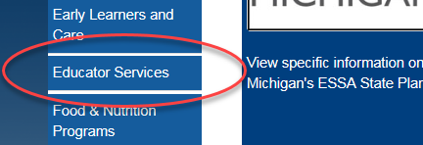
RESOURCES: WEBPAGE
1. Go to the MDE web site at http://www.michigan.gov/mde
2. Click on Educator Services on the left hand side of the page.
3. Click on Educator Evaluation in the sub menu
4. Or go to http://www.michigan.gov/mde-edevals

Slide 68
OVERVIEW OF RESOURCES
General Guidance | Student Learning Objectives | State Assessment Student Growth
Evaluation FAQs | SLO Guidance Document | What is a Student Growth Percentile?
Evaluations At-A-Glance | SLO FAQ | SGP Policy Brief
Postings and Assurances | SLO Template | SGP Educator Evaluation Calculator
Student Growth Score Exclusion Guidance | SLO Template Checklist | SGP Technical Guidance Document
Educator Evaluation Research Reports | SLO Student Growth Tool | SGP Educator Evaluation Calculator Instructional Video
 | SLO Student Growth Tool Instructions | EVAAS Homepage
 | SLO Student Growth Tool Video | SGP and EVAAS Comparison

Slide 69
WHAT ARE SGPS?
A student growth percentile (SGP) provide comparison information for the changes in scores between two points in time for students with similar prior scores.
SGPs provide similar information about the magnitude (how large or small) of academic growth using a measurement of change in scores between two points in time.
Students who are not proficient are compared against students who are not proficient, and students who are advanced are compared against students who are advanced. So a school with students with currently low achievement scores are less disadvantaged than when including proficiency.
‹#›

Slide 70
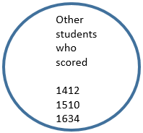
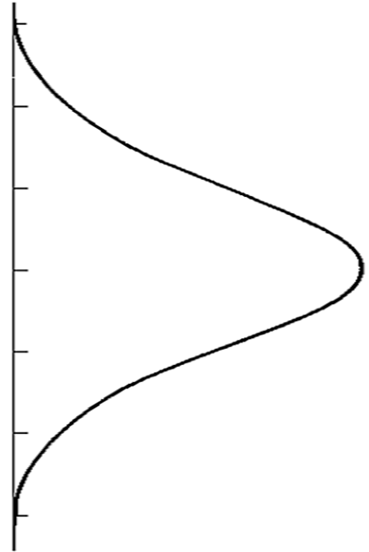
SGPS EXPLAINED
Change in SS from
2016 to 2017
2016 M-STEP Scores
2017 M-STEP Scores
2017 SS = 1712
SS Change of 78
SGP 95
Change
All the same (or very similar) scores
2017 SS = 1704
SS Change of 70
SGP 75
Change
Norming of the change in scores determine SGPs
Student’s
Previous Scores
2014 SS=1412
2015 SS=1510
2016 SS=1634
These changes in scores are normed.
2017 SS = 1694
SS Change of 60
SGP 50
Change
2017 SS = 1686
SS Change of 52
SGP 25
Change
2017 SS = 1674
SS Change of 40
SGP 5
Change
Notes:
Only use if further explanation is needed.

Slide 71
USING MEAN SGP SCORES TO DETERMINE STATE ASSESSMENT STUDENT GROWTH EFFECTIVENESS RATINGS
Student Growth Rating Score | Description of Rating | Average SGP Required for Rating
4 | Average SGP Required for State Assessment Growth Rating of Exceeds | 60
3 | Average SGP Required for State Assessment Growth Rating of Met | 40
2 | Average SGP Required for State Assessment Growth Rating of Nearly Met | 20
1 | Average SGP Required for State Assessment Growth Rating of Not Met | 19 or Less
‹#›

Slide 72
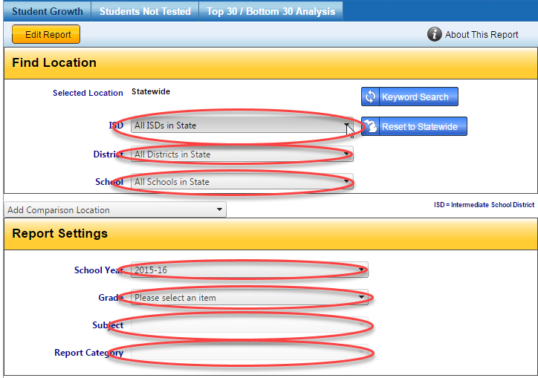
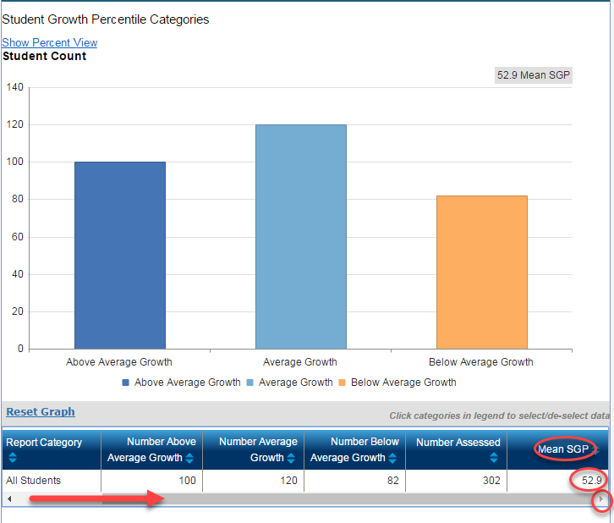
CALCULATING SGP SCORES FOR SCHOOLS AND SCHOOL GRADE LEVELS
https://www.mischooldata.org/DistrictSchoolProfiles/AssessmentResults/StudentGrowth/StudentGrowth.aspx
‹#›

Slide 73
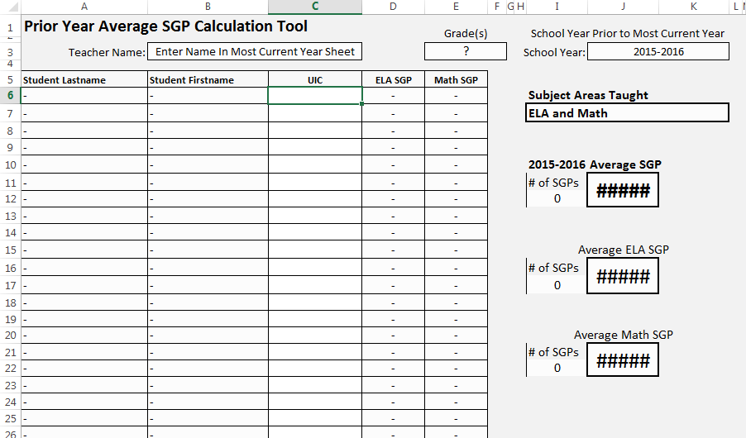
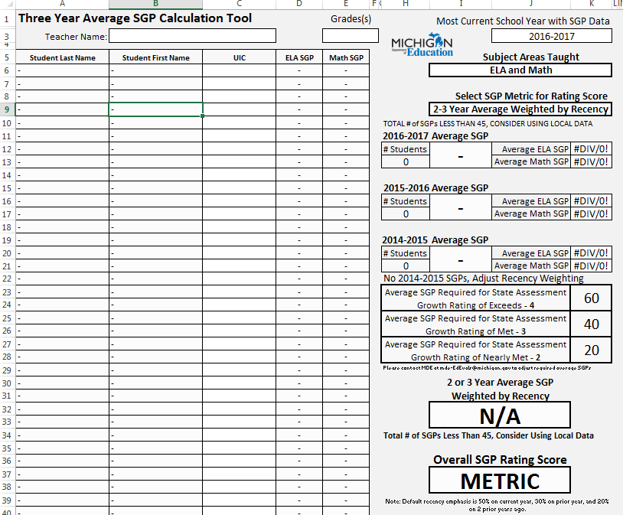
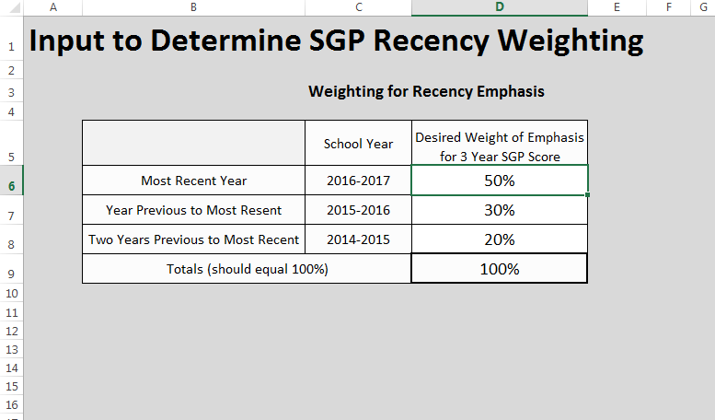
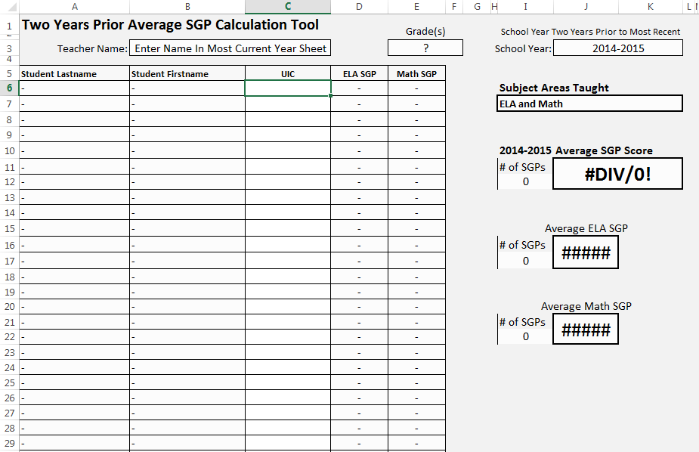
MDE SGP EDUCATOR EVALUATION CALCULATOR TOOL
Available for Download on the MDE Ed Eval SGP Webpage

Slide 74
DATA WAREHOUSE VENDOR STUDENT GROWTH REPORTS
The MDE and OEE are working with MI Data Hub to provide more efficient SGP student growth reports.
https://www.midatahub.org/support/
We are also working with data warehouse vendors to provide efficient student growth reports (state assessment AND non-state assessment). We have collaborated with these vendors to replicate our student growth tools:
Illuminate
Munetrix
Eidex
Our School Data (Kent ISD)

Slide 75
MDE SLO GUIDANCE DOCUMENT
MDE released a guidance document (October 2016) for the implementation and use of student learning objectives (SLOs).
http://www.michigan.gov/documents/mde/Implementation_of_SLO_Guidance_October_2016.ADA_FINAL_538937_7.pdf

Slide 76
WHAT ARE STUDENT LEARNING OBJECTIVES
Course-long academic goals that are set by a teacher or teacher team
Designed to monitor a student’s progress toward growth targets
Help to demonstrate a teacher’s impact on student learning within a given interval of instruction.
Just one of the multiple measures of student growth that may account for a portion of a teacher’s evaluation.
Notes:
Provides systematic method with aligning student growth to school improvement.

Slide 77
WHY SLOS?
SLOs are not mandated.
Why this process?
The models being used for student growth across the country are varied. All have strengths and weaknesses.
There is no perfect student growth model.
SLOs are recommended or mandated by approximately 25 states.
SLOs provide an opportunity to use practices that improve student outcomes.
Notes:
Joe
The legislation lists one student growth measure by name: Student Learning Objectives. MDE has determined another recommended measure for state assessment data: Student Growth Percentiles.

Slide 78
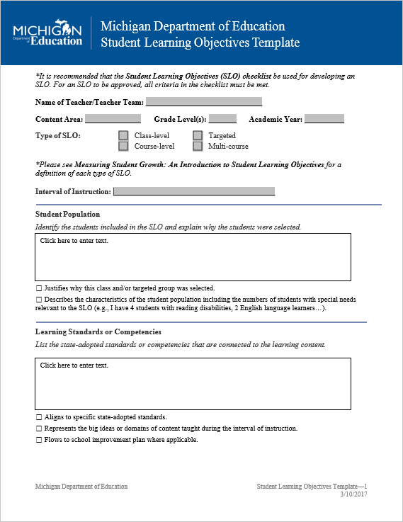
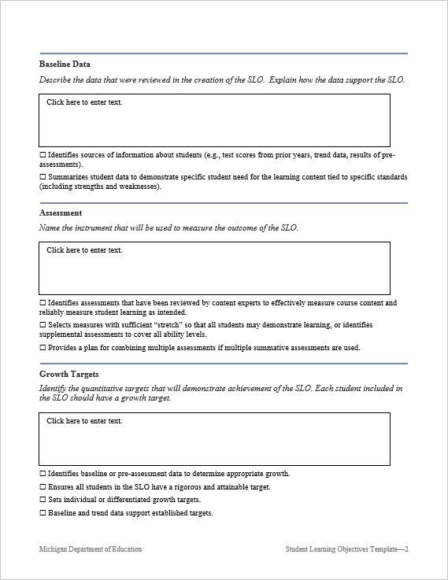
MDE SLO TEMPLATE

Slide 79
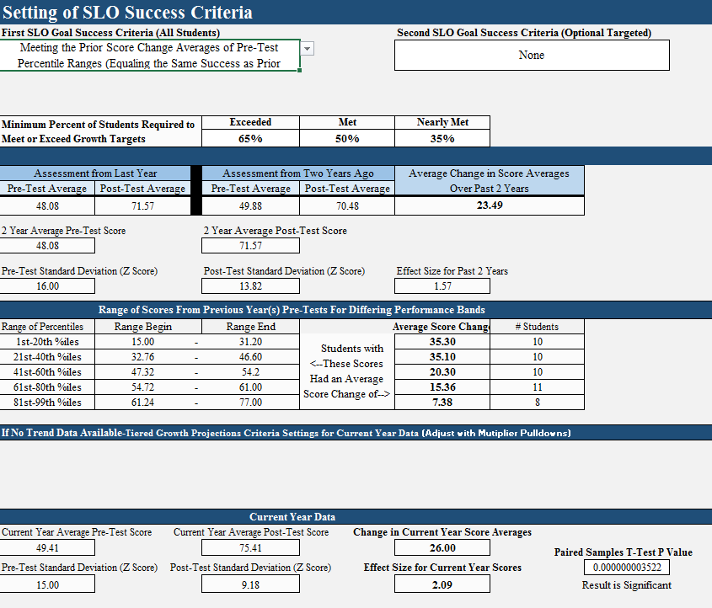
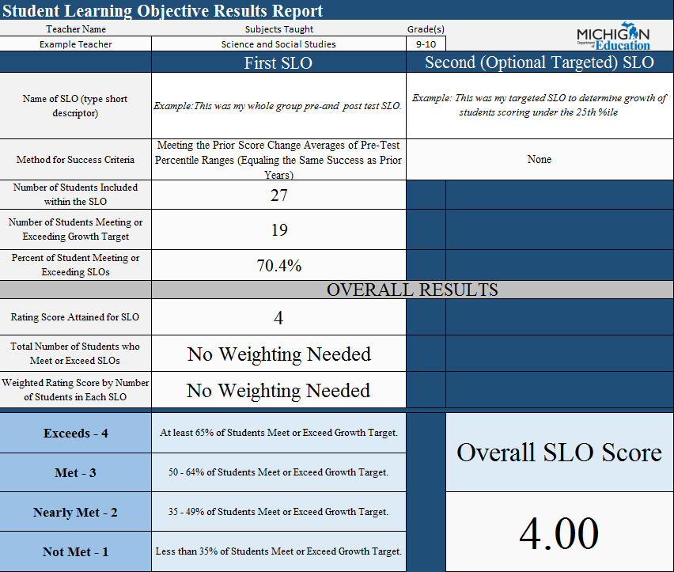
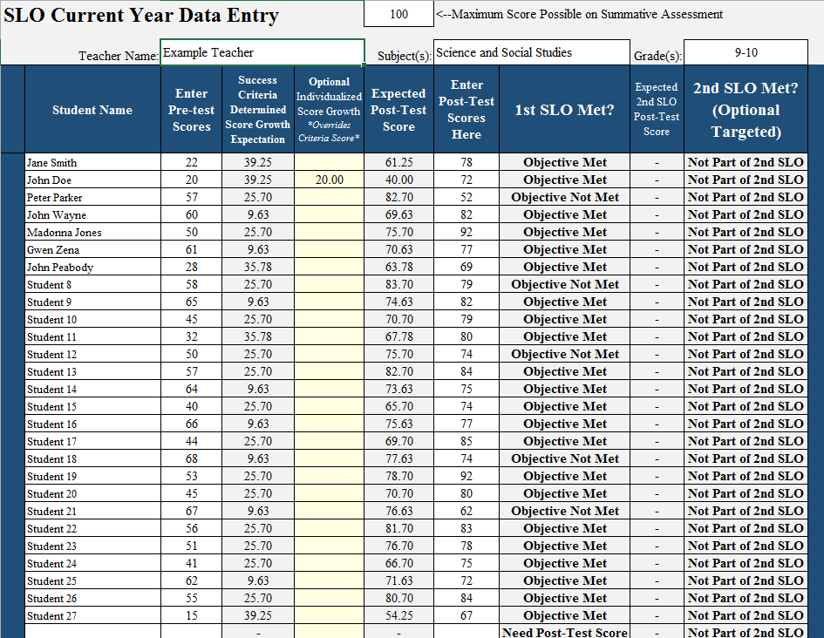
MDE SLO CALCULATOR TOOL
Available for Download on the MDE SLO Webpage
Notes:
SLOs are ONE way to measure the academic growth of students at the local level.

Slide 80
Improving Practice
Let’s open a browser and go to http://sli.do
Enter event code MSTCSG2 and join.
Ideally, my district would improve our student growth measurement practice by...
Post how you would finish the sentence above. You can “like” the ideas and questions of others, and it will prioritize the most liked posts to the top of the list.

Slide 81
Brian Lloyd
Education Research Consultant - Student Growth
Office of Educator Excellence
Michigan Department of Education
lloydb@Michigan.gov
Joseph Martineau
Senior Strategic Advisor
Psychometrics, Statistics, and Data Science
Educational Testing Service
jmartineau@ets.org

