Slide 1
What Assessment Can and Cannot Do: All that Glitters Is Not Gold and Sometimes Chaos Can be a Good Thing
Ellen Vorenkamp Assessment Consultant Wayne RESA
Joseph Martineau Senior Strategic Advisor Educational Testing Service
Michigan School Testing Conference
February 12, 2020
Ann Arbor, MI

Slide 2
Let’s warm up…
Think about how a teacher/principal/superintendent interacts with assessments:
In that role
  How often are they interacting with assessments?
  What kinds of information do they need from assessments?
  What issues/pitfalls with assessment might they run into?
Take a few minutes and write down your thoughts on these things.
We’ll come back to this at the end of the morning.

Slide 3
Let’s go back to the very beginning
Like the very, very beginning
Meaning working backward from what we ultimately want to achieve
Which means developing a theory of action

Slide 4
Assessment!
Current
State
Desired
State

Slide 5
This. Is. Not. A. Helpful. Theory. Of. Action.
Assessment!
Current
State
Desired
State

Slide 6
This. Is. Not. A. Helpful. Theory. Of. Action.
Assessment!
Current
State
Desired
State
But it is a common theory of action

Slide 7
Think About the Theory of Action Implicit in NCLB
Assessment!
Current
State
Desired
State

Slide 8
Think About the Theory of Action Implicit in NCLB
Assessment!
Poor proficiency rates, particularly for disadvantaged students
100% proficiency by 2014

Slide 9
Think About the Theory of Action Implicit in NCLB
Assessment!
Poor proficiency rates, particularly for disadvantaged students
100% proficiency by 2014
Shine a light on the issues, offer choice, transportation, and tutoring, and educators
will work harder and
smarter to avoid the
consequences.

Slide 10
Think of a Theory of Action as a Delectable Educational Policy Sandwich

Slide 11
Think of a Theory of Action as a Delectable Educational Policy Sandwich
Because the powers that be must be convinced that it is

Slide 12
Think of a Theory of Action as a Delectable Educational Policy Sandwich
Current state (baguette? gluten-free bagel?)
All the fixin’s
What key roles are involved in taking action?
What actions need to be carried out and by whom?
What indicators of progress should be immediately evident?
What indicators of progress should be evident in the mid term?
What conditions encourage people in key roles to take the necessary actions?
What supports (resources, tools) help those people to take those actions in a sound manner?
All fixed
Desired state in the long term (focaccia? pita?)

Slide 13
Where Does Assessment Fit Into Our Delectable Educational Policy Sandwich?
Current state
What key roles are involved in taking action? (for some of the people in key roles)
What actions need to be carried out and by whom? (for some key roles)
What indicators of progress should be immediately evident? (for some indicators)
What indicators of progress should be evident in the mid term? (for some indicators)
What conditions encourage taking the necessary actions? (assessment & data literacy)
What supports (resources, tools) help to take those actions in a sound manner? (opportunities and support for active communities of practice in assessment and data literacy)
Desired state in the long term

Slide 14
Key Questions About Assessment In Our Delectable Educational Policy Sandwich
What types of assessment data are needed by people in each role to carry out the necessary actions?
  To what degree do the types of assessment data needed differ by role?
  How can people at different levels in the organizational hierarchy successfully negotiate with each other to meet needs for each role?
What characteristics of assessment are well-matched to the needs

Slide 15
Matching Characteristics of Assessment to Needs
How often does a person in this role need assessment data to successfully carry out the needed actions?
How fine-grained or coarse-grained is the assessment results a person in this role needs to successfully carry out the needed actions?
What degree of control over assessment content does a person in this role need?
What degree of control over assessment timing does a person in this role need?
What type of assessment is needed to produce the necessary data?
What initial and ongoing professional learning is needed to appropriately generate and/or use the necessary data?
What communities of practice and ongoing time for collaboration around assessment and data literacy and use ?

Slide 16
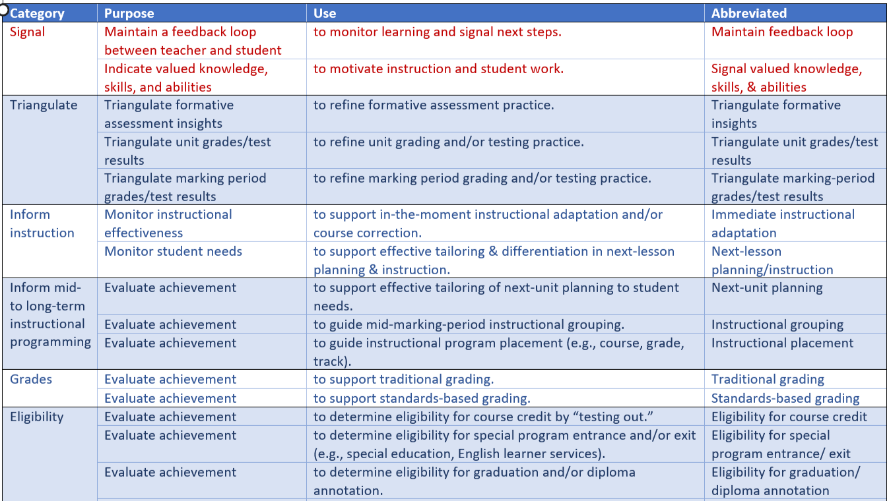
Purposes and Uses of Assessment
Handout

Slide 17
Practicing on a Simple Theory of Action
Sharif wants to improve his students’ achievement on his end-of-course mathematics assessments by more quickly identifying students falling behind and addressing their needs as soon as possible.

Slide 18
Where Does Assessment Fit Into Our Delectable Educational Policy Sandwich?
What key roles are involved in taking action?
Notes
What assessment characteristics match?
Notes

Slide 19
Where Does Assessment Fit Into Our Delectable Educational Policy Sandwich?
What actions need to be carried out and by whom?
Notes
What assessment characteristics match?
Notes

Slide 20
Where Does Assessment Fit Into Our Delectable Educational Policy Sandwich?
What indicators of progress should be immediately evident?
Notes
What assessment characteristics match?
Notes

Slide 21
Where Does Assessment Fit Into Our Delectable Educational Policy Sandwich?
What conditions encourage taking the necessary actions?
Notes
What assessment characteristics match?
Notes

Slide 22
Where Does Assessment Fit Into Our Delectable Educational Policy Sandwich?
What supports (resources, tools) help those people to take those actions in a sound manner?
Notes
What assessment characteristics match?
Notes

Slide 23
Small Groups
Identify a current state
Identify a desired end state that doesn’t require too many different roles to cooperate (otherwise, it’s a lengthy process)
Develop a theory of action using outline described above
We will wander between groups
We will call you back with 15 minutes left

Slide 24

A Balanced Assessment System
Summative assessments
Benchmarked to career and college readiness
Teachers and schools have information and tools they need to improve teaching and learning
Michigan State Standards specify
K-12 expectations for career and college readiness
All students leave
high school career and college ready
Teacher resources for
formative assessment practices
to improve instruction
Interim assessments
Flexible, open,
used for actionable feedback

Slide 25
Assessment of and for Learning
Assessment for Learning – Assessment that occurs while learning is still underway, so that instruction can be adjusted to increase its effectiveness (formative)
Assessment of Learning – Assessment that takes place after learning has occurred to determine if it did (summative)
Both types of assessment help to create a balanced assessment system
Notes:
Ellen

Slide 26
Assessment for Learning versus Assessment of Learning
 | Assessment for Learning | Assessment of Learning
Reasons for Assessment | • Help more students achieve • Support student growth | • Document student achievement • Accountability
Audience | • Students | • Policy makers • Educators • Parents
Focus of Assessment | • Achievement targets selected by the teacher | • Achievement targets common to all schools
Place in Time | • During learning | • After learning
Notes:
Ellen

Slide 27
Assessment for Learning versus Assessment of Learning
 | Assessment for Learning | Assessment of Learning
Primary Users | • Students • Teachers • Parents | • Policy makers • Program planners • Program supervisors • Teachers
Typical Uses | • Help students improve their learning • Help teachers diagnose & respond to student needs | • Certify proficiency • Determine progress of the school or district
Teacher Role | • Teach to targets and use the assessments to adjust instruction based on results | • Administer tests and use results to adjust curriculum for future years
Notes:
Ellen

Slide 28
Assessment for Learning versus Assessment of Learning
 | Assessment for Learning | Assessment of Learning
Student Role | • Self-assess, set goals and act on assessment results to do better next time | • Study, then take the test by working hard on it
Primary Motivator | • Belief that success in learning is achievable | • Threat of punishment and the promise of rewards
Examples | • Using rubrics with students • Student self-assessment • Descriptive feedback to students | • Achievement tests • Final exams • Placement tests • Short cycle assessments
Adapted from Understanding School Assessment, J Chappuis and S. Chappuis, Assessment Training Institute, copyright 2002.
Notes:
Ellen

Slide 29
Comprehensive Balanced Assessment System
Aligned to Content Standards
M-STEP/MI-Access/WIDA/End of Course
Summative – Assessment of Learning
Are students proficient?
Benchmark Assessments/Unit/Chapter
Short-Cycle Summative Assessments
Did students learn the important parts of this unit?
Classroom Assessment Practices
Formative – Assessment for Learning
Did the student learn what I just taught them?
Teacher - How might I adjust my instructional strategies?
Student – How might I adjust my learning strategies?
Notes:
Kim

