Slide 1
Michigan Assessment Consortium
Common Assessment Development Series
Module 17
Looking at Field Test Data
Module 17
Looking at Field Test Data

Slide 2
Narrated By:
Jim Gullen
Oakland Schools

Slide 3
Previous Modules
Previously, you have:
  Developed your test blueprint
  Written your test
  Students have taken your test
  Begun to look at editing the items to improve them

Slide 4
Field Test Information
There are several types of information field testing can provide:
  Level of overall student performance
  Item analyses
  Item Discrimination
  Differential item functioning
Don’t worry if you don’t understand these. This module will teach you – and no “Greek” is involved!

Slide 5
Overall Performance
In order to look at the overall performance on the test, you will need to
  Use the answer key to score each student’s exam
  Use the scoring rubrics to score students’ responses to constructed-response items
  Add up each student’s score to all items to get the total raw score for each student

Slide 6
Frequency Distribution
To look at all of the students’ scores, construct a frequency distribution such as this:
  Score Range Number of Scores
  60-65
  54-59
  48-53
  42-47

Slide 7
Frequency Distribution
Put a mark next to the score range that each student’s score falls into, as shown here:
  Score Range Number of Scores
  60-65 III
  54-59 II
  48-53 IIII
  42-47 III

Slide 8
Frequency Distribution
It is best to use about 8 to 12 score intervals in your frequency distribution
When you are all done, it might look like the sample on the next page

Slide 9
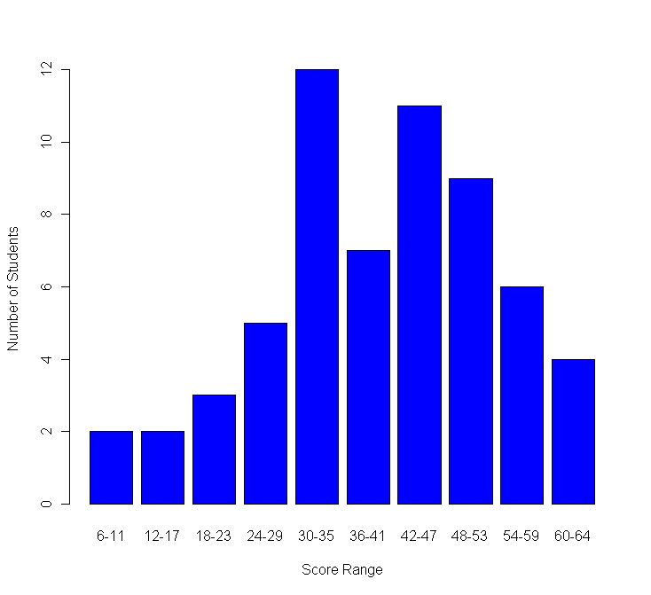
Sample Frequency Distribution
Score Range | Number of Students
60-64 | 4
54-59 | 6
48-53 | 9
42-47 | 11
36-41 | 7
30-35 | 12
24-29 | 5
18-23 | 3
12-17 | 2
6-11 | 2

Slide 10
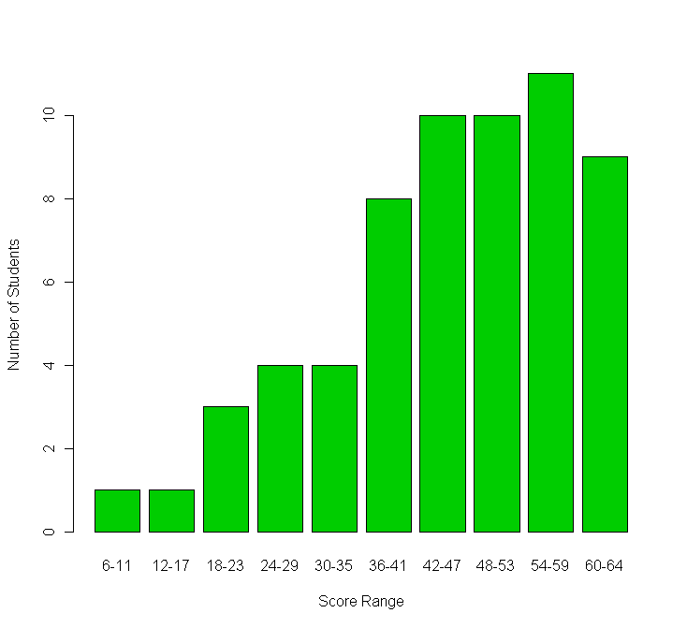
Sample Frequency Distribution
Score Range | Number of Students
60-64 | 9
54-59 | 11
48-53 | 10
42-47 | 10
36-41 | 8
30-35 | 4
24-29 | 4
18-23 | 3
12-17 | 1
6-11 | 1
10

Slide 11
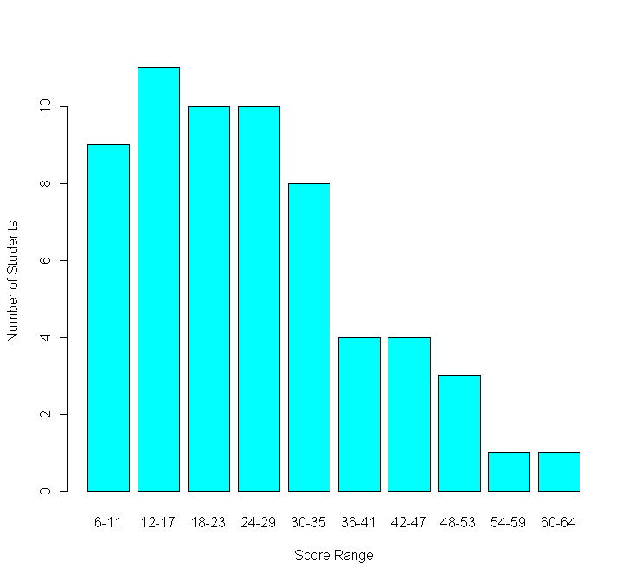
Sample Frequency Distribution
Score Range | Number of Students
60-64 | 1
54-59 | 1
48-53 | 3
42-47 | 4
36-41 | 4
30-35 | 8
24-29 | 10
18-23 | 10
12-17 | 11
6-11 | 9
11

Slide 12
Sample Frequency Distribution
Score Range | Number of Students
60-64 | 4
54-59 | 6
48-53 | 9
42-47 | 11
36-41 | 7
30-35 | 12
24-29 | 5
18-23 | 3
12-17 | 2
6-11 | 2
12

Slide 13
Difficulty Level of the Test
To judge the difficulty of the test, look at where most of the scores fall:
  If near the top of the distribution, then it is a fairly easy test
  If near the bottom of the distribution, then it is a fairly hard test
Does the difficulty level surprise you?
  If so, then you might want to investigate whether there is something wrong

Slide 14
Item Analysis
Scanning your test into a computer with test scoring software or administering a test online makes this much easier!
Item analyses are run to investigate whether there might be specific items that are contributing to the difficulty of the test.
We first look at item difficulty…

Slide 15
Item Difficulty
7 Students Correct
Item Difficulty =
= .70
10 Total Test Takers
Typically we want item difficulties to be between .35 and .9

Slide 16
Item Response Patterns
A B C D Omit Mult
Question 1: 46%* 47% 2% 1% 0% 4%
Question 1: What is the BEST Ice Cream Flavor?
A. Vanilla
B. Chocolate
C. Garlic
D. Lima Bean

Slide 17
Item Response Patterns
A B C D Omit Mult
Question 1: 24% 26%* 25% 24% 1% 0%
Question 1: What is the BEST Fit Index for structural equation models?
A. GFI
B. TLI
C. RMSEA
D. SRMR

Slide 18
Item
Discrimination
Range: -1 to +1
Values closer to +1 are better
Negative values indicate a problem!

Slide 20
We’re looking for:
Discriminations > 0

Slide 21
Item Discrimination
Item discrimination can be done by hand
There are several steps to the process:
  Arrange the student total scores in order from highest to lowest (Example: 120 students)
  Select the students in the top and bottom quarter (25%) of the students (Example: top and bottom 30 students in this sample)

Slide 22
Item Discrimination
There are several steps to the process:
  Compute the percentage of students in the top and in the bottom groups who passed each test item (Example: Top group: 28/30 passed = 93% passing; Bottom group: 7/30 passed = 23%)
  The upper group should have outscored the bottom group on every test item, by a large or small margin

Slide 23
Item Discrimination
The items to look at most carefully are the ones where the lower group (based on total scores) outscored the upper group – in other words, the students who knew less overall did better on this item
  The item has a flaw in it, something that was attractive to the better-prepared students
  Look at how many chose A, B, C or D
  Edit or delete the item

Slide 24
Differential Item Functioning
This is a fancy phrase for looking at whether different subgroups do differently on each item on the test
This is similar analysis to the upper-lower group analysis, except we are looking at the performance of all of the members of different sub-groups

Slide 25
Differential Item Functioning
There are several important subgroups to examine:
  Racial-ethnic groups
  Gender
  Students who did or did not take a course for which you have written an end-of-course test, for example

Slide 26
Differential Item Functioning
In each case, you need to determine how many students in each subgroup passed the test item
Don’t try too many comparisons at once. In a sample of 120 students, try only 2 or 3 comparisons
The goal is to have roughly equal-sized subgroups

Slide 27
Differential Item Functioning
Once you have each sub-group’s passing rate, compare the groups
  Are they about the same? If yes, there is little or no “differential item functioning” or “DIF”
  If the difference is 10%, 15% or more, favoring one group over another, then the item is said to “have DIF”
  Is the difference due to “opportunity to learn” differences or item bias?

Slide 28
Test Analyses
You might wonder whether you need to carry out all analyses on all of your test items that you field tested. The answer is that it depends, on:
  Your sample size – small samples will prevent most useful analyses
  If the stakes for your test are high (e.g., course credit or grades), you should look at your entire exam

Slide 29
Test Analyses
This module presented some of the basic analyses you could carry out yourself
If you have access to test scoring software, these analyses can be done routinely, and other analyses carried out as well
Carrying out these analyses will help you create good tests

Slide 30
Series Developers
Kathy Dewsbury White, Ingham ISD
Bruce Fay, Wayne RESA
Jim Gullen, Oakland Schools
Julie McDaniel, Oakland Schools
Edward Roeber, MSU
Ellen Vorenkamp, Wayne RESA
Kim Young, Ionia County ISD/MDE

Slide 31
Development Support for the Assessment Series
The MAC Common Assessment Development Series is funded in part by the Michigan Association of Intermediate School Administrators
In cooperation with
  Michigan Department of Education
  Ingham and Ionia ISDs, Oakland Schools, and Wayne RESA
  Michigan State University

